Slide 1
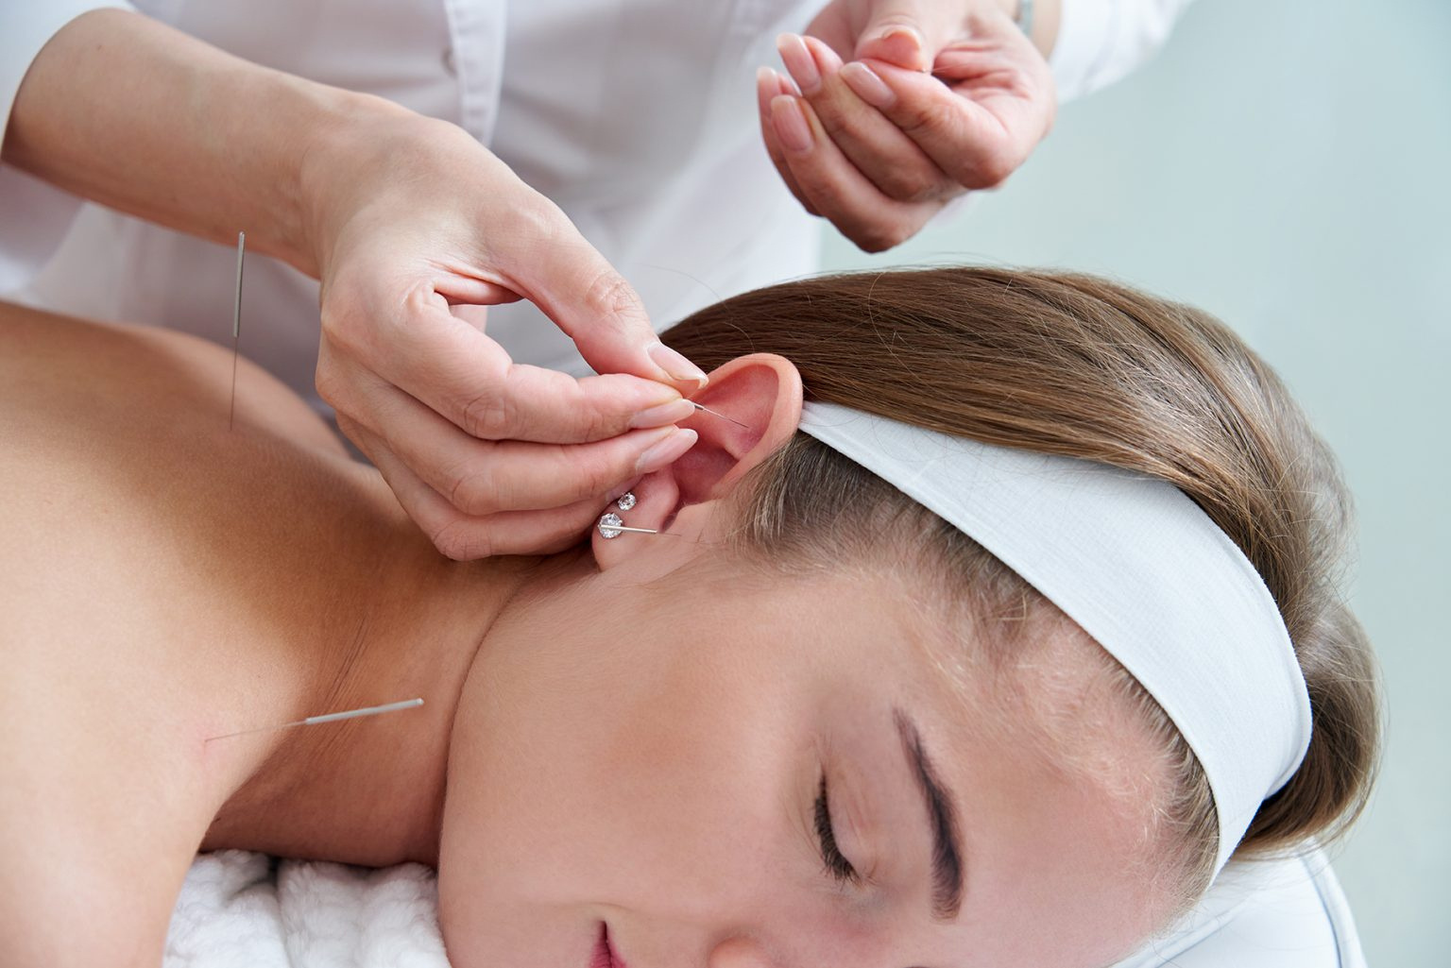

Acupuncture for Immune System
Visit - https://www.dramieshimmel.com/specialists/immune-support/

Slide 2
Concise Benefits of Immune Support Therapy
  Regular acupuncture boosts T-cell production, enhancing the body's defense against infections.
  Stimulates white blood cell activity, improving immune response to pathogens and viruses.
  Reduces inflammation and supports faster recovery from illnesses and infections.
  Enhances overall health and resilience, leading to fewer illnesses and improved well-being.
  Provides a safe, holistic approach to strengthening the immune system naturally.
  Helps manage chronic immune conditions by balancing energy flow and reducing stress hormones.
  Supports seasonal immunity, reducing frequency and severity of colds and flu symptoms.
  Complements other treatments, enhancing their effectiveness without interfering with medications or therapies.

Slide 3
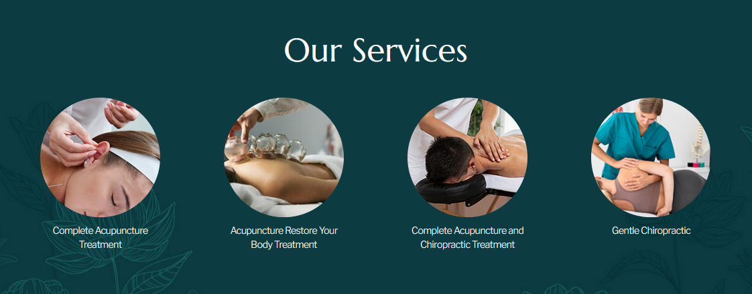
Address - 1 E Superior St #300, Chicago, IL 60611
Call - 312-877-5056
Email - dramieshimmel@gmail.com
Website - https://www.dramieshimmel.com/specialists/immune-support/

Slide 4

Thank You
Visit - https://www.dramieshimmel.com/specialists/immune-support/

