Slide 1

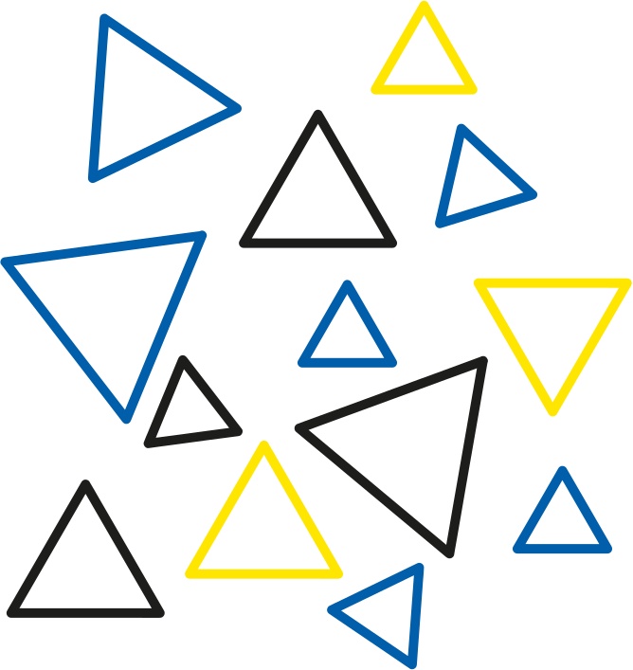

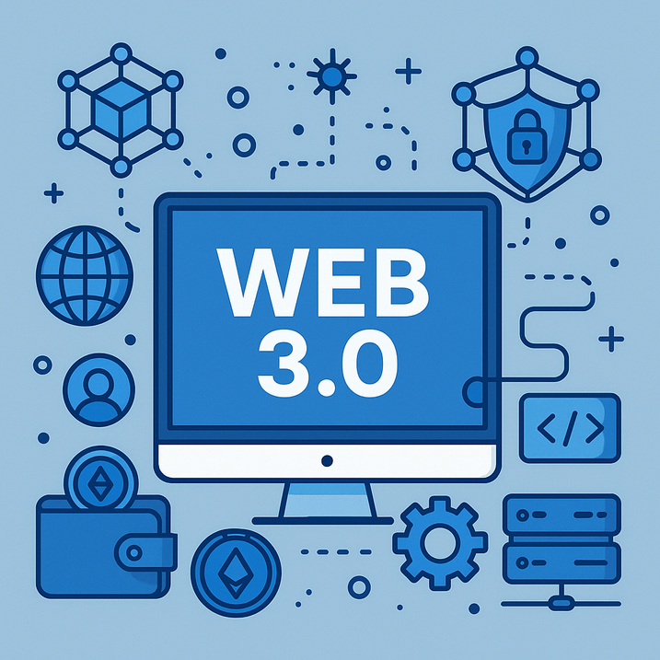
What’s New in Web3 Development? Trends to Watch in 2025
www.blockchainx.tech

Slide 2
Web3 has come a long way since the initial days of crypto experiments and speculative tokens. While making a year forward to 2025, one thing is clear: Web3 is no longer simply a buzzword; rather, it is a fundamental shift in the way digital products are built, used, and governed. Today, the highest web3 development platforms take it one step further by providing developers with scalable, modular, user-friendly tools to build decentralized applications that can bring industrial-level changes. The ecosystem has grown immensely, extending from DeFi to NFTs, from DAOs to decentralized charging storage. What makes the situation of 2025 special is that implementation will focus on scalability, usability, and real-world integration. So, it will be the year when Web3 has some actual working greases and shafts-anyone can use it and access it from almost every digital experience in their daily lives.

Slide 3
Modular Blockchain Architectures Are Taking Over
Monolithic blockchains are hitting a ceiling. Modular blockchains are picking up steam, whereby roles of consensus, data availability, and execution are split into separate layers. This architecture provides unspeakable scalability, greater performance, and freedom to developers. With Celestia and Polygon CDK at forefront, the developers can build application-specific blockchains that are fully tailored to their specific needs. This way, modular systems stand to become the bedrock of the Web3 development platform of the future, albeit with more flexibility and control than ever before. So, in 2025, do expect more chains to embrace modularization in their designs as the demands for high throughput dApps and low fee dApps increase.

Slide 4
The Rise of ZK Technology in Mainstream dApps
Once just for academics, ZK-Technology, predominantly ZK-rollups, has now become one of the pillars of Web3 infrastructure. These cryptographic techniques enable a proof of the truth while hiding the underlying data, Great for privacy-preserving uses and reducing on-chain data loads. Platforms such as zkSync Era, Starknet, and Polygon zkEVM are making ZK easier for developers. By 2025, expect ZK to underpin everything from private transactions to secure voting to confidential DeFi operations will propel Web3 into more privacy-conscious terrains.

Slide 5
Account Abstraction Is Changing Wallet UX
Account abstraction is Mass Adoption and a great leap in the field. Having smart wallets is a perfect way to abstract user interaction with the blockchain with respect to some of its complicated elements and characteristics. No more seed phrases, confusing gas fees, or terribly clunky UI-if only: gasless transactions, social recovery, MFA, and automation via standards like ERC-4337.Wallets such as Safe (formerly Gnosis Safe) and Soul Wallet have already started implementing these features.At the dawn of 2025, expect a new wave of dApps with onboarding experiences resembling that of Web2: intuitive, secure, and seamless.

Slide 6
Real-World Assets (RWAs) Are Flooding DeFi
The tokenization of real-world assets is without doubt one of the most exciting trends that will shape the year 2025. These include, among others, tokenized versions of government bonds, real estate, and commodities. An off-chain value brought on-chain is liquidity, transparency, and programmable financial products. In some way, Centrifuge, Maple Finance, and Ondo Finance are bridging TradFi and DeFi. With clearer regulations and increasing institutional appetite, RWAs could unlock trillions in dormant capital and make DeFi a respectable competitor to traditional finance.

Slide 7
AI x Web3: Smarter Contracts and Autonomous Agents
All the way into 2025, the synergy between AI and Web3 is blooming. Currently, AI agents are being integrated into decentralized systems to perform tasks such as smart contract optimization, DeFi strategies prediction, and creating autonomous DAOs. Enter Fetch.ai, Bittensor, and SingularityNET, melding machine intelligence with decentralized governance and marketplaces. Imagine DAOs run by AI algorithms or on-chain systems that learn and adapt. This merging opens the gates for new kinds of decentralized applications that are more intelligent, responsive, and scalable than ever before.

Slide 8
Web3 Social Media and Decentralized Identity
With growing concerns over censorship and data rights, 2025 sees a rapid pace of development within decentralized social media. Protocols such as Farcaster, Lens Protocol, and DSNP (Decentralized Social Networking Protocol) grant more control to creators and users over their content, relationships, and data. Another trending concept is that of Decentralized Identity (DID) systems, which empower users to securely own their identity and port it across platforms. These developments are shifting our communication methods, with self-sovereign identity set to be the core of the next digital age.

Slide 9
Developer Tooling and L2 Ecosystem Maturity
Layer 2 has moved beyond being experimental. Fast and inexpensive transactions with Ethereum-level security are offered by Optimism, Arbitrum, and Base, established as significant Web3 pillars. The L2 developer ecosystem is thriving in 2025 because of improved tooling: Foundry, Hardhat, Scaffold-ETH 2.0, and Viem (TypeScript-based). These tools would radically simplify Web3 development, therefore enabling teams to ship faster with increased security. And as such, mainstream applications are increasingly opting to L2 as their default host.

Slide 10
Conclusion
By 2025, the Web3 space will be vibrant and swift-moving, with a higher degree of maturation. The trends that have been discussed-modular chains, ZK-tech, AI agents, tokenized assets-are indicators of a technology stack coming of age. The lesson for developers, founders, and investors is to remain agile, keep learning, and build toward value that lasts. Use the right web3 development solutions to position yourself as a leader in this fast-changing world of decentralization. With Web2 and Web3 will increasingly intertwined, those who understand and act on these trends will be the frontiersmen moving into Terra Incognita digital tomorrow.

Slide 11





Thank You
CONTACT US
www.blockchainx.tech
contact@blockchainx.tech
+91 7708889555

