Slide 1



CRYPTO EXCHANGE DEVELOPMENT
TRENDS TO WATCH IN 2025

Slide 2
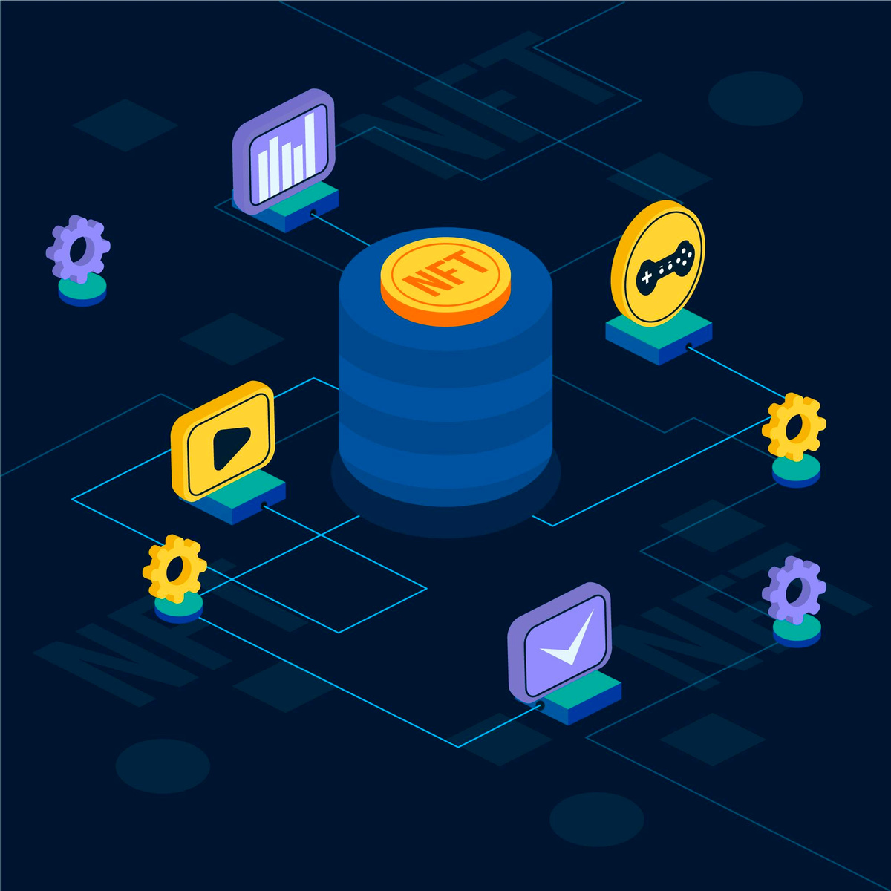
INTRODUCTION
The cryptocurrency market is still changing its dynamics, and a crypto exchange is the center hub of that ecosystem since it facilitates buying, selling, and trading digital assets. As we look toward 2025, the crypto exchange development will be gathering a lot of changes mostly due to technology advancements, regulatory challenges, and the ever-growing expectations of users. This blog post takes a look at the all-important trends that will pave the way for the development of new crypto exchanges into the coming year, alongside insights into the innovations and changes that insiders and enthusiasts will need to track.

Slide 3

TRENDS TO
WATCH IN 2025
It is quite significant for some developments in crypto exchange in 2025, as trends build enough momentum that make for interesting observation. Let us look at them individually:

Slide 4
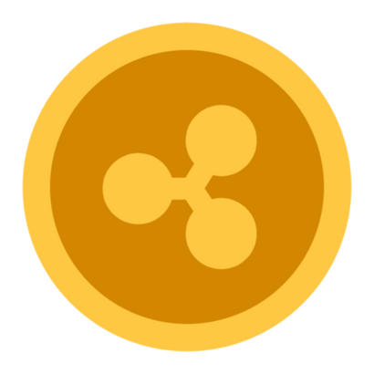
DECENTRALIZED EXCHANGES (DEXS)
1
GAINING MOMENTUM
Catering to much needs rendering traditional models more obsolete in the year 2025 and thus giving each user a distinctive autonomy, privacy, and overall control over assets would be decentralized exchanges. Users are now completing almost instantaneous and safer transactions between themselves without any intermediary. Increasing attention has been diverted from centralized exchanges to DEXs because of decreased control and spying, improving the level of transparency, reducing the chances of hacking or mismanagement, and other relevant parameters. Advances in cross-chain interoperability and user-friendly interfaces also increase the mainstream exposure of DEXs, pushing their adoption rates to new highs.

Slide 5
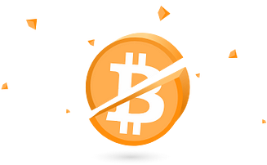
AI INTEGRATION FOR TRADING,
2
SECURITY, AND SUPPORT
With the broadening definition of artificial intelligence, the transformation that this technology is bringing to the world especially in the crypto and fintech scene is an optimization in the various layers of its operation. As far as trading goes, AI algorithms are used for predictive analytics, automated strategy generation, and decisions made in real-time, all in helping a trader sharpen the accuracy and improve efficiency. Measures as per security adopt AI-powered systems to discover anomalous behavior which, in turn, prevents fraud and cyberattack schemes from being executed towards a victim. Finally, customer support is being broken into intelligent chatbots making use of natural language processing allowing much faster and more personalized customer service experiences.

Slide 6

ENHANCED KYC/AML COMPLIANCE
3
THROUGH BLOCKCHAIN
Most probably being revolutionized is KYC, also known as the Know Your Customer nomenclature, and AML, having the Anti-Money Laundering act on it, in 2025 through blockchain technology. Distributed ledger systems allow companies to create virtually tamper-proof and verify digital identities, thus ensuring an improved onboarding process for clients while following closely the stringent requirements of regulation. Smart contracts automate compliance procedures and enforce them, reducing human error and costs. This not only increases transparency but also gives individuals more power over their personal information that can be shared with trusted entities to enhance both security and privacy.

Slide 7
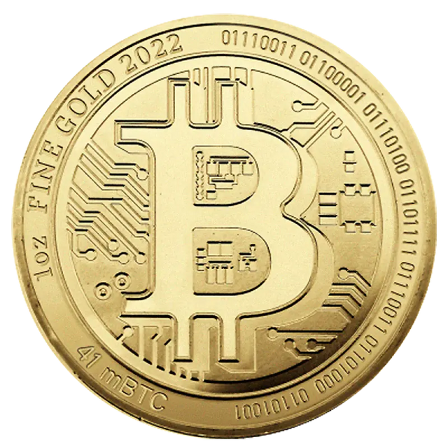
MODULAR AND
4
MICROSERVICE-BASED ARCHITECTURES
Modularity and microservices are being restored to development as business shines on flexibility and scalability. Next, fintech and crypto platforms will have to rely on modular and microservice-based architectures. These decompose massive systems into smaller services that are independently deployable units and scaled, changed, or replaced without requiring system-wide interference. This transformation in architecture results in faster cycles for developing new functionality, with the ease of integrating third-party tools and better fault isolation. In 2025, those adopting such platforms will boast of responding effectively to changes in the market and customer demand.

Slide 8

GAMIFICATION AND
5
SOCIAL TRADING FEATURES
To enhance engagement and establish connections with younger customers, platforms are increasingly considering features like gamification and social trading. Gamification models, which include aspects like leaderboards, achievements, rewards, and competitions, make trading more fun and interesting. Social trading, on the other hand, helps users to follow or copy traders they consider successful, thereby providing an avenue for learning and collaboration within the community. These features not only make trading easier for newbies, but they also establish a community of individuals who can trust each other two major factors that help with the retention of users in the long run.

Slide 9
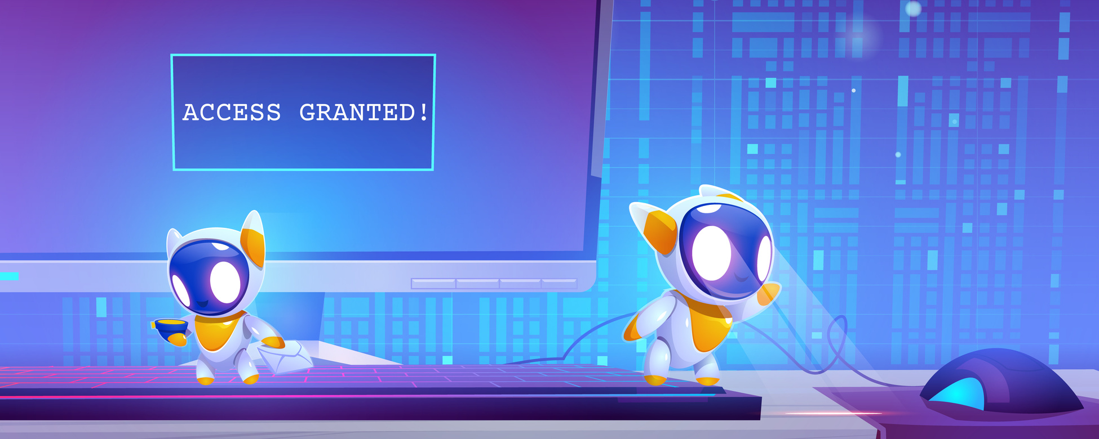
RISE OF WHITE-LABEL AND
6
NO-CODE PLATFORMS
Fast, cost-effective solutions have been creating impressive demand in the crypto and fin-tech milieu, which consequently propelled the rise of white-label and no-code platforms. They provide a great opportunity for the entrepreneurs and startups to get their customized exchanges, wallets, or financial services into the market without any strenuous coding skills or deployment of a huge development team. From 2025 onwards, the platforms are going to enable a faster go-to-market model and decrease the entry barriers for both startups and traditional institutions for setting up businesses. This will lead to increased competition, and soon, the vendors of these tools will specialize on the basis of modularity, scalability, and integrated compliance.

Slide 10
BENEFITS OF
CRYPTO EXCHANGE DEVELOPMENT
REVENUE GENERATION: THE CRYPTO EXCHANGE DEVELOPMENT HAS LOTS OF ADVANTAGES, FIRST AND FOREMOST THE OPPORTUNITY TO EARN A LOT OF MONEY.
MARKET DEMAND: AS THE WORLD OF CRYPTOCURRENCY GROWS RAPIDLY, THE DEMAND FOR SECURE AND USER FRIENDLY PLATFORMS TO BUY, SELL, AND TRADE DIGITAL ASSETS ALSO INCREASES.
INNOVATION POTENTIAL: CRYPTO EXCHANGE DEVELOPMENT IS A HUGE POTENTIAL GROUND FOR INNOVATIONS THAT PUSH THE BOUNDARIES OF CONVENTIONAL FINANCE.
GLOBAL REACH: UNLIKE TRADITIONAL FINANCIAL SERVICES, CRYPTO EXCHANGES ARE ALLOWED TO ACCEPT GLOBAL CLIENTELE WITH LITTLE TO NO GEOGRAPHICAL RESTRICTIONS.
DECENTRALIZATION & CONTROL: ONE OF THE MAIN ADVANTAGES OF DEVELOPING A CRYPTO EXCHANGE IS THE CAPACITY TO PROVIDE DECENTRALIZED PLATFORMS WHERE THE USER CONTROLS HIS ASSETS AND DATA.
-

Slide 11

CONCLUSION
AT THE CUSP OF FAR REACHING ADVANCES IN 2025, THE CRYPTO EXCHANGE DEVELOPMENT SPACE WILL BECOME VIBRANT WITH DEVELOPMENTS IN THE DECENTRALIZED DOMAIN, AI INTEGRATION, SECURITY AND COMPLIANCE ENHANCEMENT COMPLIANCE, MODULAR ARCHITECTURE FACILITATION, AND THE RISE OF ENGAGING USER FEATURES AND DEVELOPMENT PLATFORMS IN THE ARCHITECTURE AND DESIGN ARENA. KEEPING ABREAST OF THIS EVOLUTION WOULD BE ESSENTIAL FOR ANYONE CRYPTO: DEVELOPERS, OPERATORS, OR USERS.

Slide 12

Thank You

