Slide 1
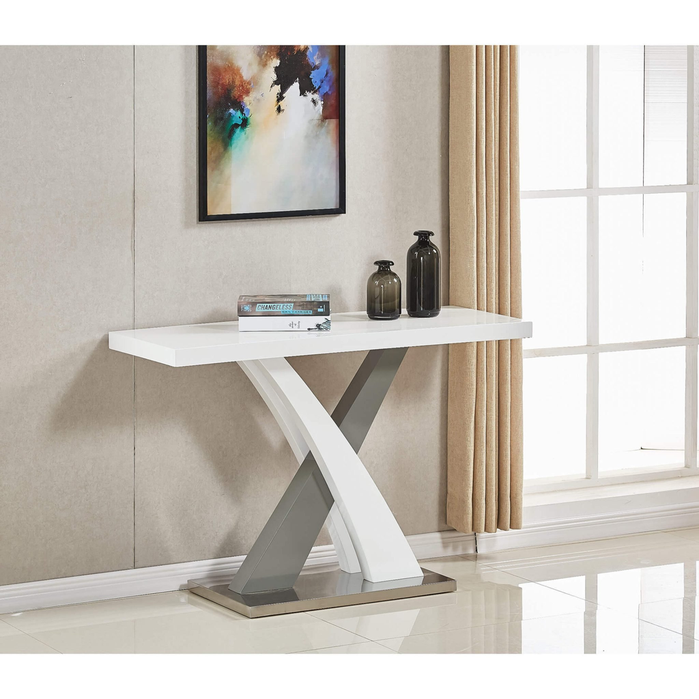



Console Tables : Furniture Villa
Discover versatile console tables blending style and practicality. Perfect for modern living spaces.
https://furniturevilla.co.uk/

Slide 2

What is a Console Table?
Versatile furniture piece for living rooms
Combines style and function
Often placed against walls
Height range: 30-36 inches
https://furniturevilla.co.uk/

Slide 3

Why Choose a Console Table?
Storage
Keep keys, mail, and accessories handy
Organization
Hide clutter to maximize living space
Display
Showcase lamps, vases, and photos
https://furniturevilla.co.uk/

Slide 4
Featured Product: Console Table
Visit Furniture Villa for details.
Materials include solid wood, metal, and glass.
Styles range from modern to rustic and traditional. Customizable dimensions available for your space.
https://furniturevilla.co.uk/

Slide 5
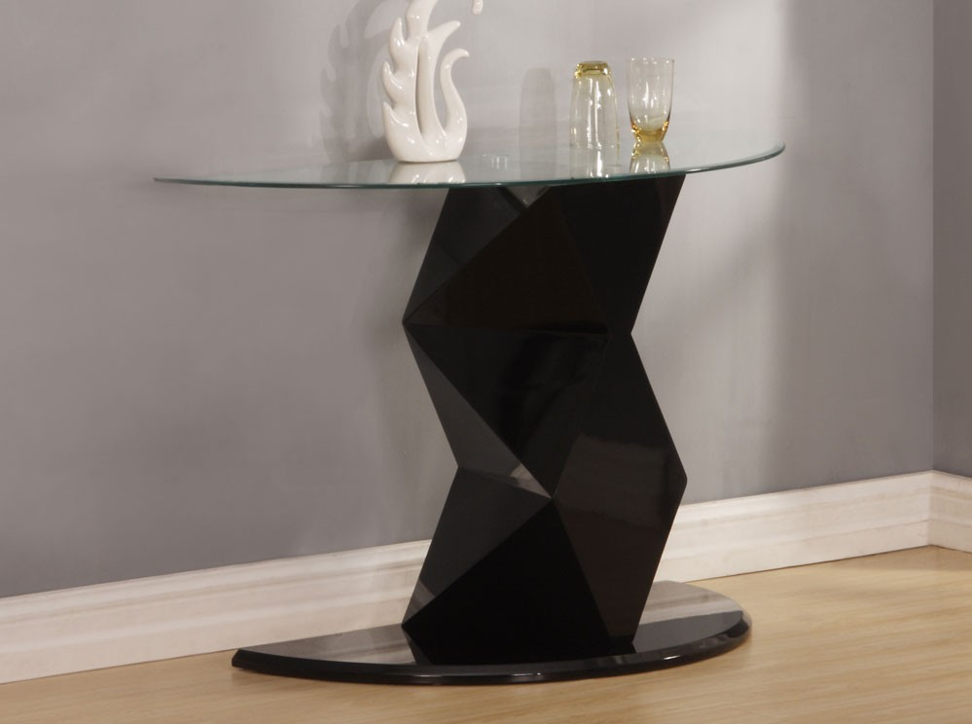
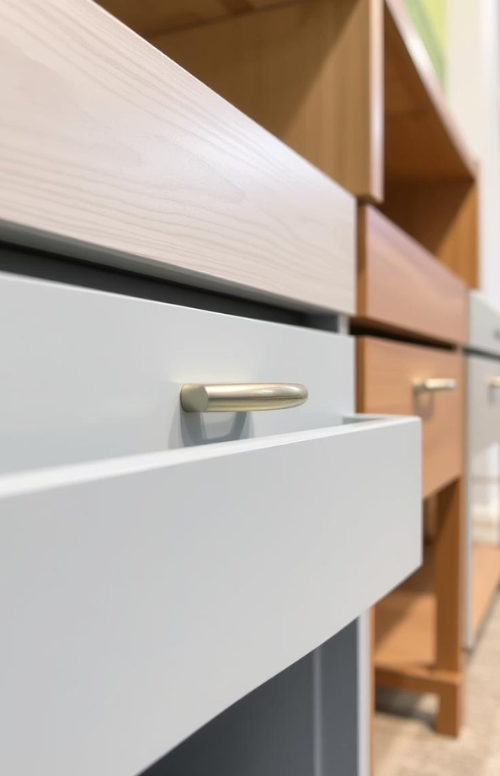

Style and Design Options
Finishes
Oak
Walnut Painted
Drawer Hardware
Knobs Pulls Handles
Leg Styles
Tapered Splayed Straight
https://furniturevilla.co.uk/

Slide 6

Benefits of Buying from Furniture Villa
Craftsmanship
High-quality materials and expert building
Variety
Wide range of styles and finishes
Pricing
Competitive prices
Shipping
Fast and reliable delivery services
https://furniturevilla.co.uk/

Slide 7



Contact Us
Website: https://furniturevilla.co.uk/ Email: info@furniturevilla.co.uk
Phone: 01322 385 108
Address: United Kingdom ,Kent
https://furniturevilla.co.uk/

