Slide 1

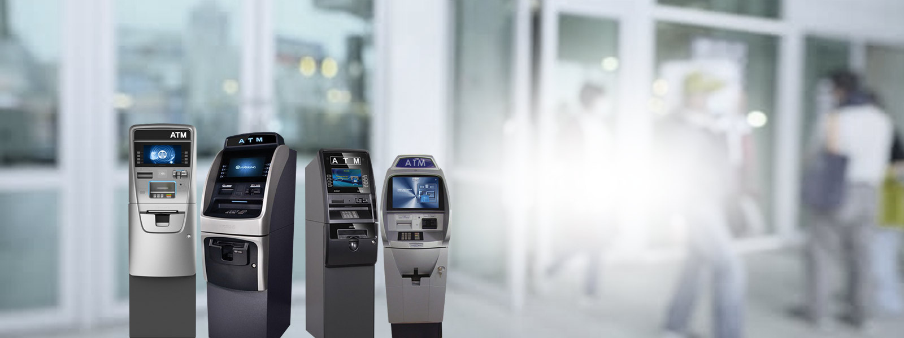
Genmega G2500 ATM Machine
By Gold Coast ATM

Slide 2
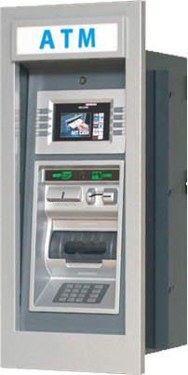
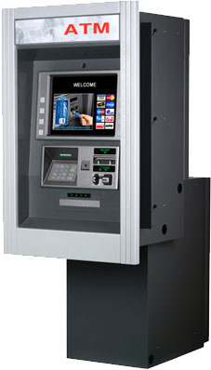
  High-definition touchscreen enhances user experience.
  Multiple configuration options for customization.
  Durable design for various environments.
  Compact models fit tight spaces.
  Advanced features for busy locations.

Slide 3

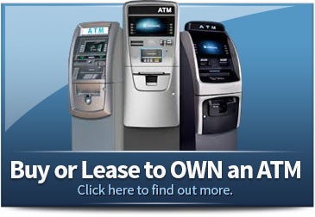
Thank You For Watching
Address - 2000 North Racine, Suite 2000, Chicago IL 60614 USA
Call - 888.950.VISA (8472), 773 416 8526
Mail - info@goldcoastatm.com
Visit - https://www.goldcoastatm.com/genmega-atm-machines.php

