Slide 1


How to Choose the Best Pay Per Click Services for Your Business
www.growthwayadvertising.com

Slide 2
PPC advertising provides businesses with an immediate solution to generate targeted visitors and revenue-generating leads for maximizing sales. A business must work with the right PPC services provider to achieve actual performance outcomes. Among India's competitive market industry, you need to understand which PPC agency will provide the best results for your business when considering the wide range of options.
Checkpoints for selecting PPC services in India or any other location include:
1. Experience and Track Record
You must evaluate both the duration of service for the pay per click advertising firm and their actual performance outcomes. A trustworthy PPC company demonstrates its excellence by presenting industry-specific case studies along with client reviews and service examples in its portfolio.

Slide 3
2. Range of Services
Your search for PPC management should target a firm that utilizes all possible PPC marketing methods including Google Ads and Bing Ads together with remarketing alongside display advertising and YouTube campaigns. Companies that offer complete PPC management services will generate customized strategies which match your business objectives.
3. Transparent Pricing
A premier PPC service company reveals its pricing structure clearly between flat billing or paying based on advertising expenses. Choose businesses that maintain fair pricing structure with no secret charges in their billing practices.

Slide 4
4. Keyword Research and Strategy
Organizations that benefit from excellent pay-per-click agency performance start with detailed keyword analysis. Your selected pay per click firm must locate search terms which your intended market uses actively because these keywords achieve maximum conversion ratios at minimum expense.
5. Campaign Customization
Every business operates differently so should their PPC advertising approaches. The development of personalized campaigns depends on your business sector plus competition, target audience and financial plan at a trustworthy pay per click advertising agency.

Slide 5
Check Communication and Transparency
Open social media management collaborations need reliable communication alongside total transparency in their reports. The company should provide steady feedback together with evaluation reports as well as knowledgeable data which helps you understand better.
Social Media Services in India
If you're exploring social media marketing service in India, you’ll find a thriving market with skilled professionals and competitive pricing. Indian social media marketing services that lead the market segment deliver customized strategies which benefit businesses at every level including startups and established enterprises. Working with a top-rated Indian agency provides your business with substantial benefits for both specified market areas and worldwide operations.

Slide 6
6. Data-Driven Optimization
Right PPC advertising companies establish campaigns that never abandon advertising responsibilities after setup. This organization tracks performance results to improve operations using available information. A proactive PPC agency uses regular A/B testing along with bid adjustments and audience refinements as indicators for proactive service delivery.
7. Clear Communication and Reporting
The management services of a skilled ppc agency ensure that they provide detailed reports alongside regular updates to their clients. A team that informs about click-through rates and conversions along with ROI evaluations and improvement recommendations will be a good fit.

Slide 7
8. Local Expertise
PPC services in India should be your choice if your target market consists of Indian consumers. PPC providers based in India understand all of the necessary local market trends including language choices and cultural implications which strongly influence advertising results.
9. Ongoing Support
PPC isn't a set-it-and-forget-it strategy. Your business growth requires active support from a reliable PPC marketing services team which will answer your questions and modify strategies.

Slide 8
10. Reputation and Reviews
Reviews along with ratings of the chosen pay per click advertising firm must be checked by potential clients before starting the partnership. The ideal pay per click organization maintains a well-established track record of delivering visible outcomes to customers while being trustworthy and open with their operations.
Successful digital advertising demands the correct selection of a PPC service agency for ongoing business achievement. Your search for pay per click services in India or additional areas should end with a decision for a pay per click company that matches your business objectives and core values.

Slide 9

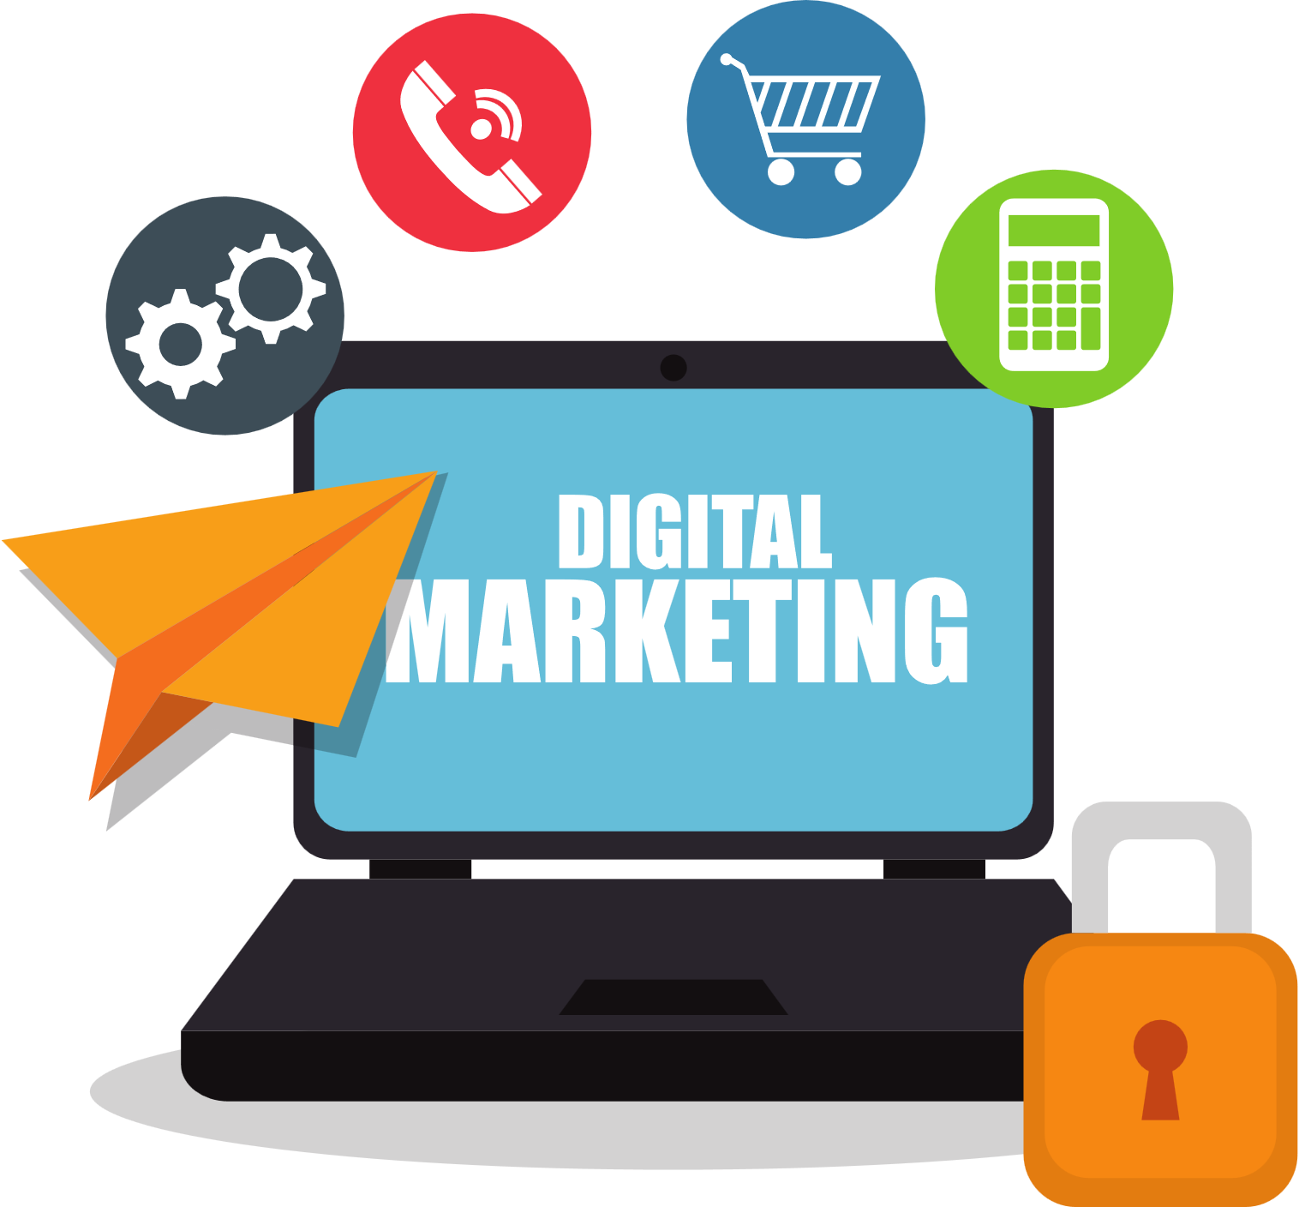
Contact us
  We combine creative marketing strategies with digital media and technology to drive your brand’s scalable and sustainable growth.
  With almost 10+ years of award-winning digital and creative marketing experience across start-ups, SMEs, and multi-national B2B and B2C brands, we love what we do!
  Visit: www.growthwayadvertising.com
  Call Us At: 91+ 77092 80369
  Email: Bhavesh@growthwayadvertising.com
  Office No – 703, ANP Landmark, Sr. no. 89, Bhumkar Chowk,Hinjawadi – Wakad Rd, Pune, Maharashtra 411057

