Slide 1


Corporate Transfer Service Sydney

Slide 2
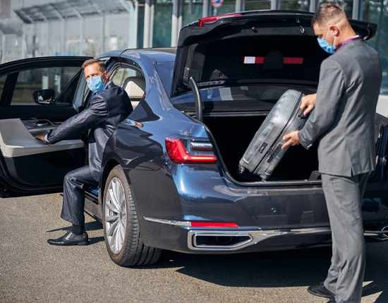

Chauffeur Hire offers premium corporate transfers in Sydney, ensuring punctual, luxurious, and discreet travel for business professionals. Their services include airport pickups, executive meetings, and tailored itineraries, all delivered with professional chauffeurs and a fleet of high-end vehicles. With amenities like Wi-Fi and climate control, they provide a seamless and comfortable experience for corporate clients.

Slide 3

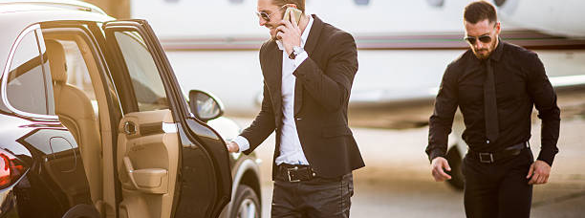

THANK YOU
Address - 12 Brahman Rd, Box Hill NSW 2765
Call - +61 451139131
Visit - https://www.chauffeurhire.com.au/our-services/corporate-transfer-in-sydney

