Slide 1

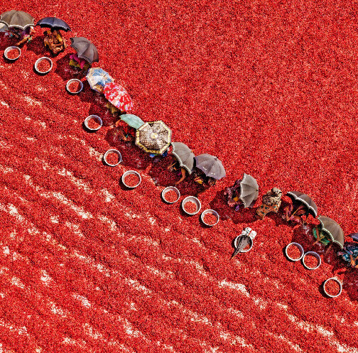
Spices India
Dry Red Chilli Exporters

Slide 2
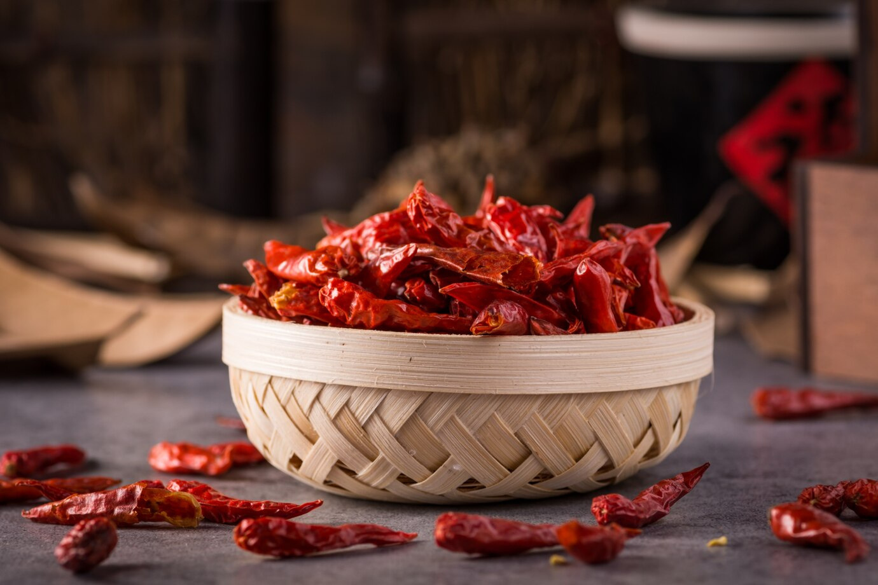
Spices India is a leading Indian exporter of premium dry red chillies. Sourcing directly from smallholder farmers, they ensure quality through meticulous sorting, stem removal, and modern processing techniques.
It offers a diverse range of Indian dry red chillies, including Guntur Sannam, Byadagi, Kashmiri, Mundu, and Wonder Hot varieties, catering to various culinary and industrial needs

Slide 3
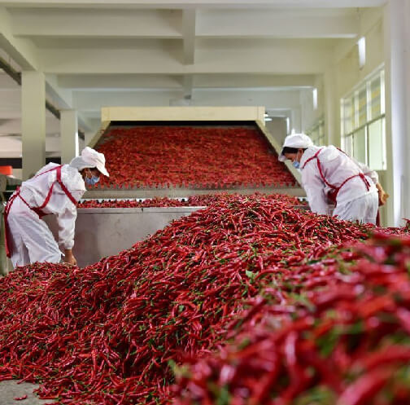
Address- D.No 25-16-180, 181,
Mirichi Yard Road, Guntur, Andhra Pradesh, 522005
Email Us - contact@agrocrops.com
Call us - +91 97013 63424
Website- https://www.spicesindia.net/

Slide 4

Thank You
Visit - https://www.spicesindia.net

