Slide 1


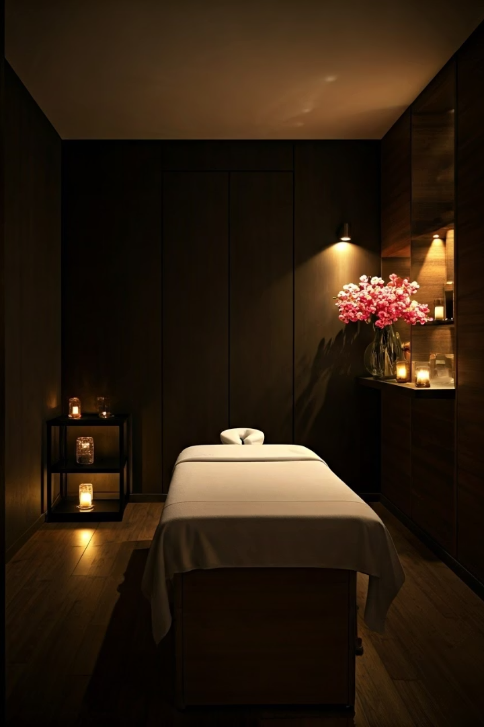
Introduction to Body Retreat Massage
Body Retreat Massage offers a holistic path to deep relaxation. It significantly enhances both mental and physical well-being. Key benefits include effective stress relief, improved sleep, and targeted muscle tension relief.
Notes:
1

Slide 2
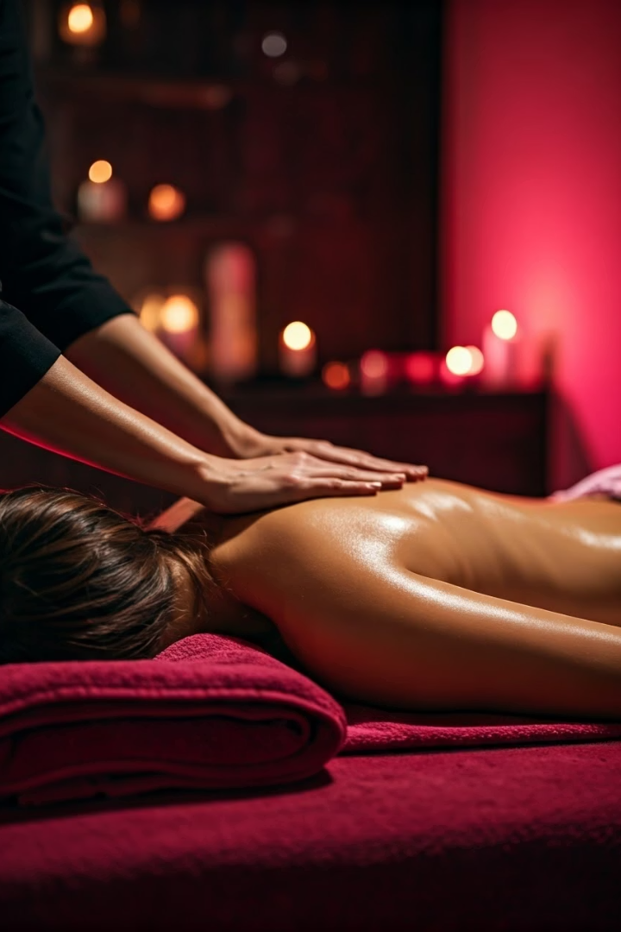



Benefits of Body Retreat Massage
Stress and Muscle Relief
Improved Sleep Quality
Body Retreat Massage excels at relieving stress. It also effectively relaxes tense muscles.
Massage helps release toxins from the body. This process significantly improves sleep quality.
Enhanced Mental Clarity
Deep relaxation during massage promotes mental clarity. It helps clear the mind and sharpen focus.
Notes:
2

Slide 3
Techniques Used in Body Retreat Massage
Diverse Techniques
Targeted Application
Circulation Boost
Body Retreat Massage expertly blends Swedish and deep tissue techniques. This combination offers comprehensive relief.
It employs gentle strokes, deep kneading, and precise trigger point work. This targets specific areas of tension effectively.
These techniques promote optimal blood circulation. They also enhance oxygen flow throughout the body.
Notes:
3

Slide 4
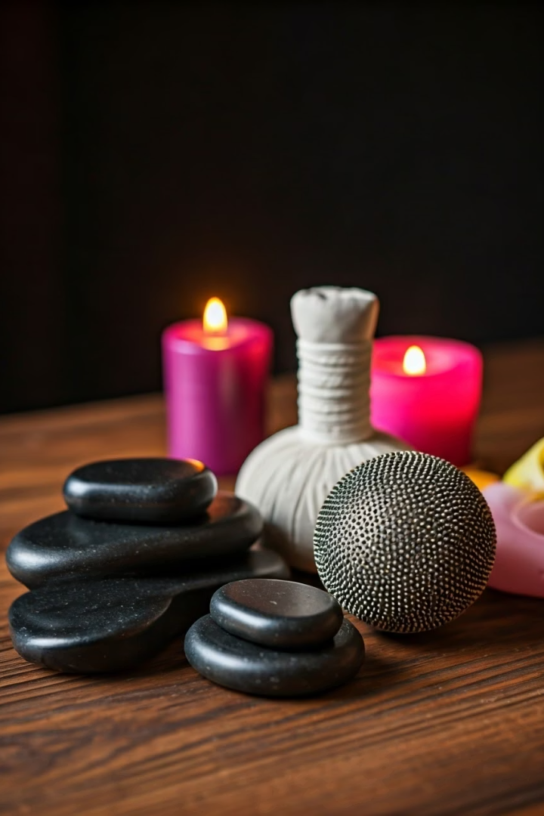



Types of Body Retreat Massages
Swedish Massage
Deep Tissue Massage
Hot Stone Massage
Ideal for overall relaxation and stress reduction. Uses long, flowing strokes.
Targets chronic muscle tension and pain. Applies firm pressure to deeper layers.
Heated stones provide deep warmth and muscle relaxation. Enhances therapeutic effect.
Body Retreat Massage offers diverse options. Each caters to specific needs. These techniques ensure a tailored therapeutic experience.
Notes:
4

Slide 5








Mental Health Benefits
Reduces Anxiety
Alleviates Stress
Body Retreat Massage significantly lessens feelings of anxiety. It creates a calming mental state.
Massage therapy actively reduces stress hormones. This promotes a sense of tranquility.
Elevates Mood
Boosts Mental Clarity
The release of endorphins during massage uplifts spirits. It naturally enhances overall mood.
Relaxation sharpens focus and improves concentration. It helps clear the mind from clutter.
Experience profound mental well-being through these benefits. It's a key component of holistic health.
Notes:
5

Slide 6




Physical Health Benefits
Pain and Tension Relief
Body Retreat Massage targets chronic pain. It effectively relieves muscle tension.
Enhanced Flexibility
Massage improves joint mobility. It increases overall range of motion.
Supports Recovery
Improved blood flow aids in faster healing. It promotes cellular regeneration.
These physical benefits contribute to a healthier, more active life. Body Retreat Massage is a cornerstone of physical vitality.
Notes:
6

Slide 7



Integrating Body Retreat Massage into Your Lifestyle
Regular Sessions
Consistent massage offers sustained well-being. Schedule appointments for lasting benefits.
Combine Wellness Practices
Integrate massage with yoga or meditation. This amplifies overall health improvements.
Customize Your Massage
Tailor each Body Retreat Massage to your needs. Address specific concerns for optimal results.
Embrace massage as a vital part of your self-care. It's an investment in your continuous health.
Notes:
7

Slide 8
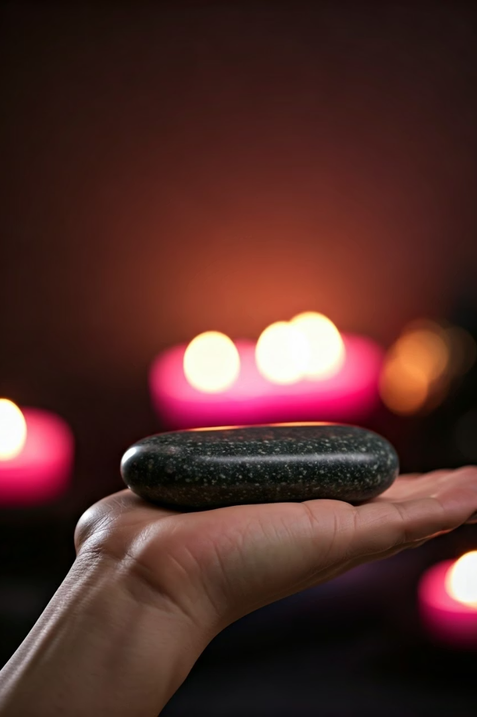


Conclusion and Contact Information
Invest in your well-being with Body Retreat Massage today. Prioritize relaxation and self-care for a healthier you.
Contact us to schedule your appointment.
Phone: (03) 5963 7000
Email: info@cedarvaleretreat.com.au
https://cedarvaleretreat.com.au
Notes:
8

