Slide 1



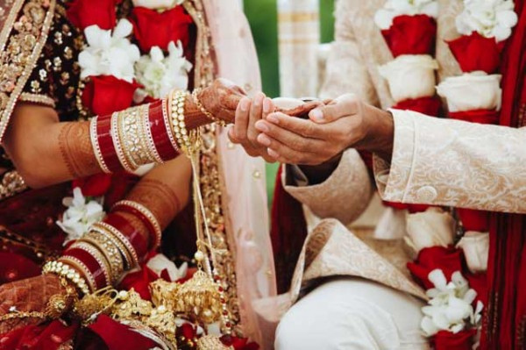

Imperial Weddings
Matrimonial Services in Noida

Slide 2
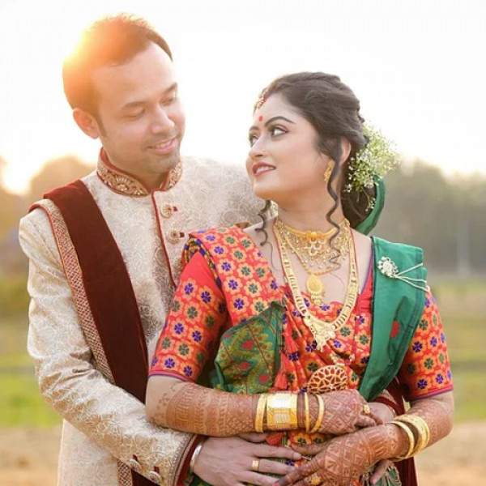
Imperial Weddings offers premium Matrimonial Services in Noida, specializing in Aggarwal, Baniya, Punjabi, Jain, and Marwari communities. With over 30,000 successful matches, they provide 100% verified profiles, personalized matchmaking, and dedicated relationship managers. Their comprehensive services include pre-marital counseling, astrology, personality profiling, and more. Operating from Noida, Imperial Weddings is a trusted choice for individuals seeking culturally aligned partners in India.

Slide 3

Address - 117, 1st Floor, NDM-1, Netaji Subhash Place, Pitampura, Delhi-110034
Phone - +91 9773 525 525, 011-40505815
Email - info@imperial.wedding
Address

Slide 4
Thank You
Visit - https://www.imperial.wedding/matrimonial-services-in-noida

