Slide 1
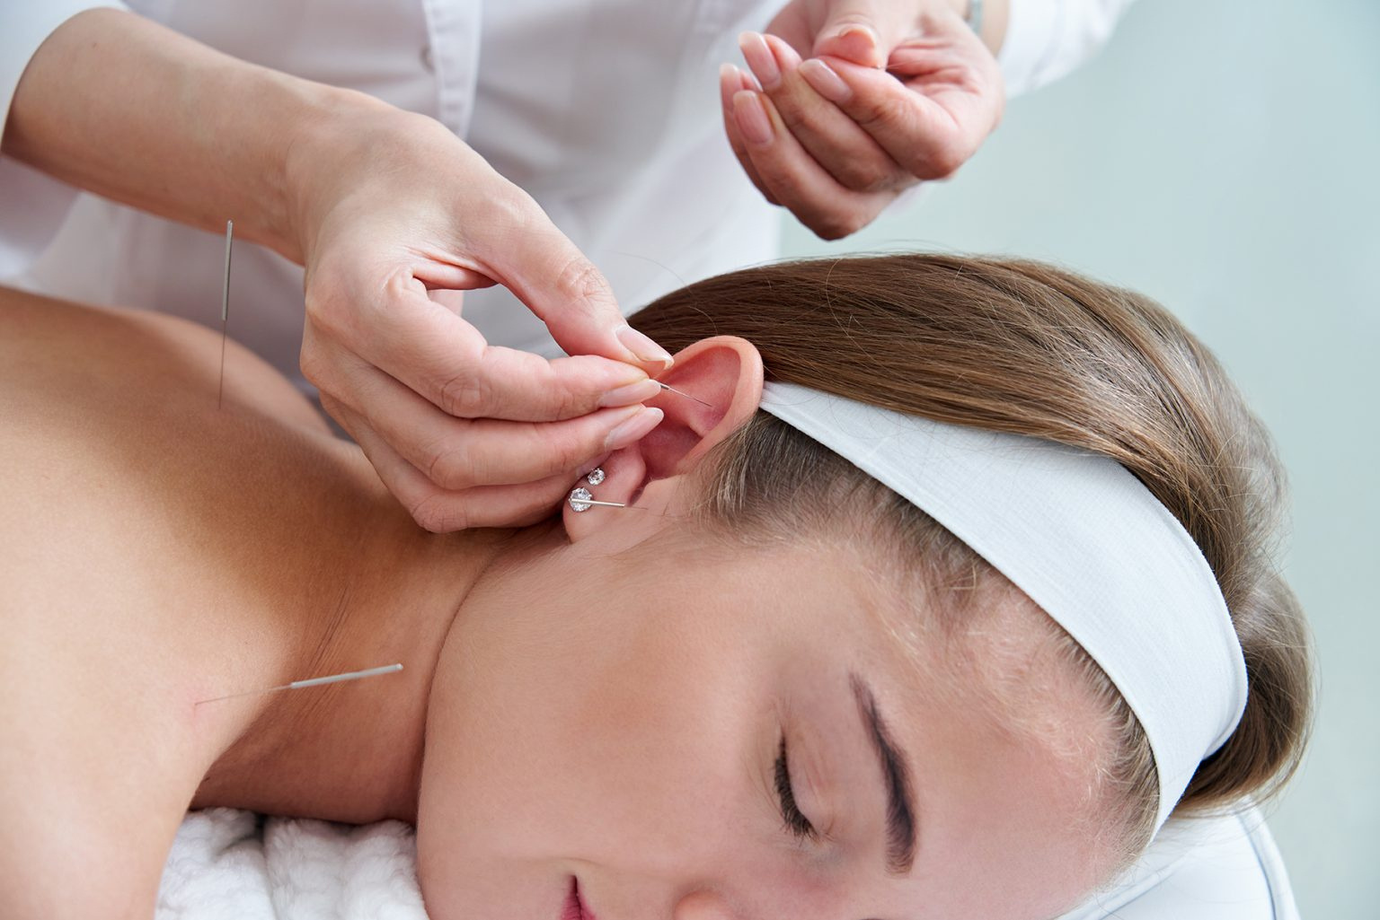

Acupuncture & Chinese Medicine Chicago

Slide 2
Benefits of Acupuncture & Chinese Medicine
  Dr. Amie Shimmel Handa integrates traditional acupuncture with modern techniques to address diverse health concerns holistically.
  Treatments focus on restoring balance between yin and yang, targeting root causes of various ailments.
  Advanced methods like electro-acupuncture and cupping enhance healing, providing relief from chronic pain and inflammation.
  Acupuncture sessions stimulate specific points to improve immune function, energy levels, and overall vitality.
  Personalized care plans are designed to promote long-term wellness and prevent future health issues.

Slide 3
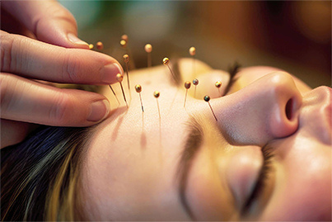
Address - 1 E Superior St #300, Chicago, IL 60611
Call - 312-877-5056
Email - dramieshimmel@gmail.com
Website - https://www.dramieshimmel.com/specialists/acupuncture-chinese-medicine/

Slide 4

Thank You
Visit - https://www.dramieshimmel.com/specialists/acupuncture-chinese-medicine/

