Slide 1

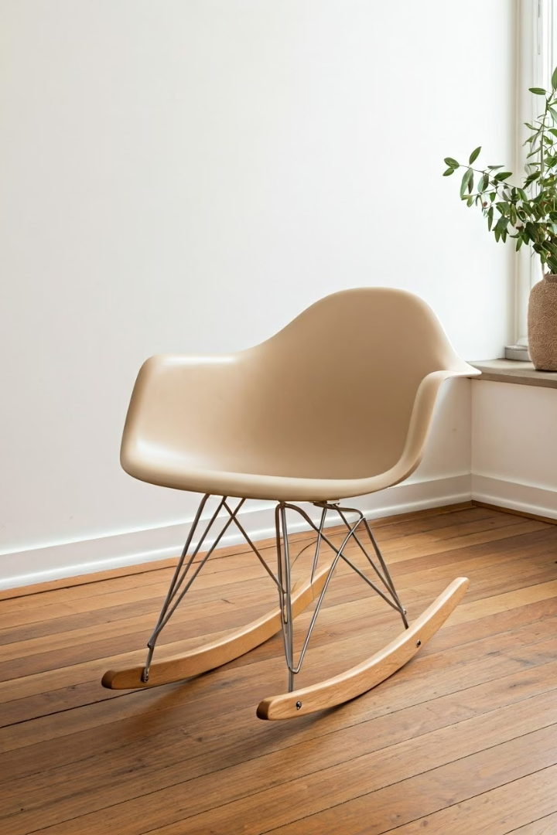


Eames Rocking Chair
Discover the iconic Eames Rocking Chair, a perfect blend of style and comfort. Presented by Luxe Furnishes with a chic beige theme.
https://www.luxefurnishes.com
Notes:
1

Slide 2
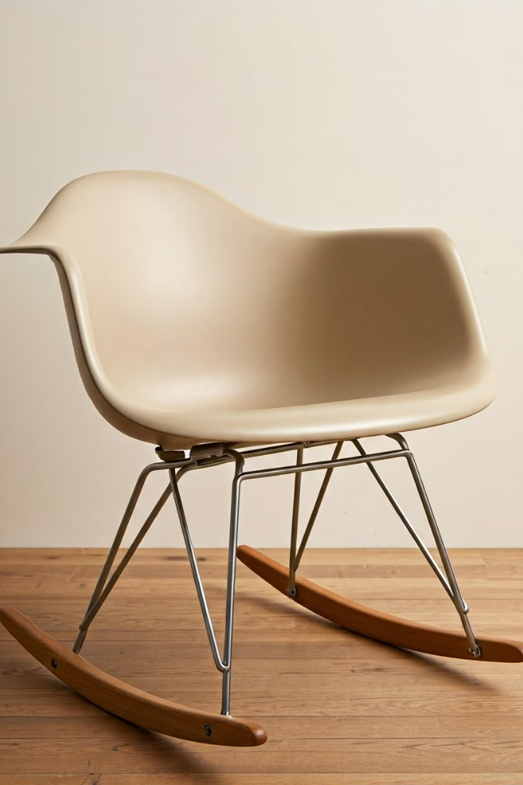
Design & Aesthetics
Ergonomic Comfort
Distinctive Base
Molded plastic seat designed for support and style.
Chrome or wooden rockers add modern elegance.
Neutral Palette
Beige tones seamlessly complement diverse interiors.
https://www.luxefurnishes.com
Notes:
2

Slide 3
Comfort & Relaxation
Soothing Motion
Posture Support
Versatile Use
Gentle rocking helps reduce stress and promotes calm.
Contoured seat cushions and cradles your body perfectly.
Ideal for relaxing in nurseries and living spaces alike.
https://www.luxefurnishes.com
Notes:
3

Slide 4
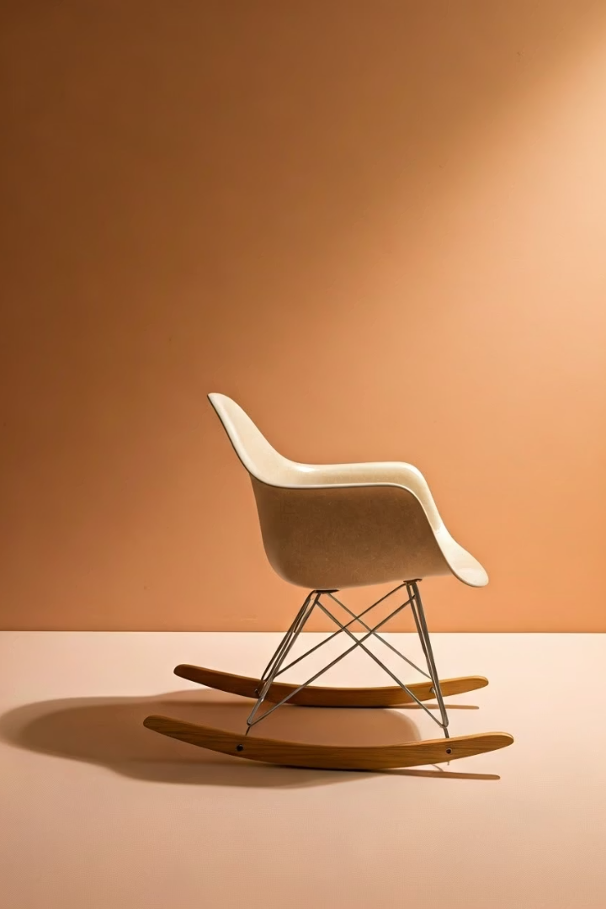
Legacy & Influence
Design Icon
Renowned Designers
Symbolic piece of mid-century modern design history.
Created by Charles & Ray Eames, pioneers in furniture design.
Global Presence
Featured in esteemed museum collections around the world.
https://www.luxefurnishes.com
Notes:
4

