Slide 1
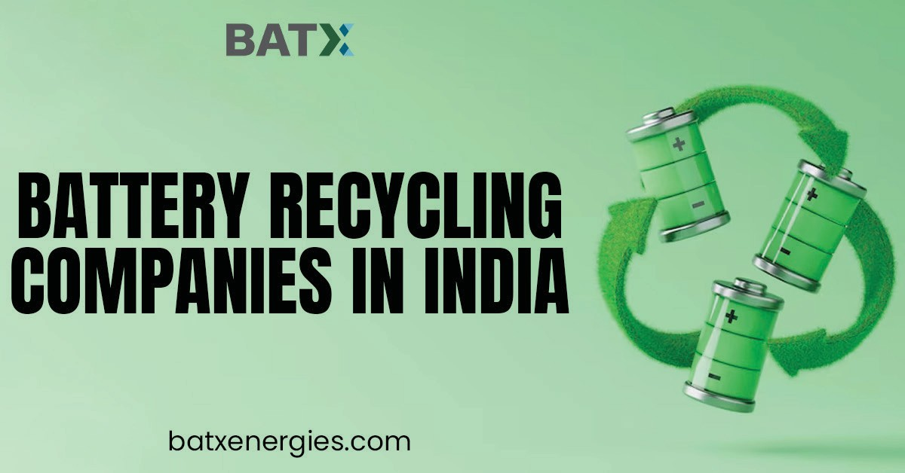

Slide 2

This is not just about us. This is about everybody. We, at BatX Energies Pvt. Ltd., are just the agents of change whose mission it is to create a truly Circular Economy. We’re doing our part by extracting Rare Earth metals such as Lithium, Cobalt, Nickel and Manganese from used Lithium-ion cells. The result of this is that these precious Rare Earth metals can go back into manufacturing Lithium-ion batteries.
batxenergies.com

Slide 3
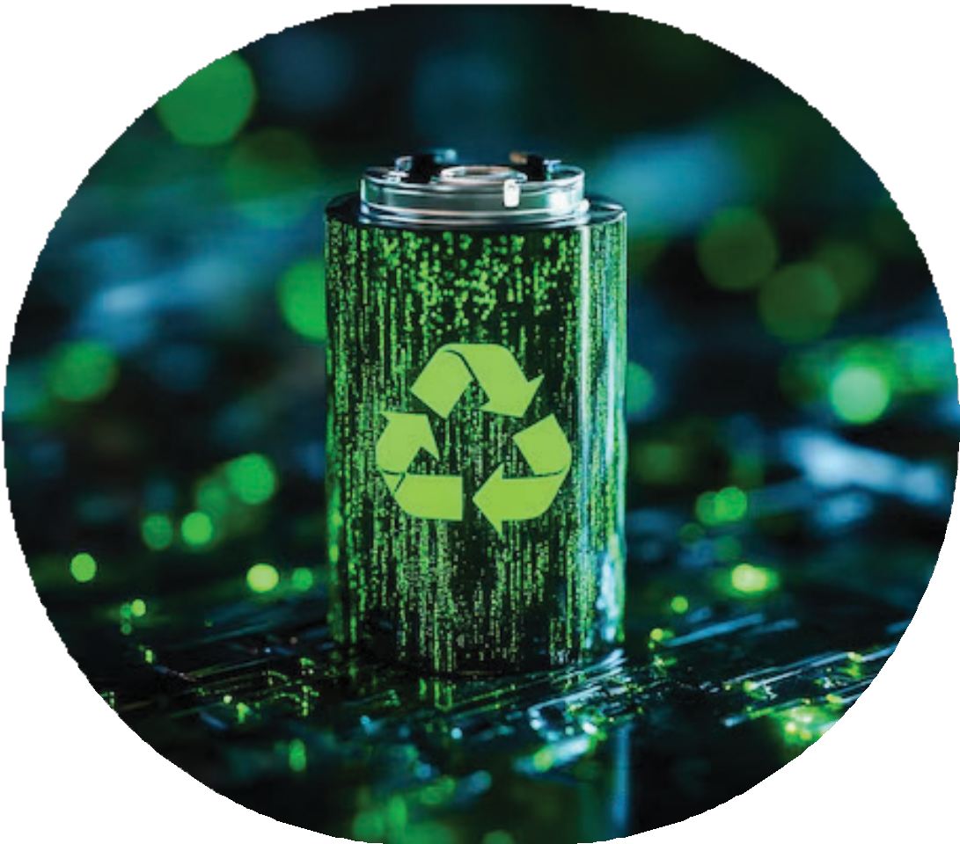
BATX Energies(EV Battery Recycling Company India): Revolutionizing India's EV Landscape - The Green Drive Towards Tomorrow
Welcome to BATX Energies Pvt. Ltd., where innovation and eco-consciousness converge to redefine the future of electric vehicles in India. As the premier EV battery recycling company India, BATX Energies stands at the forefront of sustainable solutions, offering a comprehensive range of services from EV battery manufacturing to cutting-edge recycling.
Why BATX Energies? - "Driving Sustainable Change" Sustainable EV Battery Solutions:
Being one of the best EV battery recycling companies India, BATX Energies is not just a company; it’s a movement driving sustainable change. Our commitment to a Circular Economy and international initiatives positions us as the go-to solution for eco-friendly EV battery production in India.
Technical Brilliance in EV Battery Recycling India:
With our proprietary Net Zero Waste, Zero Emissions process, BATX Energies excels in recycling end-of-life Lithi- um-ion batteries. We extract Black Mass with less than 1% impurities, ensuring the highest quality battery-grade materials and setting a new standard for technical excellence.
Complete Circular Economy Solutions:
Experience a paradigm shift with BATX Energies, the best EV battery production company in India. Our circularity approach not only addresses immediate challenges but actively contributes to reducing dependence on mining. We extract critical minerals and reintroduce them into the market, reshaping the future of battery production in India.
Global Commitment to Climate Goals:
With the growing awareness of sustainability, there has been a surge in the establishment of companies dedicated to EV batteries recycling in india. BATX Energies aligns with global climate goals, actively contributing to Climate Action, Life on Land, Sustainable Cities and Communities, Affordable and Clean Energy, and Responsible Con- sumption and Production. Join us in making a difference on a global scale.
Why Recycle with BATX Energies? - "Recycle. Reuse. Revolutionize." Future-Ready Solutions:
The demand for Lithium-ion battery materials is soaring, and BATX Energies offers future-ready solutions. With the global demand for EV batteries set to reach 2000 GWh by 2030, our recycling process ensures a continuous supply of high-quality materials for sustainable EV battery production.
Global Solution to Local Challenges:
BATX Energies isn’t just addressing challenges; we’re redefining solutions. By extracting Rare Earth metals from used Lithium-ion cells, we contribute to a sustainable circular economy on a global scale, making a positive impact on India’s local challenges.
batxenergies.com

Slide 4
info@batx.in
+91-9667723923
batxenergies.com

Slide 5
batxenergies.com

