Slide 1

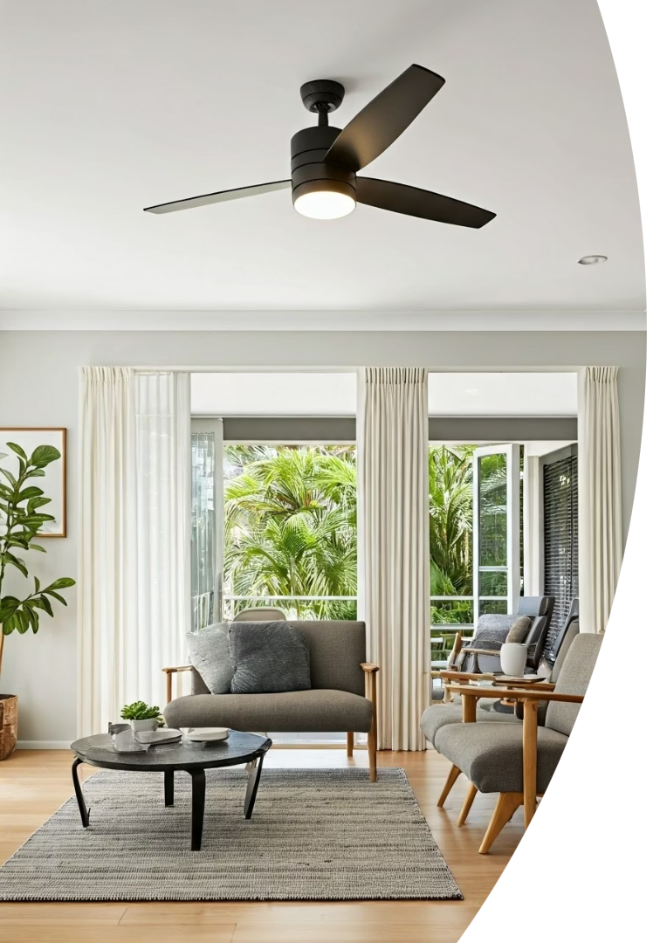
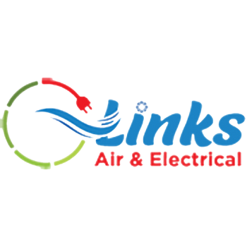

Beat the Brisbane Heat: Ceiling Fan Installation
Trusted in Brisbane for safe, efficient ceiling fan installation.
Ceiling Fan Installation Brisbane - Done Right!
https://linksairelectrical.com.au/
Notes:
1

Slide 2
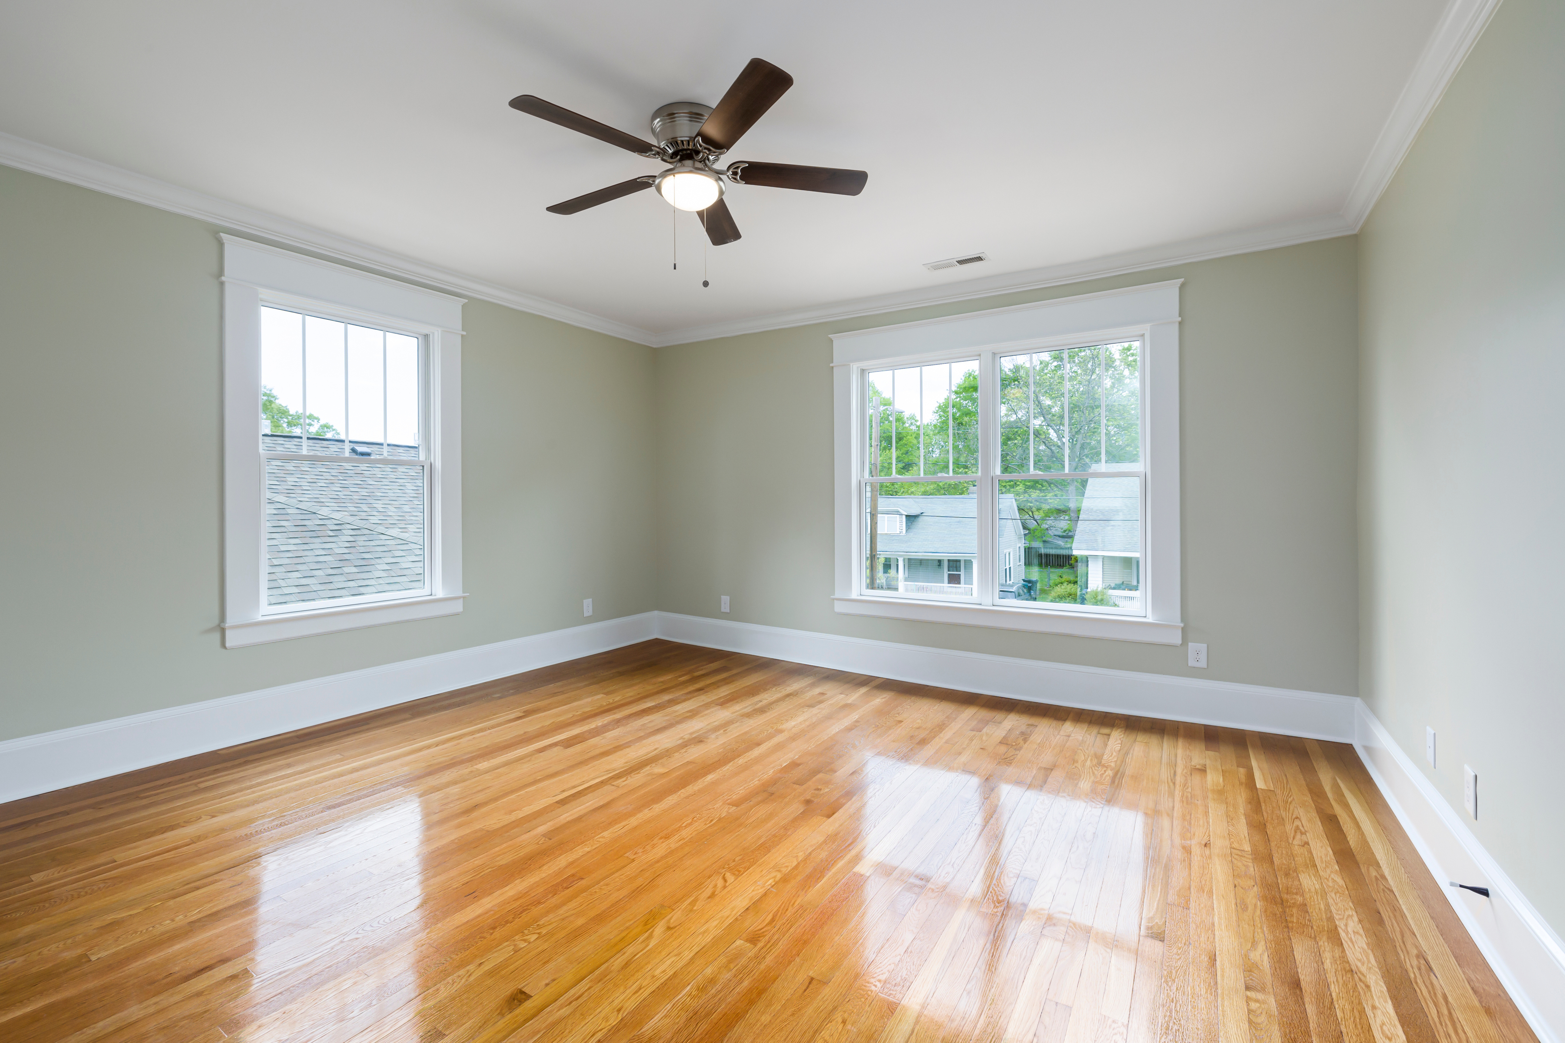



Why Choose Ceiling Fans?
Energy Efficient
Better Airflow
Save up to 40% on cooling costs compared to air conditioning.
Circulates air to reduce humidity and increase comfort.
Stylish Designs
Matches any room decor with modern and classic options.
https://linksairelectrical.com.au/
Notes:
2

Slide 3
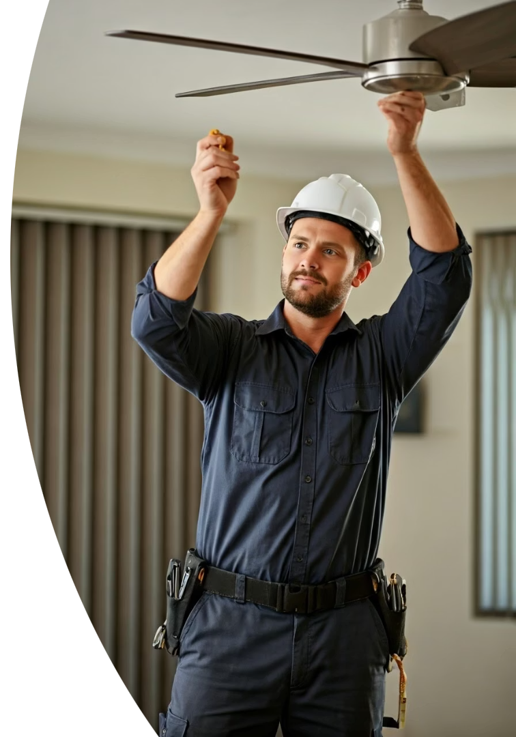

Links Air & Electricals: Your Brisbane Fan Experts
Licensed & Insured
Reliable Workmanship
Certified electricians ensuring your peace of mind and safety.
Guaranteed installation quality with attention to detail.
10+ Years in Brisbane
Experienced team dedicated to serving local homes and businesses.
https://linksairelectrical.com.au/
Notes:
3

Slide 4
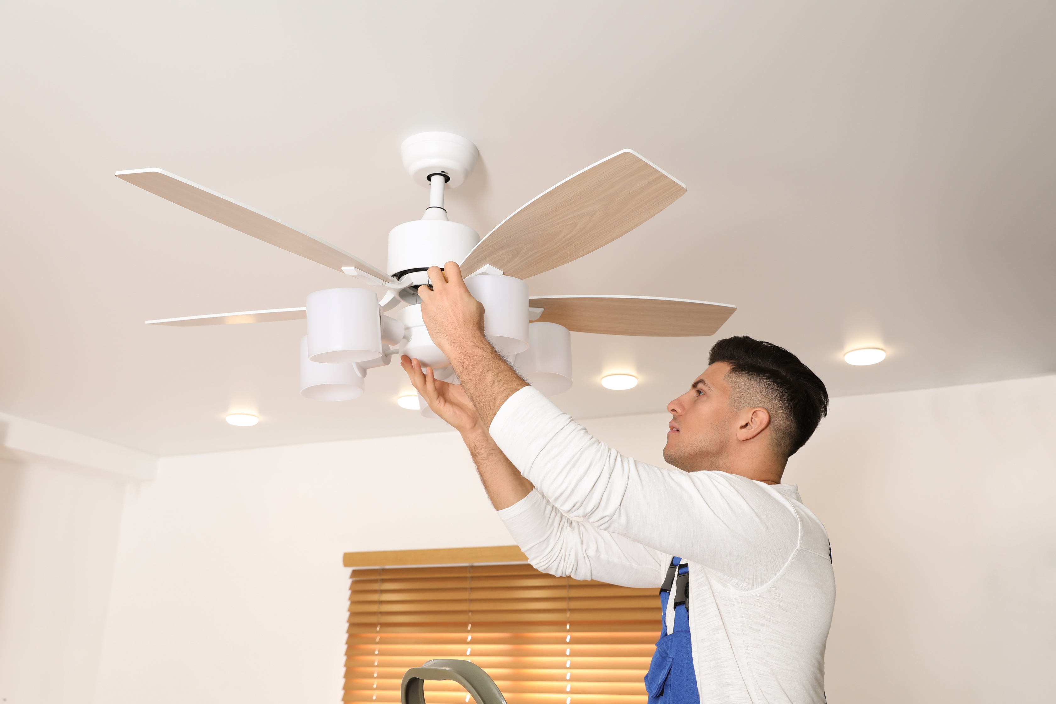




The Installation Process
Free Quote
No surprises, transparent pricing upfront.
Safety Check
Ensuring secure, compliant mounting for your ceiling fan.
Professional Installation
Expert fitting for optimal fan operation and durability.
Final Testing
Confirming functionality and your satisfaction before sign-off.
https://linksairelectrical.com.au/
Notes:
4

Slide 5
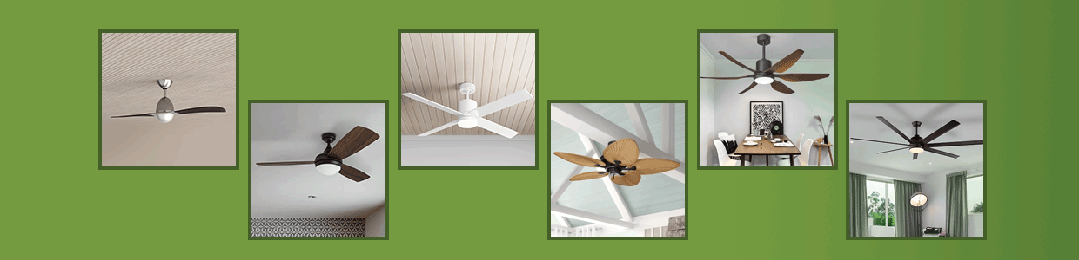
Wide Range of Options
Indoor & Outdoor Fans
Remote Controlled
Trusted Brands
Choose durable fans designed for any environment.
Convenience and control at your fingertips.
  Hunter
  Fanco
  Mercator
Notes:
5

Slide 6

Get Your Free Quote Today!
Contact Links Air & Electrical
info@linksairelectrical.com.au
Call Now
Phone: 1300 010 393
Visit Our Website
linksairelectrical.com.au
Notes:
6

