Slide 1

Emergency Relief Vents VS. Rupture Discs
Which One Does Your Facility Need?
+91 9156463116/5/4
sales@vcplin.com
www.vcplin.com

Slide 2
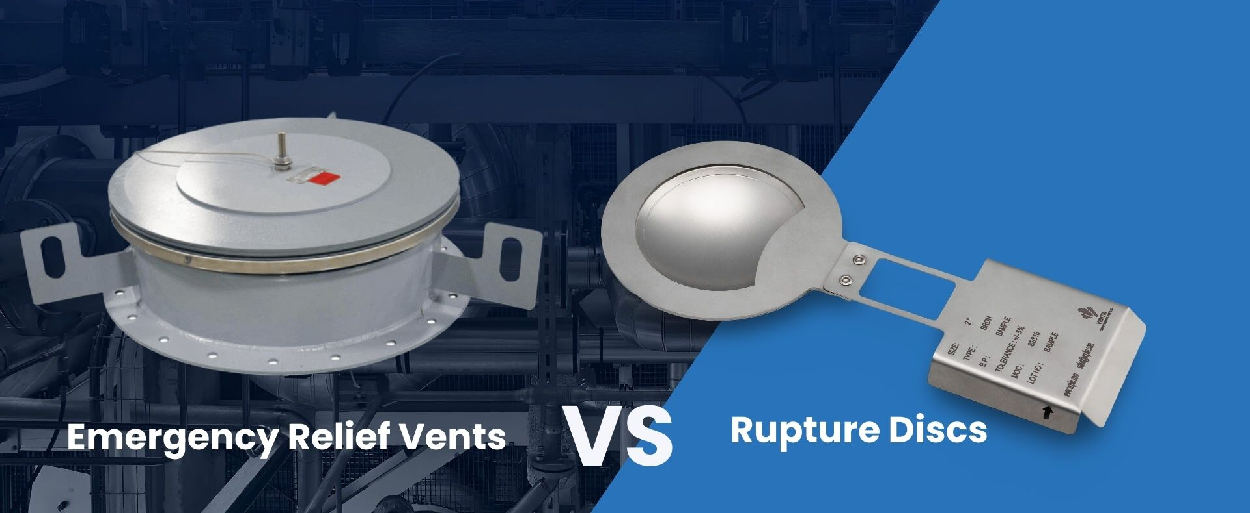
Introduction :
Industrial facilities face serious risks from overpressure events like explosions or equipment failure. To prevent disasters, two critical solutions are commonly used: emergency relief vents and rupture discs. While both protect against pressure buildup, they work differently and suit different applications.
In this guide, we'll compare emergency vents and rupture discs to help you choose the right protection for your operation — ensuring safety, compliance, and system reliability.
+91 9156463116/5/4
sales@vcplin.com
www.vcplin.com

Slide 3
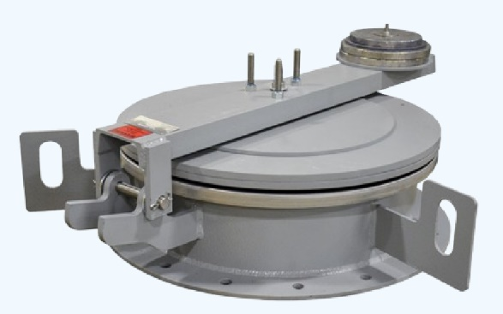
What Are Emergency Relief Vents?
Devices that rapidly open to relieve sudden pressure build-ups, especially from explosions.
Applications: Dust collectors, grain silos, chemical storage tanks.
Key Features:
    Lightweight design for fast reaction.
    Can often be reset after activation.
    Compliant with NFPA 68 for explosion venting.
+91 9156463116/5/4
sales@vcplin.com
www.vcplin.com

Slide 4
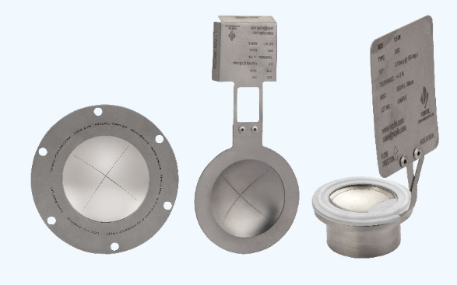
What Are Rupture Discs?
Single-use devices that burst at a specific pressure to protect equipment from catastrophic failure.
Applications: Pressure vessels, reactors, pipelines, pharmaceutical processing.
Key Features:
Ultra-fast response to overpressure events.
No moving parts — maintenance-free.
Compatible with ASME and PED standards.
+91 9156463116/5/4
sales@vcplin.com
www.vcplin.com

Slide 5
Key Differences: Emergency Relief Vents vs. Rupture Discs
Feature | Emergency Relief Vents | Rupture Discs
Operation | Opens under pressure, resealable models available | Bursts at predetermined pressure
Speed | Fast for explosions | Instantaneous burst
Reusability | Some reusable | Single-use only
Best For | Dust explosion, deflagration control | Liquid/gas overpressure, chemical containment
Certifications | NFPA 68, OSHA | ASME Section VIII, PED, ISO
+91 9156463116/5/4
sales@vcplin.com
www.vcplin.com

Slide 6
When to Choose an Emergency Relief Vent:
Use emergency relief vents when:
Dealing with combustible dust hazards.
Protecting low-pressure storage vessels like bins, silos, or dust collectors.
Needing compliance with NFPA 68 and OSHA explosion protection standards.
Resetting the system quickly after an event matters.
+91 9156463116/5/4
sales@vcplin.com
www.vcplin.com

Slide 7
When to Choose a Rupture Disc
Use rupture discs when:
Protecting high-pressure vessels and piping systems.
Working with toxic or corrosive gases and liquids.
Needing a zero-leakage pressure protection solution.
Pairing with pressure relief valves (PRVs) for system redundancy.
+91 9156463116/5/4
sales@vcplin.com
www.vcplin.com

Slide 8
Can Emergency Vents and Rupture Discs Work Together?
Yes! Many industries layer protection using both.
Example: A rupture disc installed upstream of an explosion vent.
Advantages: Enhanced safety, compliance with multi-layer protection codes.
+91 9156463116/5/4
sales@vcplin.com
www.vcplin.com

Slide 9
Final Decision: Which Is Best for Your Facility?
Choose emergency relief vents for dust explosions and low-pressure venting.
Choose rupture discs for high-pressure containment and precision overpressure protection.
Always consult safety standards like NFPA 68, ASME, and OSHA before choosing.
+91 9156463116/5/4
sales@vcplin.com
www.vcplin.com

Slide 10
📞 Need Help Selecting the Right Protection?
Choosing between an Emergency Relief Vent and a Rupture Disc depends on your process, pressure levels, and safety requirements. Contact Ventil today for a free system assessment. Our experts will help you select, size, and install the right emergency relief vents or rupture discs for your specific needs.
+91 9156463116/5/4
sales@vcplin.com
www.vcplin.com

Slide 11
Conclusion
Ventil provides a complete range of high-performance pressure safety solutions, including rupture discs, bursting discs, flame arrestors, explosion vent, flameless venting and other essential pressure relief components. Designed for reliability and efficiency, our products ensure maximum protection across industries such as, pharmaceuticals, oil & gas, and manufacturing, reinforcing our commitment to safety, innovation, and quality.
+91 9156463116/5/4
sales@vcplin.com
www.vcplin.com

Slide 12




Speak with Our Expert:
Ventil Components Pvt Ltd. 246/9, Maan Hinjawadi, Phase1, Tal- Mulshi, Pune
411057, Maharastra
+91 9156463116/5/4
sales@vcplin.com
www.vcplin.com
+91 9156463116/5/4
sales@vcplin.com
www.vcplin.com

