Slide 1
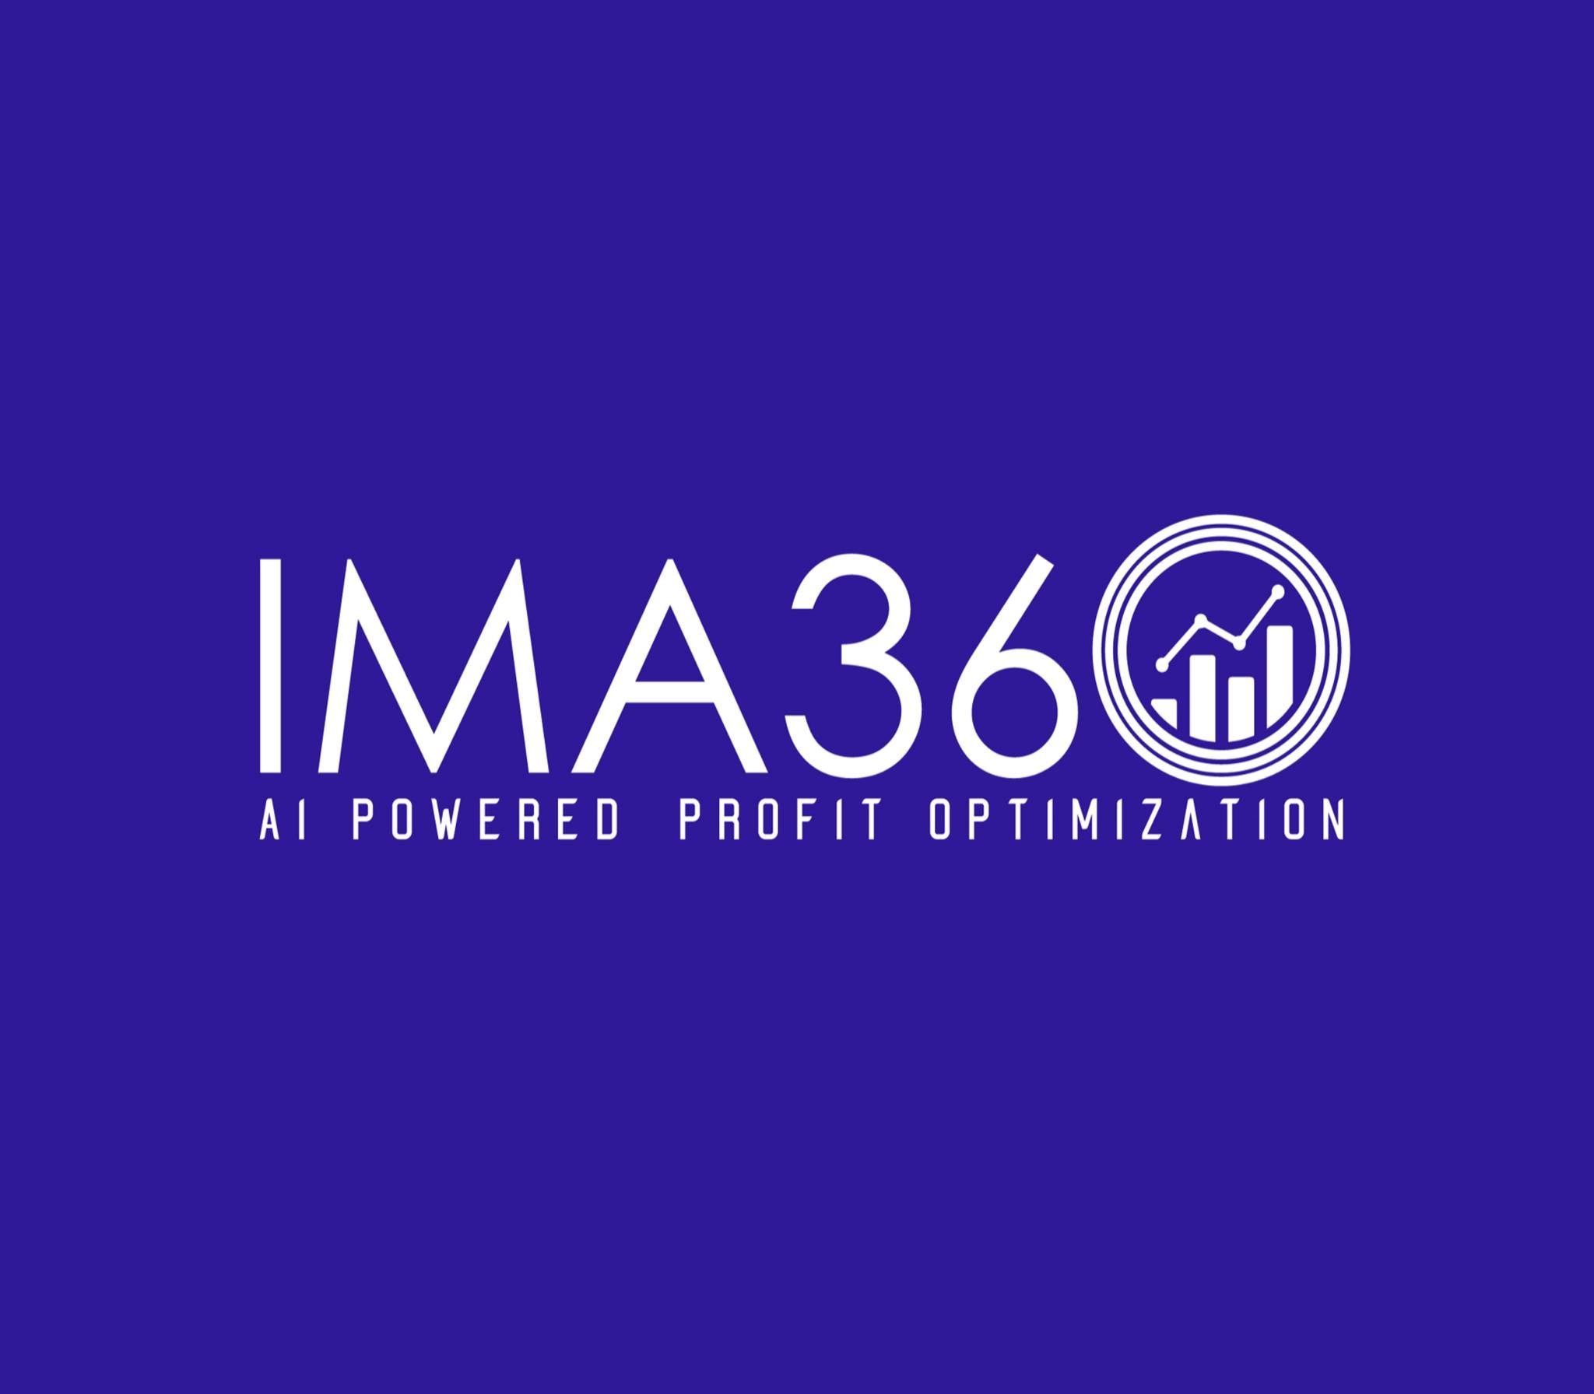
Enhancing Sales and Profitability with Advanced Pricing and Rebate Solutions
https://ima360.com/

Slide 2
Because the market moves quickly today, firms must use advanced tools to manage pricing, rebates and their sales processes. Using customer rebate tracking tools, pricing software and teaming up with proven cpq companies helps you master the art of price and promotion optimization.
Managed by a Customer Rebate Tracking Software
Incentives such as rebates help keep customers loyal and increase overall sales, but as your business gets larger, handling them can become difficult. The use of Customer Rebate Tracking Software allows companies to automatically track and check rebate deals, resulting in true displays of rebates and payments on time.
Thanks to this software, companies can see what they owe in rebates and track customer actions. With fewer clashes and less paperwork, both sales and finance can turn to forming ways to meet targets instead of checking every invoice.

Slide 3
How Pricing Optimization Software Helps Driving Profitability
Price matters a lot in helping your business gain revenue and outperform competitors. This software uses information from data and the market to choose the best prices to satisfy customers and increase profits.
When companies adopt pricing optimization software, they can set new prices according to influences such as season, the competition’s pricing and stock numbers. Thanks to its flexibility, you can maintain good margins and act promptly to new market situations.
Picking the Best Partner: Top Companies in CPQ
Configure, Price, Quote (CPQ) software makes sure sales processes are automatic and the prices given are accurate. Selecting the correct cpq software providers can improve how easy and successful selling becomes.
By integrating easily with CRM and ERP systems, leading cpq software makes it simple to set up product configuration and apply pricing rules. Connecting these methods results in consistent operations, fewer errors and faster processing for sales.

Slide 4
Bringing solutions together to help optimize prices and promotions
Firms that succeed understand that combining pricing, promotions and rebates into one strategy is needed. This process unites these factors to increase sales while keeping profits high.
With the help of customer rebate tracking software, pricing optimization software and respected CPQ solutions, businesses understand how promoting and setting prices influence both sales and clients’ actions.

Slide 5
Contact Us
Feel free to contact us for any questions and doubts​ on
https://ima360.com/
Phone No:
+1 214-584-6660
Email Address:
info@ima360.com
Head Office:
6600 Chase Oaks Blvd. Ste. 150, Plano, TX 75023

