Slide 1
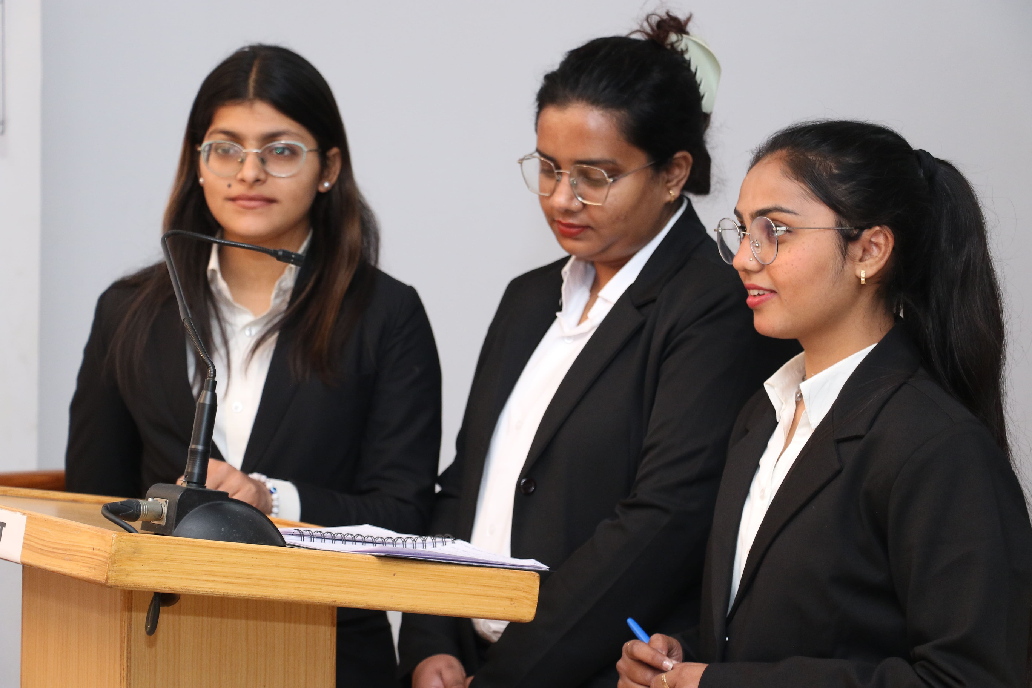

MBA in Healthcare & Hospital Management College in Uttar Pradesh

Slide 2
MBA in Healthcare & Hospital Management program at SRMU,
Lucknow
  Comprehensive Curriculum: The program offers a well-rounded curriculum covering IT, healthcare, project management, and Hospital Management Information Systems (HMIS).
  Flexible Learning Options: Classes are conducted in a hybrid mode—both offline and online—during weekends or suitable business hours.
  Industry Collaboration and Internships: The program boasts collaborations with premier corporate hospitals for internships, training, and placements.
  Specialization and Elective Choices: In the second year, students can choose from various specializations such as Human Resource, Marketing, Finance, International Business, Operations Management, and Entrepreneurship & Family Business Management.
  Career Opportunities and Placement Support: Graduates of the program are well-prepared for roles like Health Information Manager, Healthcare Consultant, Clinical Services Manager, and Hospital Administrator.

Slide 3

ADDRESS
Shri Ramswaroop Memorial University
Village - Hadauri, Post - Tindola, Lucknow-Deva Road
Phone: 18001026004, +91-9120007948
Email: examination.cell@srmu.ac.in, admissions@srmu.ac.in

Slide 4

Thank You
Visit - https://srmu.ac.in/program/m-b-a-healthcare-hospital-management

