Slide 1


B.Tech. in CSE (Cyber Security)
https://srmu.ac.in/program/b-tech-cse-cyber-security

Slide 2

B.Tech. in CSE (Cyber Security)
at SRMU
Shri Ramswaroop Memorial University (SRMU) in Lucknow offers a B.Tech. in Computer Science Engineering (CSE) with a specialization in Cyber Security. This program, developed in collaboration with L&T, provides students with a robust curriculum covering areas such as ethical hacking, cryptography, network security, and threat intelligence. Students gain practical experience through access to L&T-certified labs and live projects, preparing them for careers in cyber security roles like ethical hacker, security engineer, and penetration tester.

Slide 3

ADDRESS
Shri Ramswaroop Memorial University
Village - Hadauri, Post - Tindola, Lucknow-Deva Road
Phone: 18001026004, +91-9120007948
Email: examination.cell@srmu.ac.in, admissions@srmu.ac.in

Slide 4
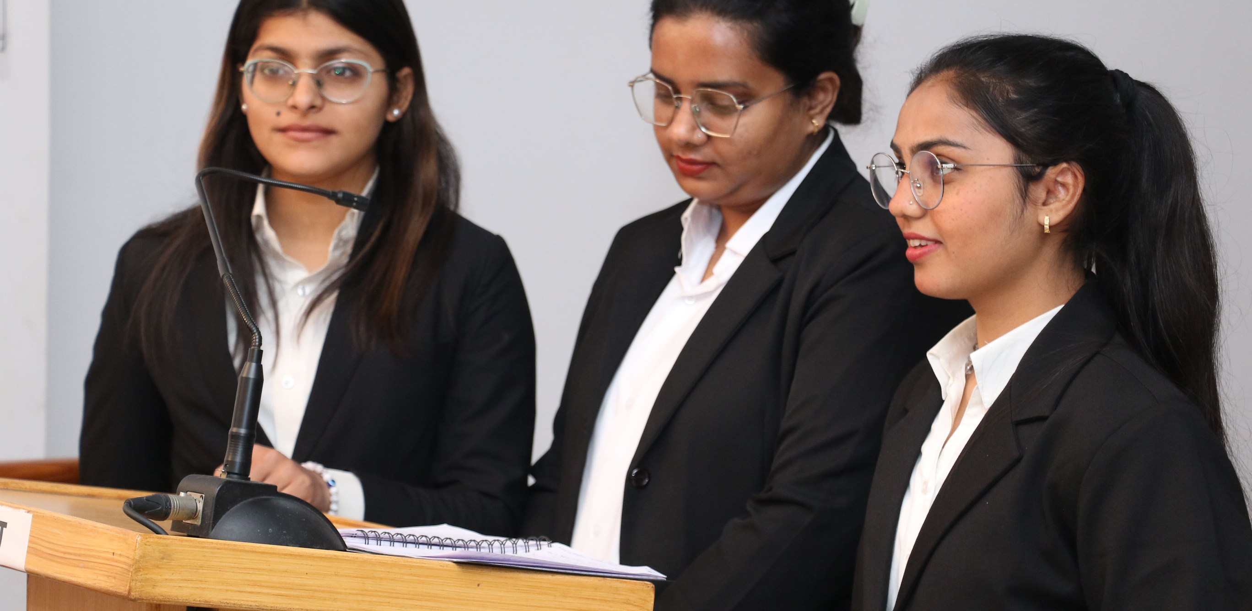
Thank You
Visit - https://srmu.ac.in/program/b-tech-cse-cyber-security

