Slide 1


B.Tech. in Civil Engineering Colleges in Lucknow
Visit - https://srmu.ac.in/program/b-tech-civil-engineering

Slide 2

The B.Tech. Civil Engineering program at Shri Ramswaroop Memorial University (SRMU) offers a comprehensive 4-year undergraduate curriculum, emphasizing practical learning through lab work, field visits, and industry collaborations. Students gain expertise in areas like structural, environmental, transportation, geotechnical, and water resource engineering, preparing them for diverse roles in infrastructure development and related sectors.

Slide 3
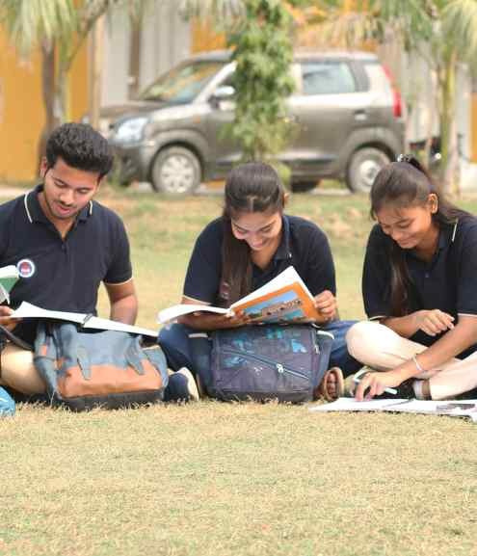
Address: Village - Hadauri, Post - Tindola, Lucknow-Deva Road
Pin: 225003
Phone: 18001026004, +91-9120007948
Email: examination.cell@srmu.ac.in, admissions@srmu.ac.in
Website: https://srmu.ac.in/

Slide 4
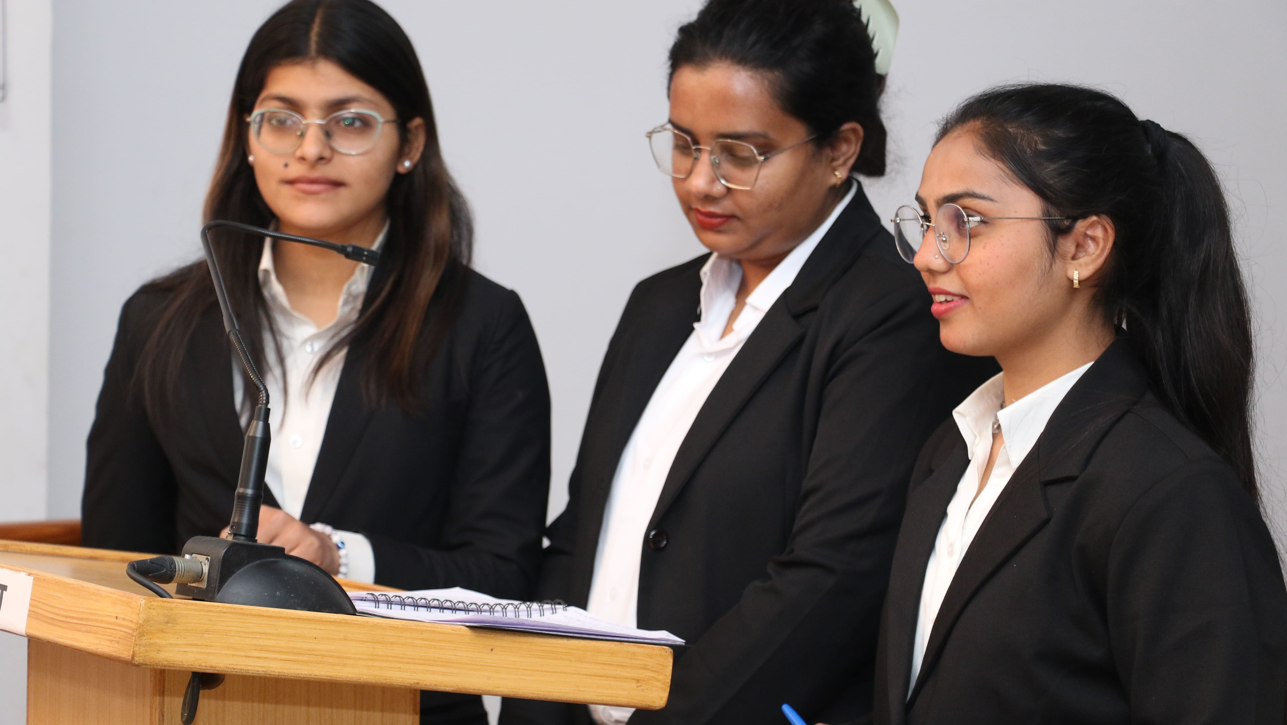
Thank You for Watching
For more details, visit- https://srmu.ac.in/program/b-tech-civil-engineering

