Slide 1


Shri Ramswaroop Memorial University
B.Sc. (Hons.) Biotechnology College in Uttar Pradesh

Slide 2
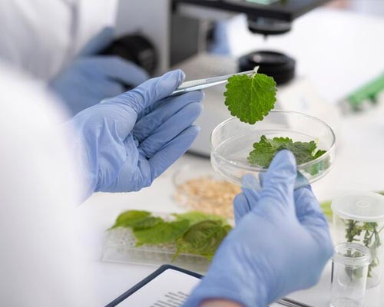
SRMU's B.Sc. (Hons.) Biotechnology program integrates molecular biology, genetics, and biochemistry, emphasizing research and development to equip students for impactful careers in biotechnology. Students gain hands-on lab experience and exposure to industrial training, enhancing their practical skills. The curriculum aligns with current scientific innovations and career opportunities in pharma, agriculture, and healthcare.

Slide 3
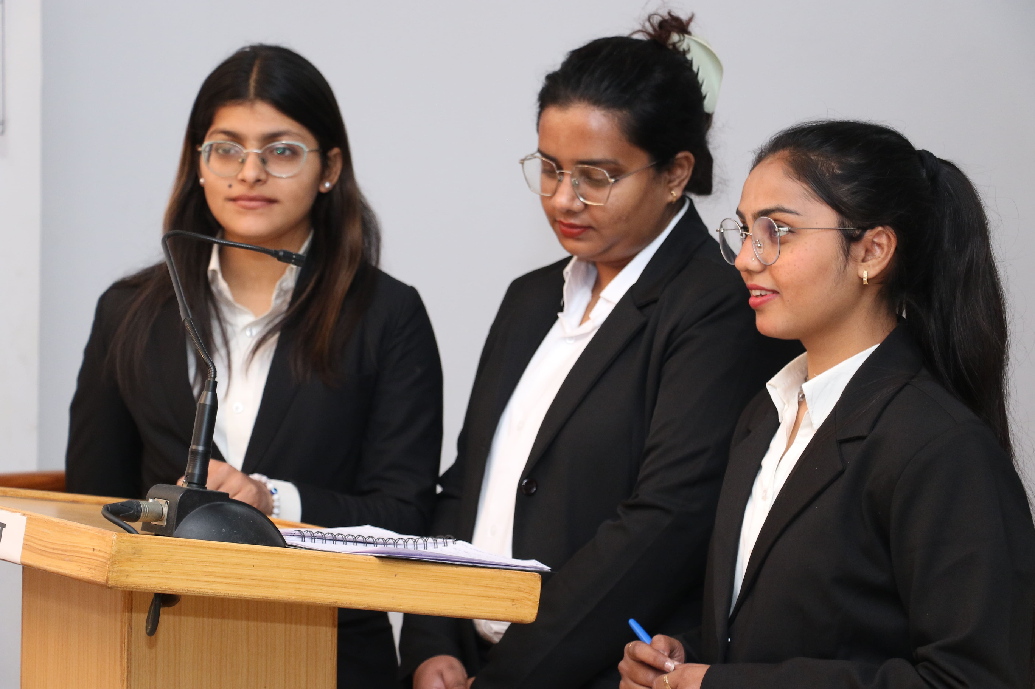
Address: Village - Hadauri, Post - Tindola, Lucknow-Deva Road
Pin: 225003
Phone: 18001026004, +91-9120007948
Email: examination.cell@srmu.ac.in, admissions@srmu.ac.in
Website: https://srmu.ac.in/

Slide 4

Thank You for Watching
For more details, visit- https://srmu.ac.in/program/b-sc-hons-biotechnology

