Slide 1

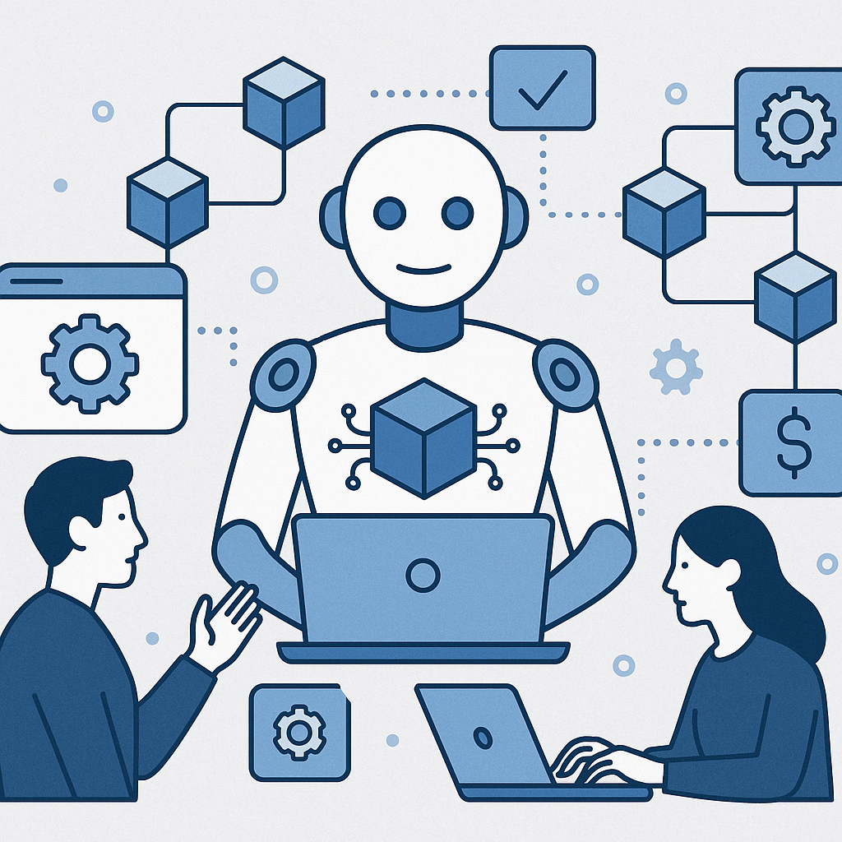
How Enterprises Are Using AI Agents in Blockchain-Based Automation
www.blockchainx.tech

Slide 2
Experiencing a hyper-digital business realm today, enterprises have been changing rapidly towards next-gen technologies to attain more operational efficiency, improved transparency, and agile decision making. Artificial Intelligence (AI) and blockchain are two of the technologies responsible for the conversion. They create one of the strongest alliances where blockchain enforces security and trust while AI instills intelligence and autonomy. We now see a steep rise in AI agents-an autonomous digital entity capable of performing complex tasks-being embedded within blockchain ecosystems. This integration allows enterprises to automate many manual, data-intensive processes much faster and with greater reliability. Hence, organizations are increasingly seeking the assistance of an experienced AI agent development company in designing and developing systems that think, act, and learn in decentralized environments.

Slide 3
What Are AI Agents?
AI agents are intelligent software programs that perceive through their environment, interpret data, and take actions to achieve specific goals. With traditional methods of automation, AI agents dynamically make decisions, adapting to new information and drawing on past experience. AI agents do work continuously and act without having a person supervise them and then can be designed to have different degrees of autonomy-from a simple task-oriented bot to a complex multi-functional agent.
In an enterprise environment, AI agents are fulfilling several roles: customer service bots that map user behavior, financial agents who trade accounts, and logistics agents who detect changes in delivery issues and reroute shipments. This flexibility and learning ability make the agents a very important element in the whole automation system, especially when these agents are embedded into blockchain platforms demanding secure, trustable execution.

Slide 4
The Role of Blockchain in Automation
  Smart contracts that self-execute an agreement upon the fulfillment of pre-discussed conditions so that intermediaries wouldn't be required.
  Transparent audit trails that register all reports, regardless of purchase or payment stages.
  Immutable data records verifiable and trustworthy by all parties.
  Tokenization mechanisms that help companies create incentive-led ecosystems.

Slide 5
How AI Agents Enhance Blockchain-Based Systems
  Analyze off-chain data and provide smart contracts on the blockchain with the necessary insights.
  Predict an outcome based on the historical data stored on the blockchain, such as failure prediction of equipment in manufacturing scenarios.
  Make context-aware decisions, such as dynamic pricing adjustment in a decentralized marketplace.
  Coordinate with other agents within decentralized networks to attain collective objectives, manage shared resources, or submit bids for certain services.

Slide 6
Enterprise Use Cases: AI Agents + Blockchain
1.Supply Chain Management
In enterprises, AI agents track goods along world supply chains, detect anomalies and manage inventory in real-time. The blockchain technology makes sure that all shipment-related data is securely stored and verifiable by all participants-retailers, manufacturers, and suppliers.
2. DeFi
Within DeFi ecosystems, AI agents function as automated financial advisors managing portfolio compositions, balancing liquidity pools, and making trades according to market dynamics. Blockchain thus ensures all transactions are transparent, accountable, and protected.

Slide 7
3. Healthcare
AI agents are deployed by hospitals and research centers to go through huge medical datasets, aid in diagnosis, and manage patients. In this case, blockchain makes sure that sensitive health records are shared securely only with authorized parties and in a manner that ensures compliance and trust.
4. Insurance
An AI agent can automatically verify claims based on an analysis of uploaded documents and corroborating data sources. Moreover, when claims and the blockchains are used together, claims can be recorded immutably, allowing for immediate policy checks, fraud detections, and payments through smart contracts.
5. Energy Sector
AI agents in smart grids govern the distribution of energy, study consumption patterns, and implement dynamic pricing. Blockchain brings the trust and security layer necessary to allow decentralized billing systems and peer-to-peer energy trading.

Slide 8
Benefits for Enterprises
  Operational Efficiency: By automating the decision processes and execution thereof, companies can grow faster and fall fewer errors.
  Cost Reduction: Manual intervention in AI workflow processes merely adds up to labor costs and administrative overhead.
  Enhanced Trust: Blockchain discloses a transparent ledger for customers, partners, and regulators to trust each other.
  Resilience and Security: Due to their decentralized nature, such systems are not going to succumb to a single point of failure and cannot be tampered with.
  Faster Decision Making: By way of real-time analytics and autonomous execution, enterprises will react immediately to changes occurring in markets.

Slide 9
Tools & Platforms Powering This Integration
  Fetch.ai – Provides a decentralized platform to create and deploy autonomous agents that interact with smart contracts or data feeds.
  Ocean Protocol – Supports secure, decentralized data-sharing so that AI agents may access datasets for machine learning without sacrificing data privacy.
  Chain Link – Works as a reliable, decentralized oracle to connect smart contracts to real-world data for better decisions by AI agents.
  SingularityNET – Enables AI developers to monetize their models, and AI agents can collaborate and compose new services in the decentralized marketplace.
  Hyperledger Fabric – A modular blockchain framework intended to be implemented for enterprise use for the support of smart contracts and permissioned networks in which AI agents may safely operate.

Slide 10
Conclusion
Implementation of AI agents into blockchain-based automation is rapidly changing the way enterprises operate-smart, fast, and secure. This powerful synergy makes business entities shifting from reactive operating to proactive and predictive operating models. As the decentralized systems grow intelligent, they provide opportunities to have truly autonomous business ecosystems where decisions and transactions are executed with no manual oversight.
To remain competitive in this changing environment, an organization must explore all options for AI agent development services that fit their strategic basis as well as competences. Whichever industry organizations that invest today in intelligent decentralized automation will be defining the industries of tomorrow.

Slide 11





thank you!
  +91 7708889555
  www.blockchainx.tech
  contact@blockchainx.tech

