Slide 1


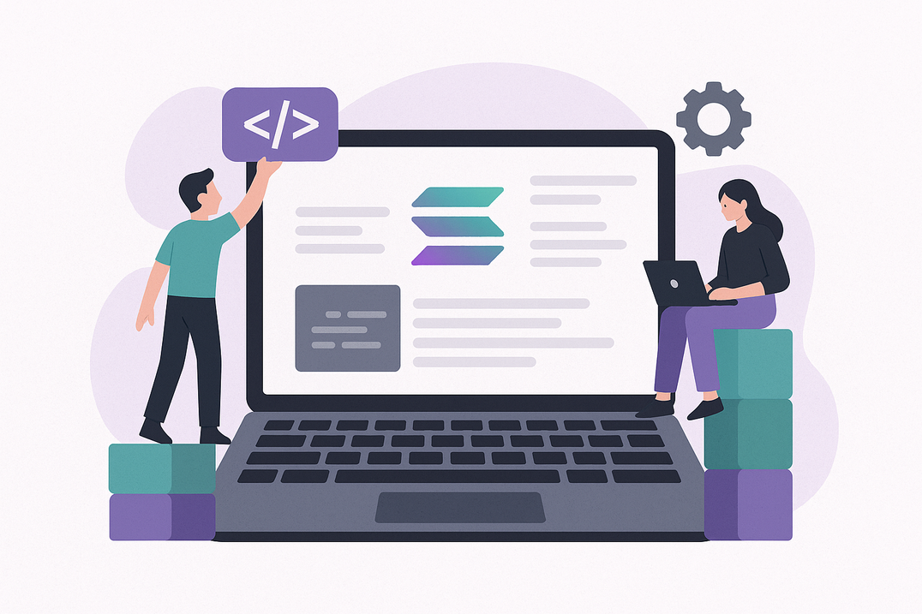
Build on the Fastest Blockchain - Hire Solana Developers Who Scale
www.blockchainx.tech

Slide 2
In the fast-paced blockchain space, speed, scalability, and developer performance are exigent. As dApps grow more intricate with greater user demand, companies must ensure their infrastructures scale well without loss of efficiency. And this is where Solana comes third. Being one of the fastest and cheapest blockchains that exists today, Solana allows developers to conceive next-generation applications with nearly zero latency and full performance.
If you are a startup founder, product manager, or CTO looking to build your next big Web3 product, it is imperative to Hire Solana developers who are well conversant with the core architecture of the blockchain while being able to build secure, scalable, and user-friendly applications. The right Solana developer is the one that enables you to unlock the full capacity of this high-speed ecosystem faster than your competitors to bring out real value to your users. Whether DeFi platform, NFT marketplace, or GameFi experience you are building, Solana is the launchpad—and great developers are the engine.

Slide 3
Why Solana?
Among blockchains, Solana stands out because its revolutionary Proof of History (PoH) method combines with Proof of Stake (PoS) for a swift and highly efficient consensus. Able to handle greater than 65,000 transactions per second and with block times as low as 400 milliseconds, Solana offers an ideal site for applications that need to be fast and interactive. Its low cost, usually below one cent per transaction, has become a huge goodwill for users worldwide, even for large-scale use cases. This makes Solana a particularly ideal choice for sectors such as DeFi, NFTs, real-time gaming, and supply chain management, where delays and fees can kill a deal. Selecting Solana as your base means you are laying your foundation on a blockchain designed for the future.

Slide 4
What to Look for in a Solana Developer
Hiring the right Solana developer goes beyond just checking a list of programming languages. Although knowledge of Rust or C, the languages primarily used in Solana smart contracts, is required, a really good Solana developer will deliver so much more. Look for developers who know the core Solana concepts, such as Sealevel—the parallel smart contract runtime—and can use this knowledge to build secure and scalable programs with frameworks such as Anchor. They should understand Solana's account model, composability, and real-time transaction execution. Strong problem-solving skills, deploying live dApps, and understanding the broader Web3 stack (IPFS, wallets, oracle integrations, and so forth) will set a developer apart as a world-class developer who will begin meaningfully contributing to your product from day one.

Slide 5
Benefits of Building on Solana
Interfacing with Solana developers renders your project an extremely advanced infrastructure in the blockchain ecosystem. From the perspective of scalability, Solana can downsize an application to a few thousand or even millions of users, all without compromising speed or cost. Hence, it allows for a richer user experience, be it for crypto transactions in a blink, NFT drops in a live auction, or quick-paced multiplayer gaming. Furthermore, with Solana's massive developer community and ecosystem, plenty of libraries, tools, and integrations can speed up your build cycle. With the right Solana developers, you can reduce time-to-market, assure long-term performance, and foster innovations that simply cannot be realized on comparatively slower congested chains.

Slide 6
How to Hire the Right Solana Developers
Hiring expert blockchain developers is a cutthroat game, especially for high-demand chains like Solana. Do a background check on potential candidates by evaluating some of their previous work: contributions on GitHub, deployments on-chain, or perhaps their name in the community could act as some of the indicators of their skills. Consider developers who also participate in Solana hackathons and work on open-source projects within the ecosystem. Whether you intend to recruit a workforce or seek out an agency, conduct technical interviews that test coding skills and also the candidate's knowledge of decentralized systems and secure contract development. Communication ability, openness for rapid technical shifts, and asynchronous working skills are other qualities very critical, especially while hiring for remote work.

Slide 7
Conclusion
The blockchain space is advancing at a breakneck pace-and Solana is leading that charge. If you are truly passionate about developing high-performance decentralized apps that scale with ease while still providing the best user experience, then success begins with the team. As Solana manages to gain some sort of global attention and adoption, the demand for Solana developers has sky-rocketed, and now it is equally important to hire those that can give you an edge.
Do not slow your momentum with talent gaps. Instead, Hire top remote Solana developers who bring deep technical expertise, battle-tested experience, and an eagerness to build in the Web3 space. With the right talent beside you, you will not just be developing an app but the future of decentralized technology.

Slide 8




Thank You
CONTACT US
www.blockchainx.tech
contact@blockchainx.tech
+91 7708889555

