Slide 1

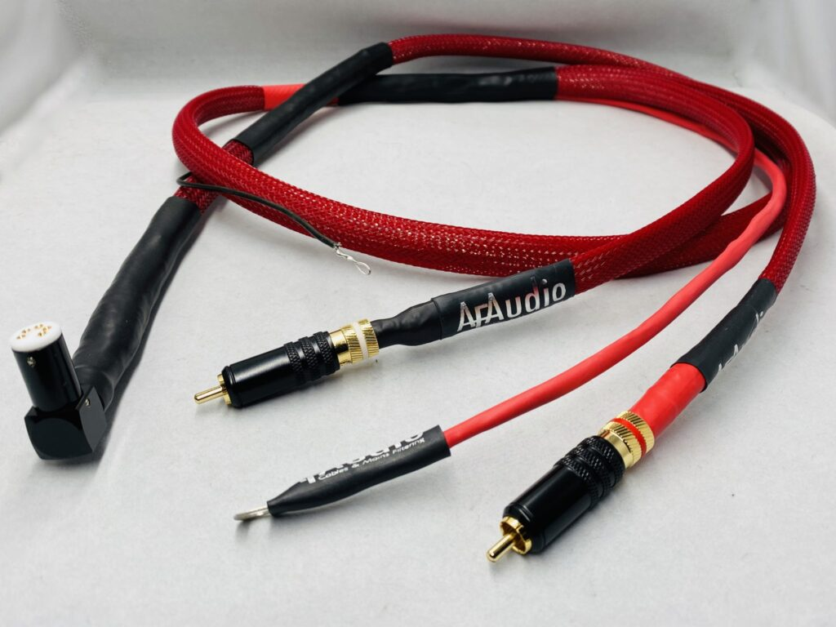

RCA to RCA Interconnect Cable
Discover the essential link for your analog audio. This presentation will cover the RCA to RCA interconnect cable, focusing on the high-quality offerings from afaudio.co.uk.
by Af Audio
https://afaudio.co.uk
Notes:
1

Slide 2
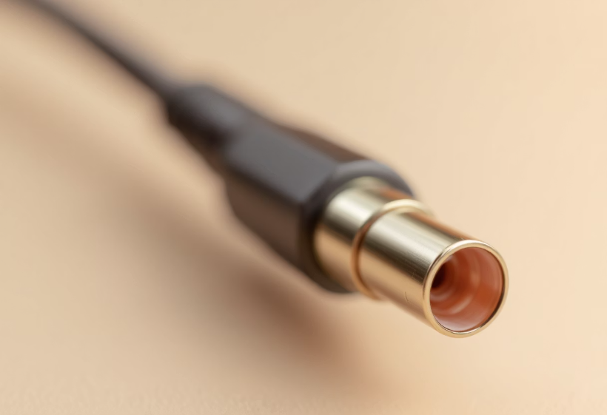
What is an RCA Interconnect Cable?
An RCA interconnect cable is a coaxial cable. It features an 8.3 mm connector. It transfers low-frequency analog signals.
This cable is common in home audio systems. It is crucial for clear sound. It operates between 0–100 MHz.
https://afaudio.co.uk
Notes:
2

Slide 3



Key Technical Features
Oxygen-Free Copper
Double-Balanced Geometry
Gold-Plated Connectors
Enhances dynamics and clarity. Conductors ensure pure signal.
Prevents corrosion. Ensures stable connections.
Improves signal-ground isolation. Reduces interference effectively.
https://afaudio.co.uk
Notes:
3

Slide 4
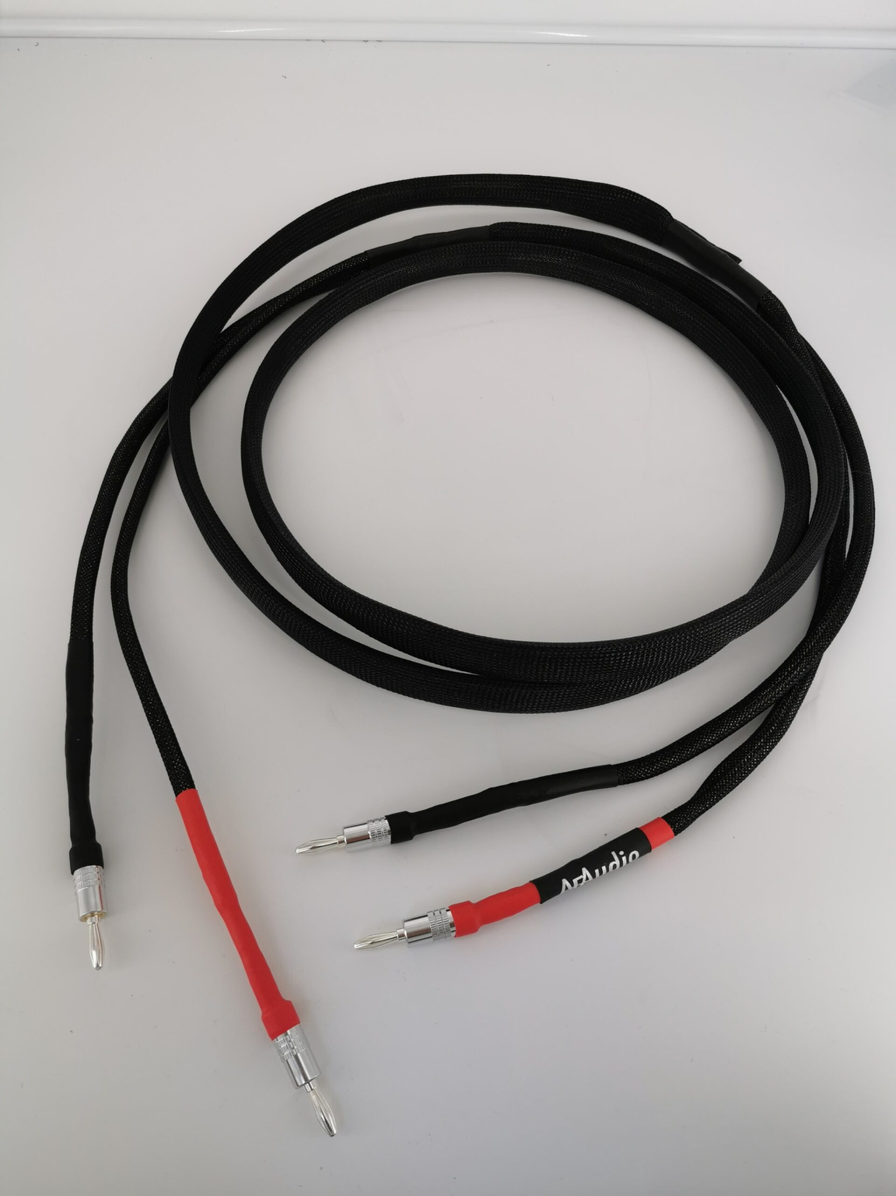



Construction and Materials
Precision Connectors
Sturdy and precisely machined. Ensures a perfect fit.
High-Quality Shielding
Reduces noise and signal interference. Protects audio integrity.
Cold-Welded Connections
Minimizes distortion from solder. Provides a purer signal path.
https://afaudio.co.uk
Notes:
4

Slide 5



Product Benefits
Richer Audio
2
Dynamic sound reproduction. Experience full range of tones.
Enhanced Soundstage
Expands audio breadth. Lower noise floor delivers clarity.
1
3
Long-Lasting Durability
Reinforced connectors. Built for prolonged use.
https://afaudio.co.uk
Notes:
5

Slide 6
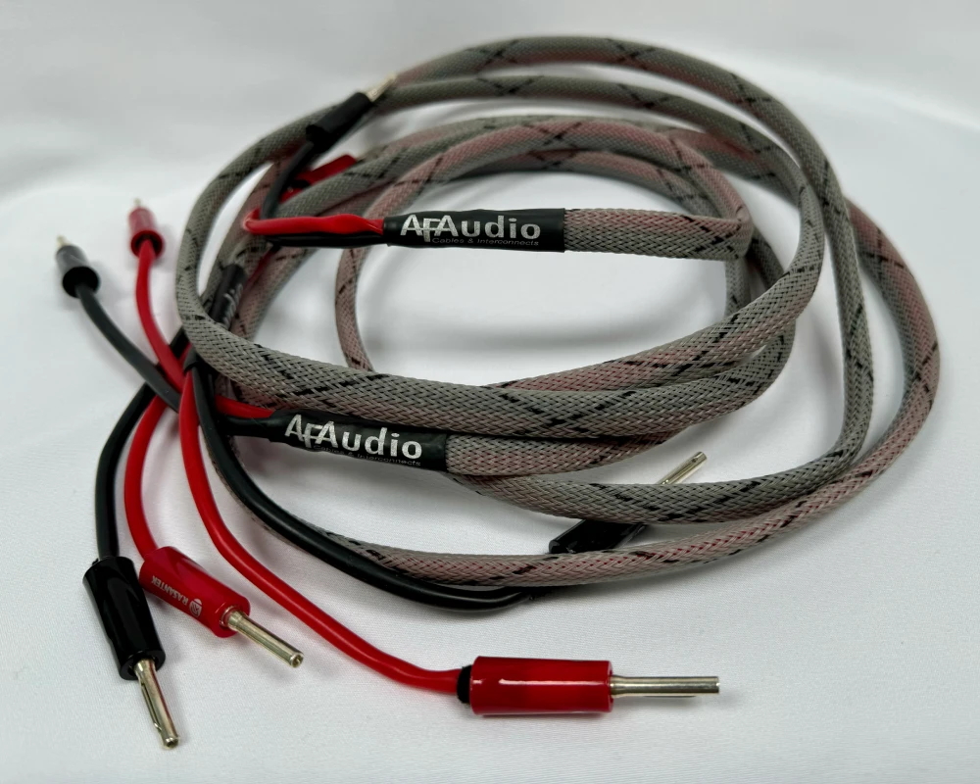
Typical Applications
Source Components
Receiver Integration
Connects CD players, DACs. Links turntables to amplifiers.
Integrates AV receivers. Connects with stereo components.
Audio Setups
Used in home audio systems. Essential for professional setups.
https://afaudio.co.uk
Notes:
6

Slide 7



Tips for Installation & Maintenance
Secure Fit
Ensure snug connector fit. Avoid excessive force.
Handle Carefully
Avoid sharp bends. Protect cable integrity.
Proper Storage
Store in dry, dust-free areas. Ensures cable longevity.
https://afaudio.co.uk
Notes:
7

Slide 8
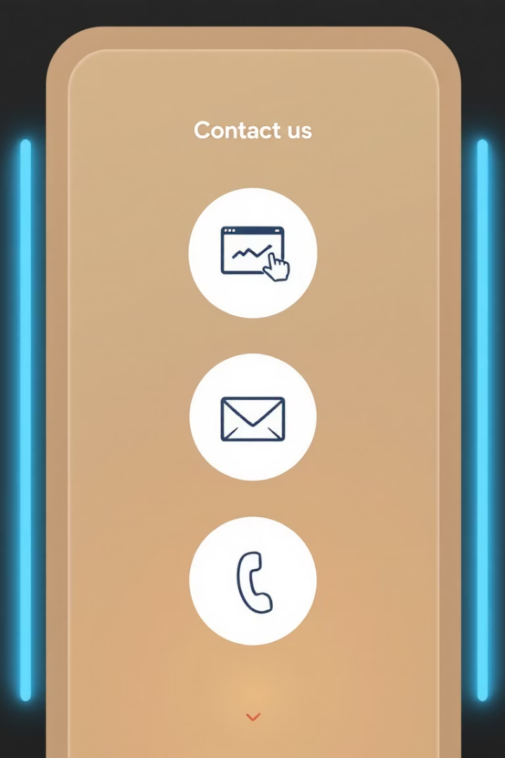
Contact Us
1
2
Visit Our Website
Email Support
afaudio.co.uk
info@afaudio.co.uk
3
Phone Inquiry
07545 197766
Notes:
8

