Slide 1
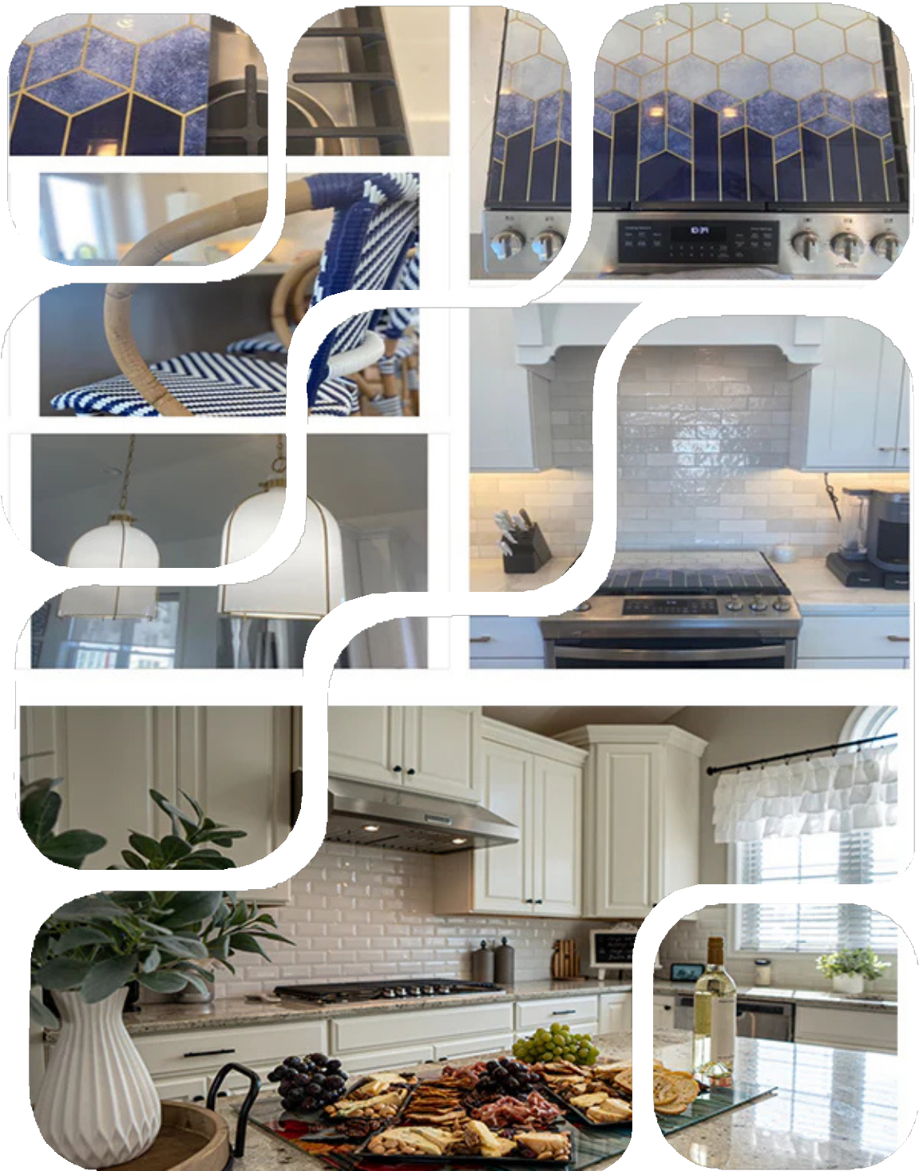
The Rise of Functional Kitchen Decor
EXPLORING THE LATEST KITCHEN DECOR TRENDS
Why Stovetop Covers are Essential in 2025
Festive Fit Home Functional Stove Cooktop Covers

Slide 2
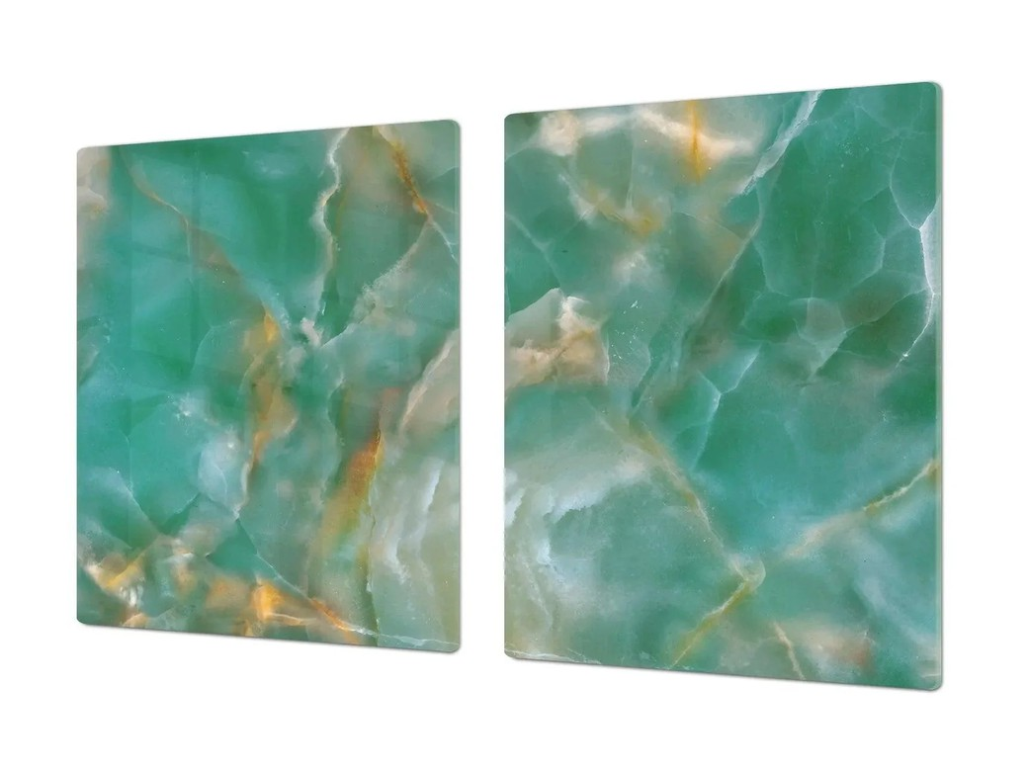
Agenda
Key Points to Cover on Stovetop Covers
Introduction to Functional Decor Benefits of Stovetop Covers Stylish Design Inspirations Current Market Trends
Tips for Implementation

Slide 3
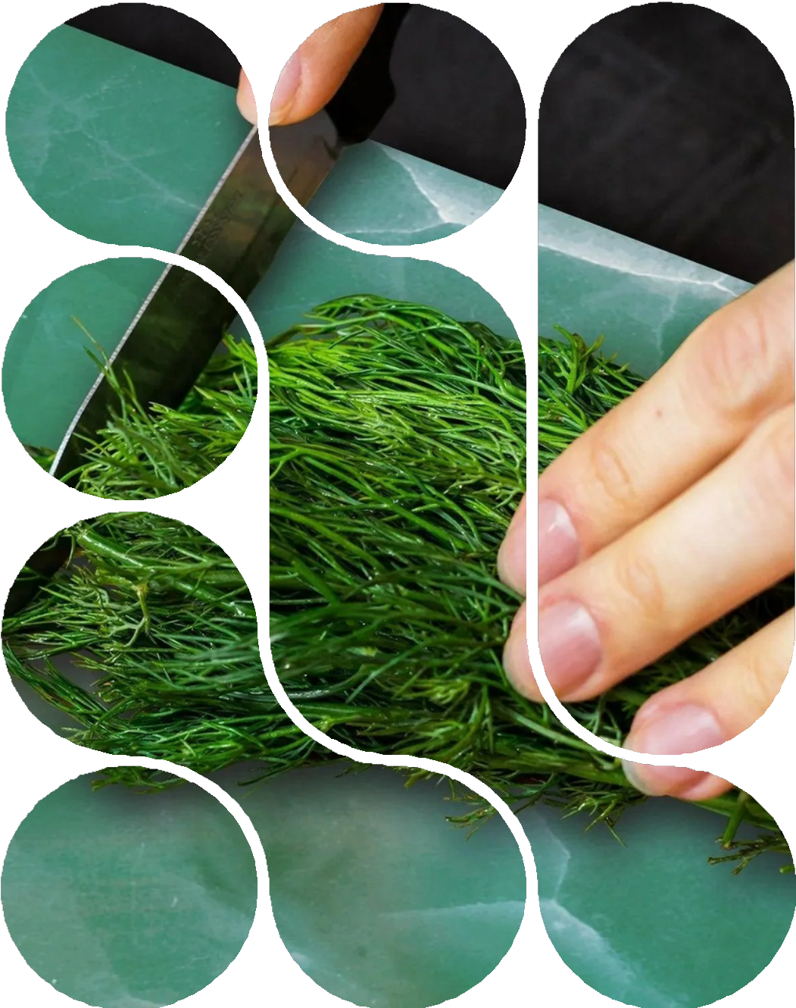
The Beauty of Stovetop Covers
Blending style and practicality in kitchen design
Stove top covers from Festive Fit Home enhance your kitchen's aesthetic appeal while providing extra workspace. This design trend reflects the growing demand for decor that is not only beautiful but also functional, making it a must-have in modern homes.

Slide 4
Space Efficiency: Maximizing Counter Space
Stove cooktop covers provide additional surface area for meal prep and other kitchen tasks.
Key Benefits of Stovetop Covers
Exploring why stovetop covers are essential in modern kitchens
Versatility: Multi-Functional Features
They can serve as serving trays or protect the stovetop while cooking.
Aesthetic Value: Enhancing Kitchen Design
Available in various designs, they add style and elegance to any kitchen space.

Slide 5
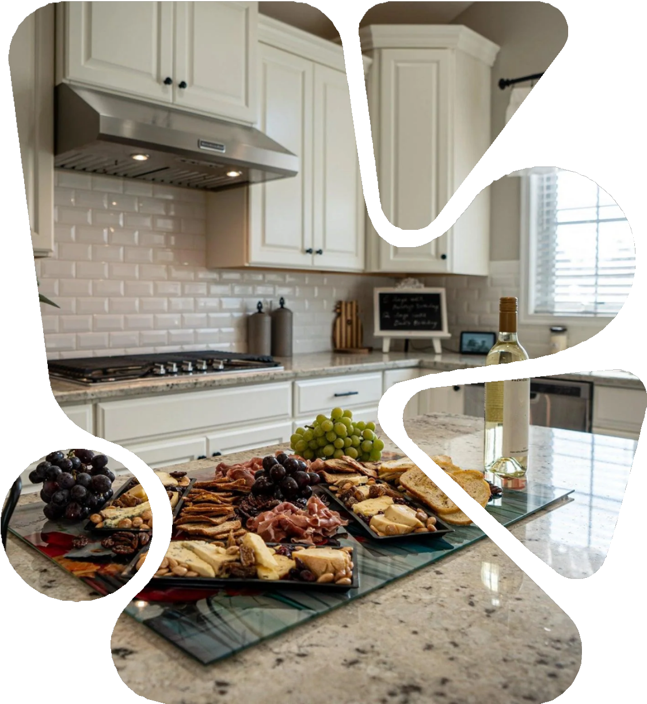
Design Inspirations for Stylish Stovetop Covers
Beautify your kitchen with functional decor pieces
Stovetop covers are not just practical; they also add a touch of style and elegance to your kitchen. With various designs and materials available, these covers can transform your stovetop into a beautiful surface that complements your overall decor.

Slide 6
“Stovetop covers not only enhance the aesthetic appeal of your kitchen but also provide additional workspace, making them an essential element in the modern kitchen of 2025.”
– HOME DECOR EXPERT

