Slide 1

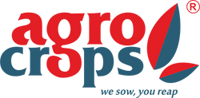
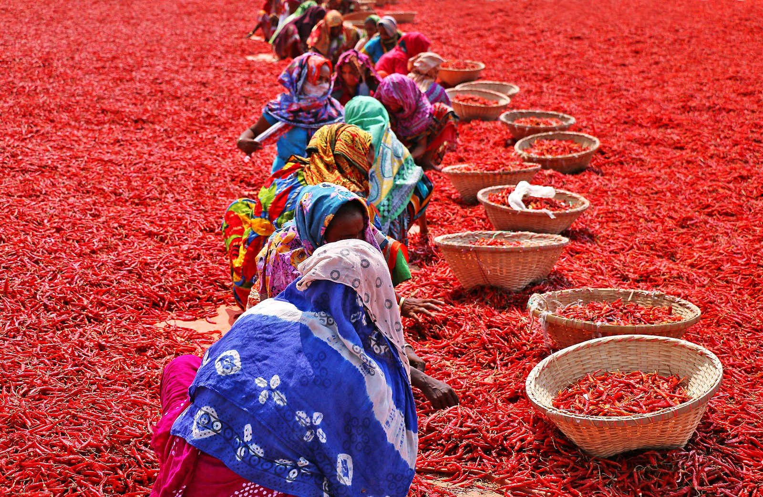
Spices India
Red Chilli Export from India

Slide 2
Indian Dry Red Chilli Varieties offered by Spices India
  LCA-334 (Guntur Sannam) - Widely cultivated in Andhra Pradesh, known for moderate heat and vibrant red color
  Wrinkle-273 - Semi-wrinkled, long chillies with fewer seeds, ideal for making flavorful chilli powder.
  Bhut Jolokia (Ghost Pepper) - Extremely hot chilli from Northeast India, once the world's spiciest variety.
  Byadagi - Mildly spicy, deep red chillies from Karnataka, prized for color and aroma
  Teja-S17 - Highly pungent variety with bright red color, commonly used in spicy Indian dishes.

Slide 3

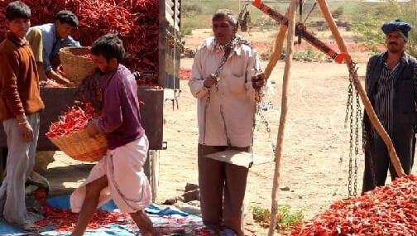


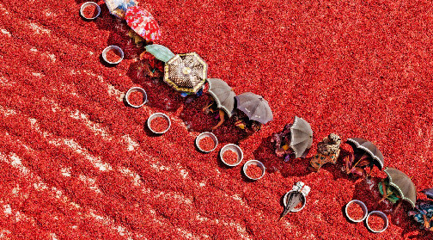


Contact US
91 9701363424
contact@agrocrops.com
https://www.spicesindia.net/types-of-dry-red-chillies-in-india
D.No 25-16-180, 181, Mirichi Yard Road, Guntur, Andhra Pradesh, 522005

Slide 4
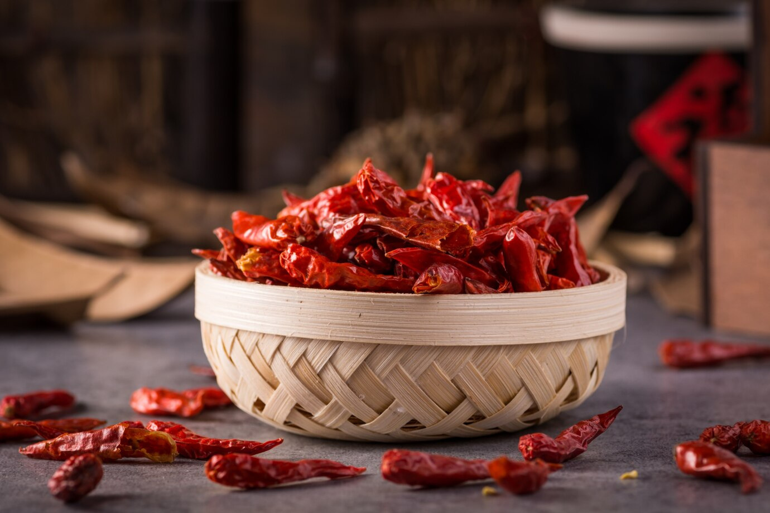
Thank you
Visit -https://www.spicesindia.net/types-of-dry-red-chillies-in-india

