Slide 1

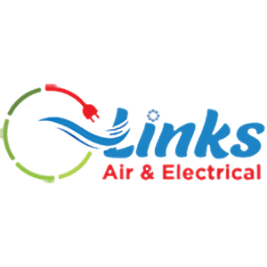
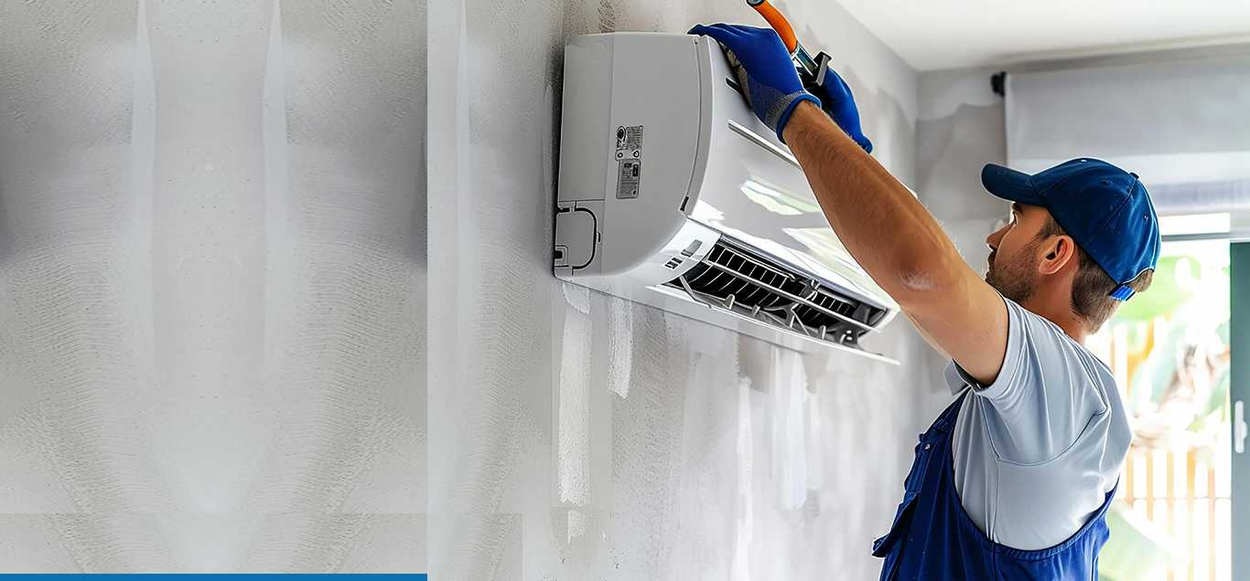

Discover the Comfort of Ducted Air Conditioning
Experience efficient, whole-home climate control with Links Air & Electrical. Enhance your lifestyle and home value with expert service in Brisbane.
https://linksairelectrical.com.au/
Notes:
1

Slide 2
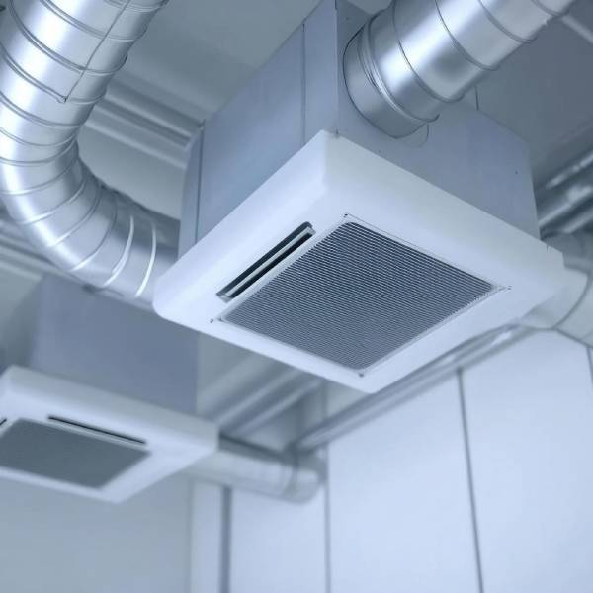
What is Ducted Air Conditioning?
Centralized System
Single Outdoor Unit
Distributes air through ducts concealed in ceilings or floors.
One exterior unit manages the entire home’s heating and cooling.
Zoned Control
Customize temperatures in different home areas independently.
https://linksairelectrical.com.au/
Notes:
2

Slide 3
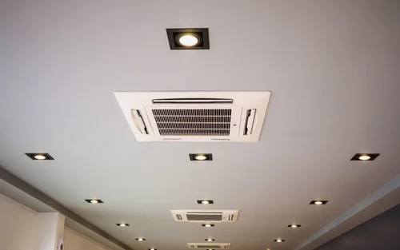
Benefits of Ducted Air Conditioning
Uniform Comfort
Maintains consistent temperature throughout your home.
Quiet Operation
Less noise compared to standalone air conditioning units.
Energy Efficient
Saves on utility bills with smart energy use.
Increased Property Value
Boosts your home's market appeal and resale value.
Notes:
3

Slide 4
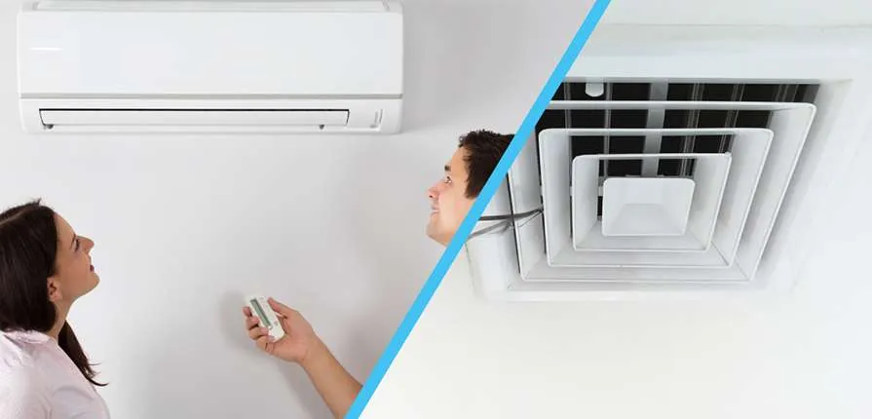
Ducted vs. Split System: Which is Right for You?
Ducted Systems
Split Systems
  Whole-house heating and cooling
  Ideal for individual rooms
  Discreet and integrated vents
  Easier installation
  Higher installation cost but long-term comfort
  Can be less aesthetic
Notes:
4

Slide 5
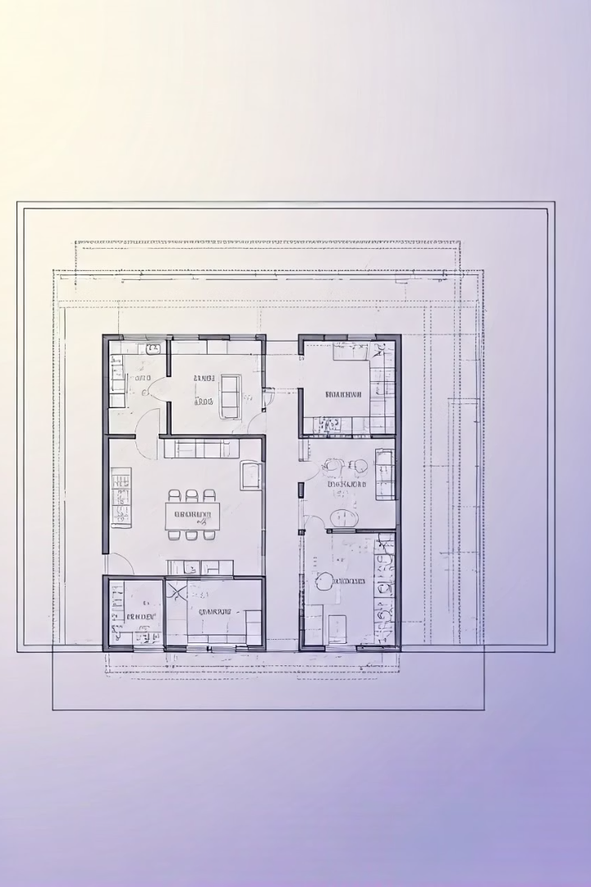
Choosing the Right Ducted System
Home Size & Layout
Determine system capacity based on your home's design.
Number of Zones
Zones affect control and energy efficiency.
Energy Ratings
Choose higher star ratings for cost savings.
Budget Considerations
Balance upfront installation with long-term savings.
https://linksairelectrical.com.au/
Notes:
5

Slide 6
Professional Installation is Key
Correct Sizing
Ensures peak system performance and comfort.
Proper Ductwork
Minimizes energy loss and maximizes efficiency.
Certified Installers
Links Air Electrical provides experienced and safe installation.
Safety Assurance
Avoid costly mistakes with professional service.
Notes:
6

Slide 7
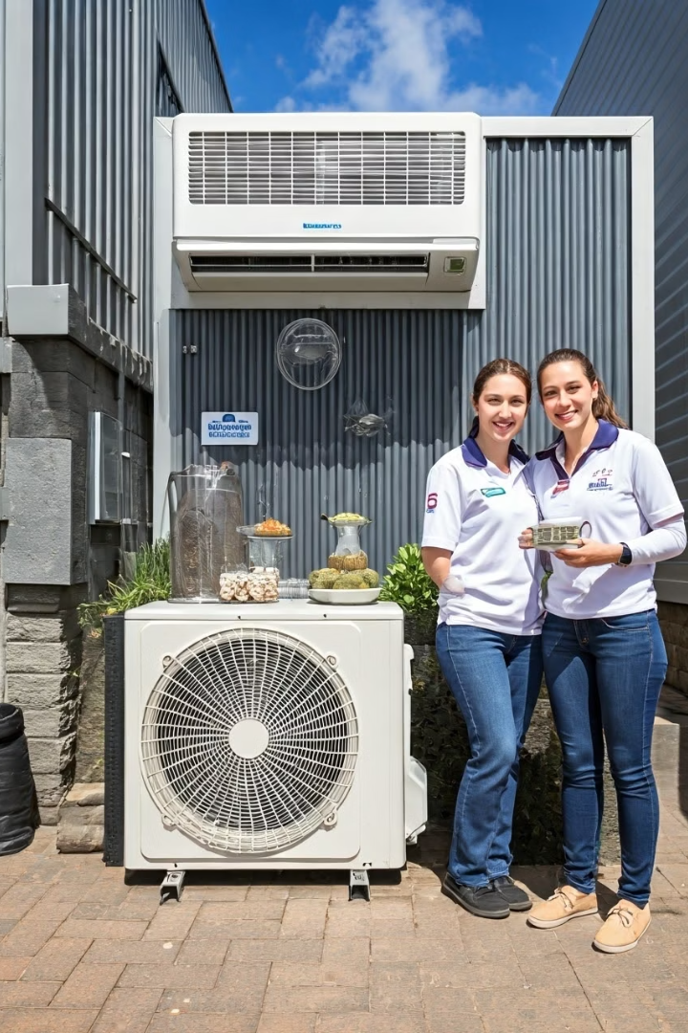





Links Air Electrical: Your Ducted Air Conditioning Experts
Brisbane Specialists
Free Quotes
Local service with expert knowledge of Brisbane homes.
Transparent pricing and tailored solutions.
Ongoing Support
Quality Brands
Maintenance plans to keep your system running smoothly.
Competitive pricing on top air conditioning brands.
Notes:
7

Slide 8
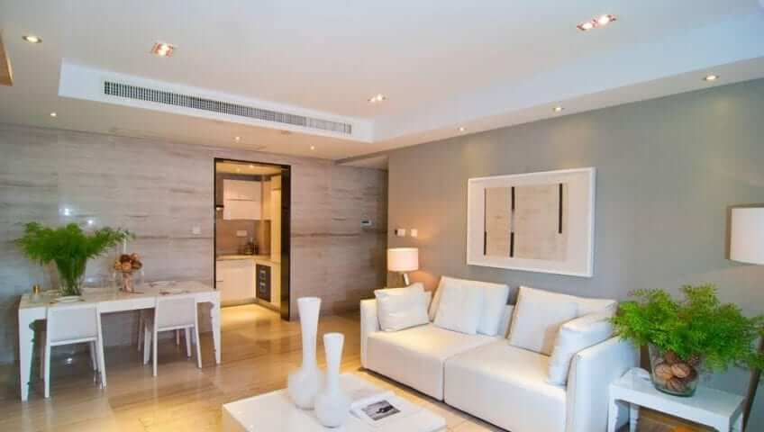




Invest in Comfort and Value Today!
Contact Us
info@linksairelectrical.com.au
Visit Us
Brisbane and Gold Coast
Check out the Website
https://linksairelectrical.com.au/
Call
1300 010 393
Notes:
8

