Slide 1




Building a Crypto Exchange Using a Kraken Clone?

Slide 2


INTRODUCTION
Digital currencies transform the financial environment while cryptocurrency exchanges gain more popularity as businesses enter the market. Entrepreneurs seeking fast and cost-efficient entry into the crypto market should consider developing crypto exchanges through the usage of a Kraken clone system.
The concept of using Kraken clone script for business needs definition along with criteria determining their suitability for different enterprises. This article explains the core points that will guide your decision.

Slide 3
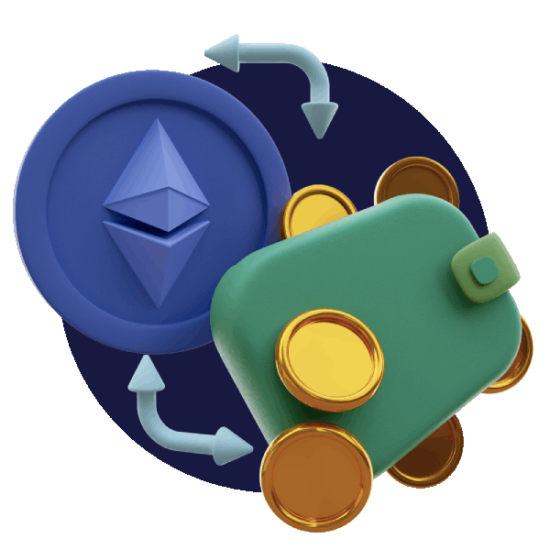
WHAT IS A KRAKEN CLONE?
A Kraken clone presents users with an already developed cryptocurrency exchange script that duplicates the key features of the established Kraken exchange platform. Kraken operates as one of the longest-running crypto exchanges globally while offering secure exchanges through its high-end trading tools and extensive liquidity.
Clones of the Kraken trading system do not steal the brand name but they duplicate the platform operations including trading technology and order processing alongside wallet functionality and management features during customization of look and additional features development. Startups can deploy a complete crypto trading system through a clone script that reduces their development period and expense to market their platform.

Slide 4



Why Choose a Kraken Clone to Build a Crypto Exchange?
1. Faster Time to Market
2. Cost-Effective Solution
3. Proven Business Model
4. Customizable Features
5. Scalability

Slide 5
Steps to Build a Crypto Exchange Like Kraken Clone
1. Research and Planning
2. Choose the Right Clone Script Provider
3. Customize the Platform
4. Implement Wallet and Payment Gateways
5. Deploy Security Protocols
6. Testing and QA

Slide 6
Two-Factor Authentication (2FA)
Security Features of Using Kraken Clone
DDoS Protection
Cold Wallet Storage
Data Encryption
Anti-Phishing Tools

Slide 7

Conclusion
A Kraken clone provides entrepreneurs with an efficient solution to start their entry into the expanding crypto exchange business. Successful entrepreneurs select this route because they gain faster deployment, reduced development costs and utilize the powerful industry-leading platform foundation.
Despite having proper technology components, success requires other fundamental elements as well. Success in this competition requires robust business planning together with effective marketing alongside regulatory compliance alongside platform improvements to achieve market differentiation. Anyone who wants to experience cryptocurrency innovation might achieve success by using a Kraken clone platform as their starting point.

Slide 8
THANK
YOU

