Slide 1


Shri Ramswaroop Memorial University
B.B.A. College in Uttar Pradesh

Slide 2
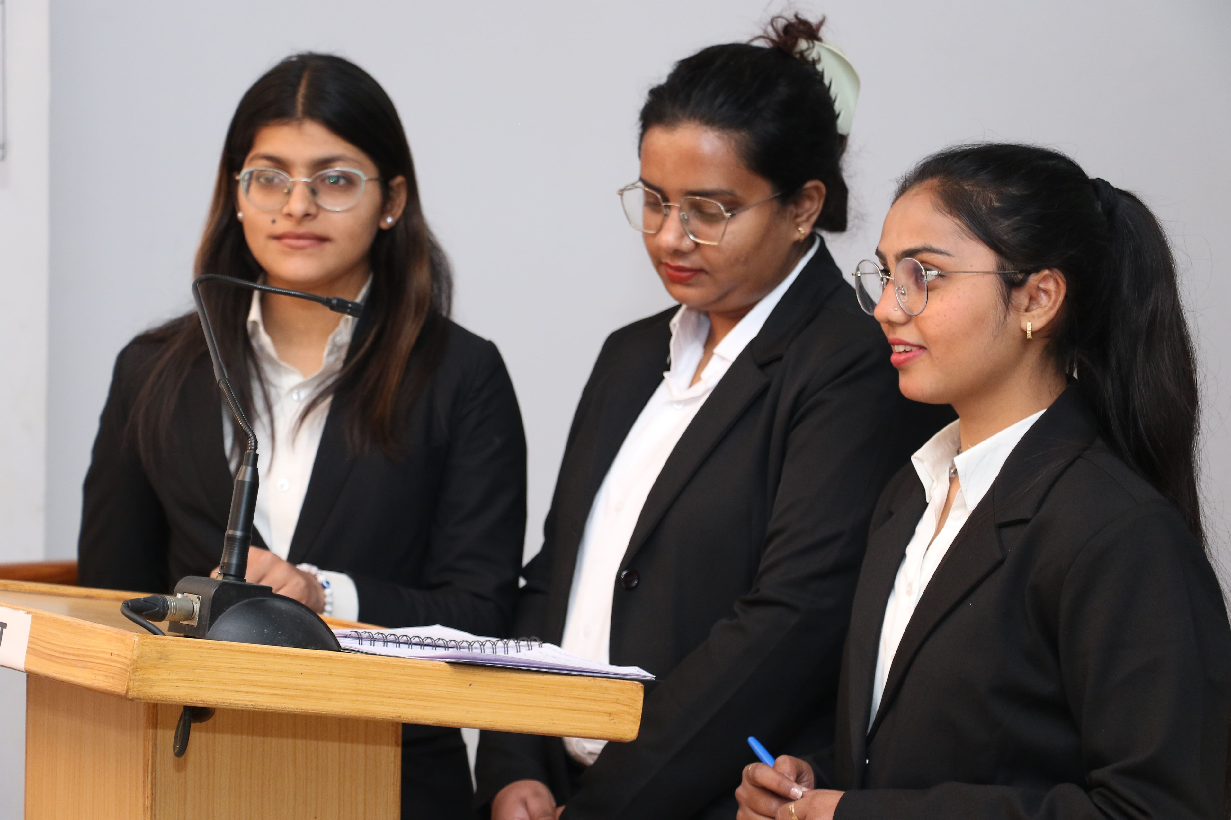
SRMU’s BBA Program Highlights
  Comprehensive Curriculum: Offers courses in marketing, finance, HR, and international business.
  Industry Integration: Includes internships, live projects, and case studies for practical exposure.
  Specialization Options: Provides electives in areas like marketing, HR, and finance.
  Accredited Program: Recognized by NAAC, ensuring quality education standards.
  Placement Support: Collaborations with top corporates for internships and job opportunities.

Slide 3

ADDRESS
Shri Ramswaroop Memorial University
Village - Hadauri, Post - Tindola, Lucknow-Deva Road
Phone: 18001026004, +91-9120007948
Email: examination.cell@srmu.ac.in, admissions@srmu.ac.in

Slide 4
Thank You
Visit - https://srmu.ac.in/program/bba-bachelor-of-business-administration

