Slide 1
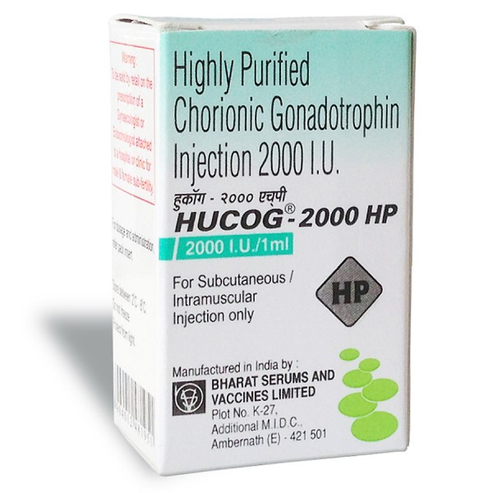

Hucog 2000 injections for Weight Loss

Slide 2
Hucog 2000 injections - Usage
  Stimulates ovulation in women undergoing fertility treatments like IVF or IUI.
  Treats delayed puberty in boys by stimulating testosterone production naturally.
  Supports normal development of eggs in the ovaries for conception.
  Aids in treating male infertility by increasing sperm count and motility.
  Often used in bodybuilding cycles to restore natural testosterone after steroid use.
  May support weight loss by promoting fat metabolism when combined with low-calorie diets.
https://www.safemeds4all.com/product-details/hucog-2000-iu-ml-injection-hcg-high-purity-intramuscular/328.html

Slide 3


+1-800-897-1053
Trustworthy Source for Generic Drugs
https://www.safemeds4all.com/product-details/hucog-2000-iu-ml-injection-hcg-high-purity-intramuscular/328.html

Slide 4



+1-800-897-1053
+1-800-897-1053
www.safemeds4all.com
orders@safemeds4all.com
https://www.safemeds4all.com/product-details/hucog-2000-iu-ml-injection-hcg-high-purity-intramuscular/328.html

Slide 5



+1-800-897-1053
Thank You
https://www.safemeds4all.com/product-details/hucog-2000-iu-ml-injection-hcg-high-purity-intramuscular/328.html

