Slide 1
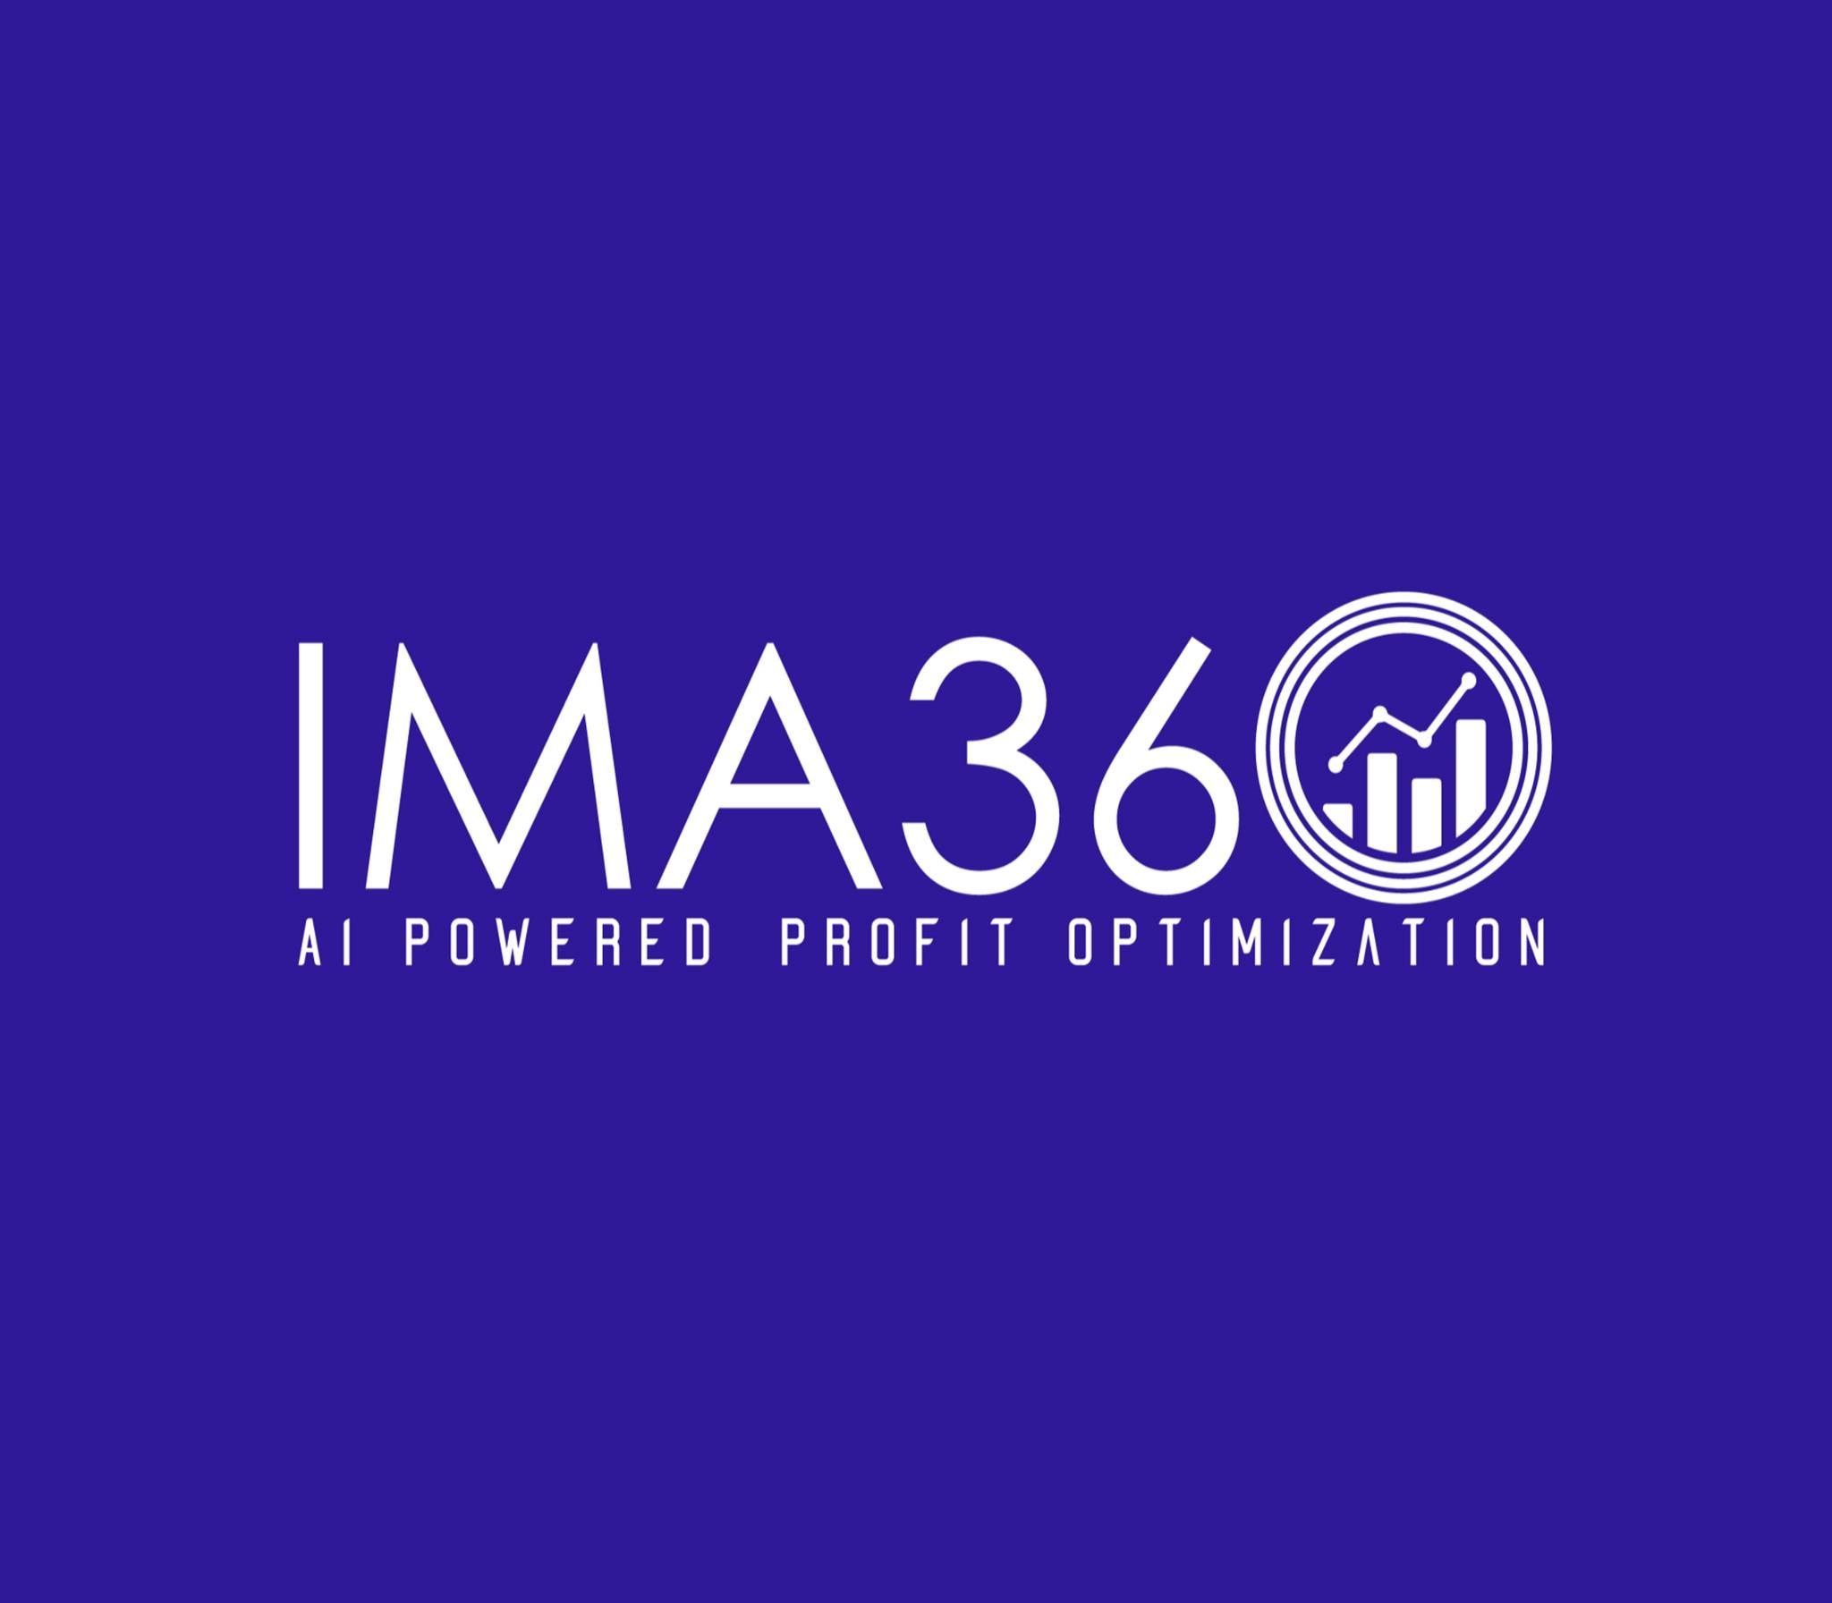
Unlocking Revenue: How Software Pricing, Royalty Management, and CPQ Drive Growth
https://ima360.com/

Slide 2
Businesses are always looking for ways to make the most of their revenue and ensure sales are smooth in the modern software world. They rely on a key trio of strategic software pricing, strong royalty management software and powerful CPQ (Configure, Price, Quote) software. Next, let’s look at how they come together to drive growth.
How to Price Software
There is more to software pricing than simply tagging a price on your product. This means you need to identify customer value, see what others want in the market and align your business objectives. There are many pricing strategies in use, among them are plans based on subscription fees, paying for usage, pricing according to service tiers and pricing to reflect value. The goal is to figure out where customer use is high and money comes in easily. Firms are required to examine ongoing shifts in the market, compare prices set by competitors and hear their customers to ensure their price strategies stay ahead.

Slide 3
Managing your royalty income is easier with the use of royalty management software.
Managing royalties is very important for businesses that license intellectual property. It takes over the difficult jobs of tracking income, determining royalties and organizing agreements related to royalty management. Using this program guarantees that royalty payments are accurate, clear and meet all guidelines. By using accounting software, companies can ensure fewer errors happen, simplify reporting, see performance instantly and maintain reliable relationships with all parties. If they don’t use it, companies may lose money and have issues with their business partners.
CPQ Software Helps Companies Increase Their Revenue
Just imagine how much easier it would be for a sales team to provide accurate quotes in minutes, rather than in days. That’s why cpq softwares is so effective. CPQ is the abbreviation for Configure, Price, Quote and these solutions are built to automate and enhance the way sales quotes are prepared. They give sales reps:

Slide 4
Design difficult products and services without effort, ensuring compatibility and following the business rules.
Set realistic prices, include bundles and discounts and use tiered structures to avoid mistakes and gain more profit.
Create branded, clear quotes and proposals for customers fast and this will both improve their experience and speed up your sales.
Main CPQ software suppliers like Salesforce CPQ, Oracle CPQ, SAP CPQ and Conga CPQ can work very well with typical CRM and ERP systems. Combining all product data, pricing guidelines and sales processes into one system, CPQ enables sales teams to work efficiently, complete more sales fast and see increased profits.
To sum up, effective growth and higher profits in the digital era depend on combining efficient software pricing, solid royalty control and powerful CPQ software. Use these solutions to boost your revenue operations and stay ahead of other companies.

Slide 5
Contact Us
Feel free to contact us for any questions and doubts​ on
https://ima360.com/
Phone No:
+1 214-584-6660
Email Address:
info@ima360.com
Head Office:
6600 Chase Oaks Blvd. Ste. 150, Plano, TX 75023

