Slide 1

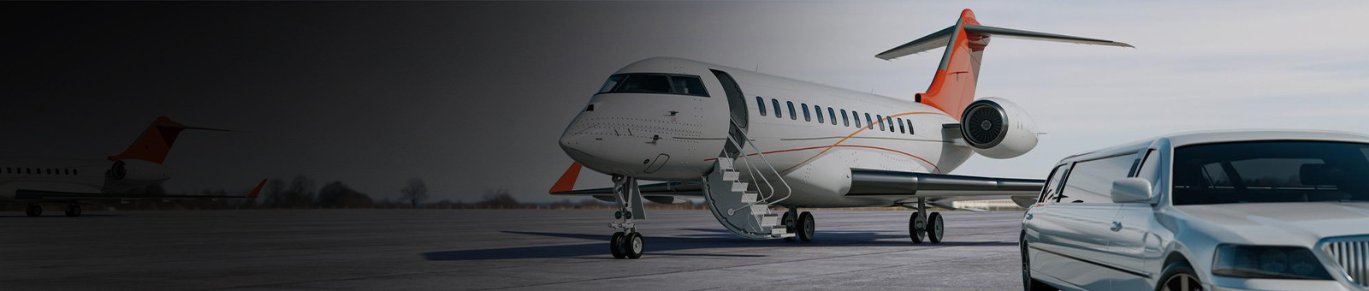
Private Sydney Airport Chauffeurs
By Chauffeur Hire

Slide 2
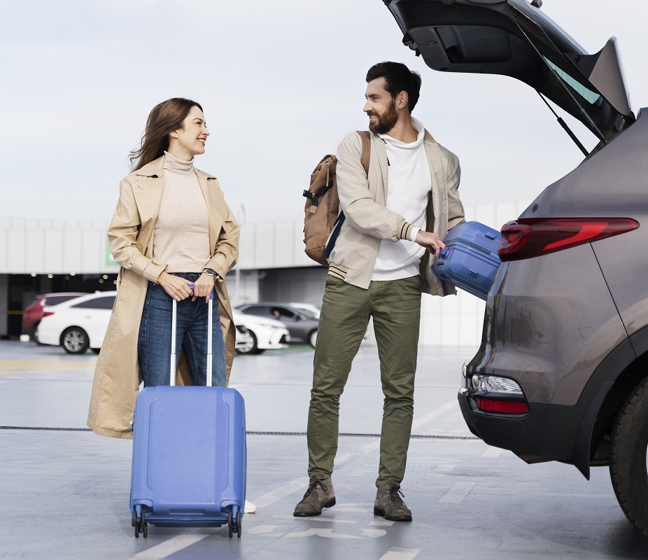
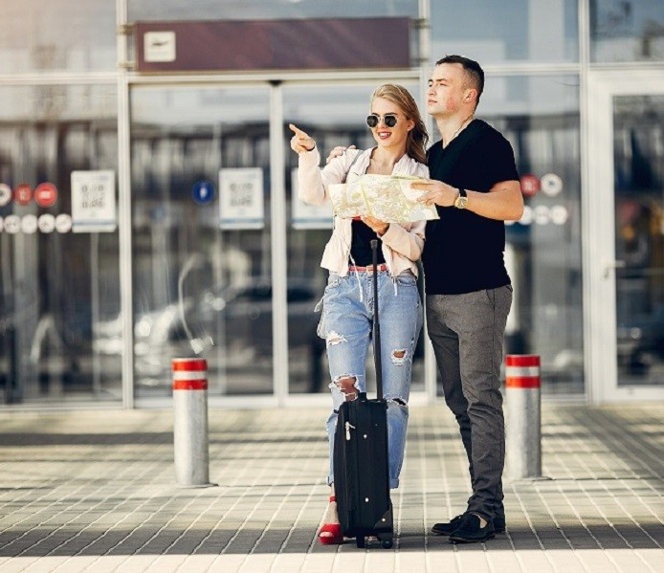
Experience seamless travel with ChauffeurHire's Private Sydney Airport Chauffeurs. Offering luxury vehicles like Mercedes and BMW, our professional chauffeurs ensure punctual, comfortable, and stress-free transfers. With real-time flight tracking, door-to-door service, and customizable options for individuals or groups, we prioritize your convenience and safety. Whether for business or leisure, trust ChauffeurHire to elevate your airport journey with exceptional service and style.

Slide 3

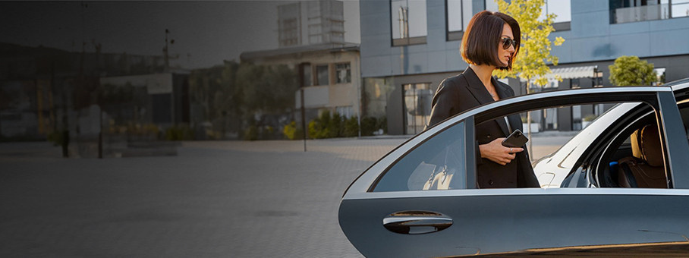

THANK YOU
Address - 12 Brahman Rd, Box Hill NSW 2765
Call - +61 451139131
Visit - https://www.chauffeurhire.com.au/our-services/airport-transfer-in-sydney

