Slide 1

THE FUTURE OF
CRYPTOCURRENCY EXCHANGE DEVELOPMENT
TRENDS TO WATCH

Slide 2
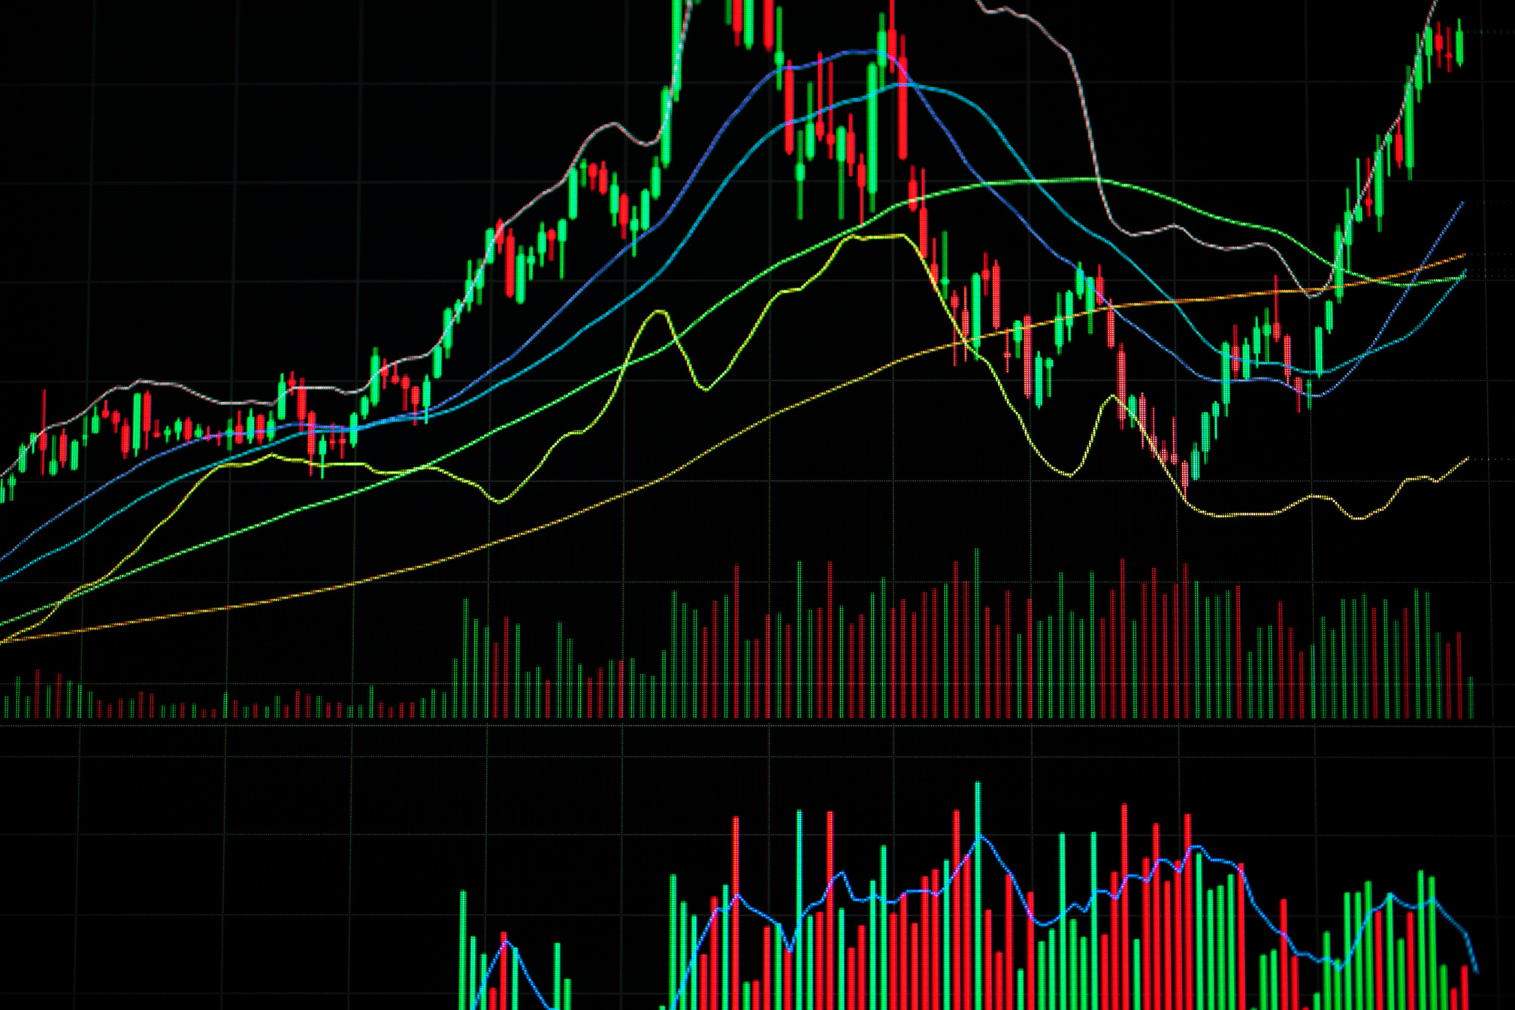
INTRODUCTION
As digital assets continue to revolutionize the financial world, the development of crypto exchanges—remains at the heart of this transformation. These platforms are evolving rapidly, driven by innovations in blockchain technology, shifts in regulatory frameworks, increasing user expectations, and the growing need for enhanced security. In the coming years, we can expect a wave of change in how crypto exchanges are built and operated. From decentralized trading infrastructures to the integration of AI and green technology, this article explores the most impactful trends shaping the future of crypto exchange development.
Learn More

Slide 3
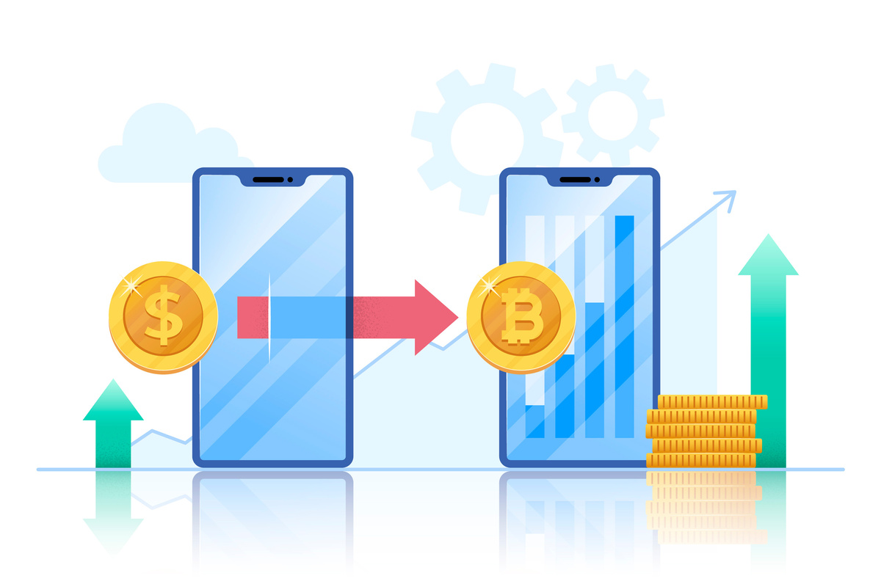
CRYPTOCURRENCY EXCHANGE DEVELOPMENT?
A crypto exchange is more than just a digital marketplace—it is a complex ecosystem that combines trading engines, wallets, security protocols, compliance frameworks, and user interfaces. To create a crypto exchange platform that is both robust and scalable, careful planning is essential, especially given the volatility of the market and the frequent changes in regulatory guidelines. These platforms offer liquidity, ease of use, and customer service. However, as blockchain technology matures and users demand more control, security, and transparency, new trends are reshaping the future of these platforms.

Slide 4


TRENDS TO WATCH
1. A Wave of DEX Popularity
Privacy and resistance to censorship are the ideals driving users away from centralised exchanges to DEXs. Centralised exchanges store assets and private data of their users, whereas DEXs illicit justice on an intermediary and arbitrate for outright peer-to-peer price determination through the smart contracts.
Other value propositions attracting users to DEXs are:
  Transparency with more confidence
  Lower hacks on centralised wallets
  Global access with minimum restrictions

Slide 5

2. Embedded Finance & EaaS
With blockchain becoming mainstream, it is witnessing a spike in Embedded Finance and EaaS models. EaaS enables any business, regardless of the industry it is in, to embed crypto trading feature into their platform without having to build an entire exchange themselves. This model is suited to fintech start-ups, banks, e-commerce platforms, and gaming companies that want to:
  Deliver seamless user experiences
  Save on development and maintenance costs
  Go to market quickly

Slide 6
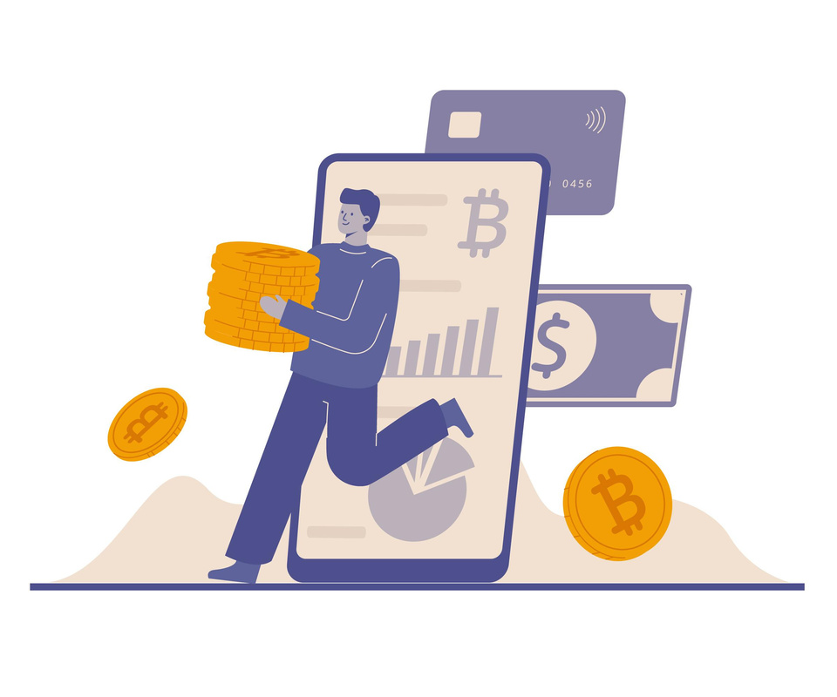

3. Enhanced Security and User Protection
Given the billions of dollars lost each year in hacks, scams and technical risks, security is a main priority in launching a crypto exchange. Developers are using layered security solutions that include:
  Multi-signature wallets
  Hardware security models (HSM)
  Cold storage
  Machine learning threat detection models
And user protection is evolving from basic two-factor authentication (2FA), and exchanges are looking toward real-time monitoring for suspicious activity, insurance funds for user asset protection, and improved education for users on the best practices for protecting assets and accounts. As regulation progresses, exchanges that provide significant security and user protection will have an edge.
Learn More

Slide 7
4. Artificial Intelligence and Machine Learning
Artificial Intelligence (AI) and Machine Learning (ML) will begin to change the way exchanges will be able to virtually manage all areas from trading to fraud detection, including:
Algorithmic Trading - AI bots will be able to trade at an exponentially faster level, and be able to determine market trends and market changes.
Risk Management - ML models will be able to forecast a risky transaction and flag it for review - useful to minimize fraud and assure future transactions align with regulations.
User Experience - As exchanges begin to use AI chatbots and virtual assistants, the overall user experience of fast access, precise answers and to be constantly available will grow rapidly.

Slide 8


5. Green Crypto Exchange Platforms
Environmental issues related to blockchain and especially proof-of-work (PoW), type blockchains, lend themselves to promoting green crypto platforms. There is increasing pressure for exchanges to lessen their carbon footprints and become environmentally oriented businesses.
  Some ways they plan on doing this are by:
  Hosting the infrastructure within renewable energy powered data centres
  Offsetting their carbon emissions through environmental credits
Listing and supporting greener coins and blockchain opportunities (i.e. the PoS networks, like Ethereum 2.0, Solana). Green exchanges will probably appeal to environmentally conscious investors and could be favoured by regulators in the future.

Slide 9

6. Biometric Security
Securing a wallet is only one aspect of the entire security landscape — securing access is also equally...well, secure. The integration of biometric features (fingerprint scanning, facial recognition, voice verification) in place of traditional security methods is being rapidly adopted by crypto exchange platforms. The integration of biometric security provides a far more seamless user experience; and it is even better on mobile platforms. Benefits of the transition include:
  Less reliance on passwords or pins
  More adequate measures against phishing and SIM swap scams
  Improve KYC/AML compliance

Slide 10




CONCLUSION
The outlook for crypto exchange development is innovative and bright. As innovation and sophistication continue to grow in the digital asset ecosystem, so too must the exchange platforms that support it. From decentralization and embedded finance to AI-driven products and regulatory automation, threads from this article are forming a new wave of exchanges that are faster, safer, and smarter. For developers, investors, and end users alike, the theme will be staying aware and on the move - whether you want to develop the next great DEX, or integrate exchange functionality into your app, sharing and tracking awareness of these trends.

Slide 11


THANK YOU

