Slide 1
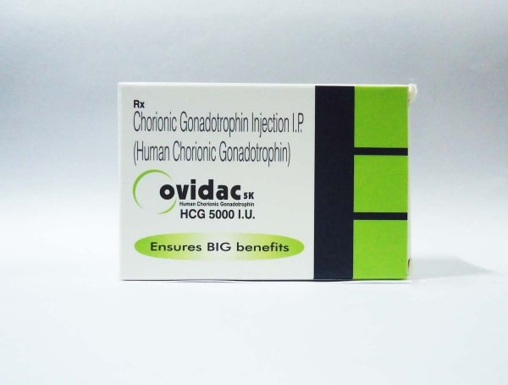

Buy Ovidac 5000 iu Canada

Slide 2
Ovidac 5000 iu - Usage
Ovidac 5000 IU is a freeze-dried powdered injection containing Human Chorionic Gonadotropin (HCG), used to treat infertility in women by inducing ovulation and in men to increase sperm count and testosterone levels. It also addresses undescended testicles in boys. Administered under medical supervision, it aids reproductive health. Results may vary based on individual health conditions. Always follow your healthcare provider’s dosage and instructions.
https://www.safemeds4all.com/product-details/ovidac-5000-iu-ml-freeze-dried-powdered-hcg-injection/442.html

Slide 3


+1-800-897-1053
Trustworthy Source for Generic Drugs
https://www.safemeds4all.com/product-details/ovidac-5000-iu-ml-freeze-dried-powdered-hcg-injection/442.html

Slide 4



+1-800-897-1053
+1-800-897-1053
www.safemeds4all.com
orders@safemeds4all.com
https://www.safemeds4all.com/product-details/ovidac-5000-iu-ml-freeze-dried-powdered-hcg-injection/442.html

Slide 5



+1-800-897-1053
Thank You
https://www.safemeds4all.com/product-details/ovidac-5000-iu-ml-freeze-dried-powdered-hcg-injection/442.html

