Slide 1


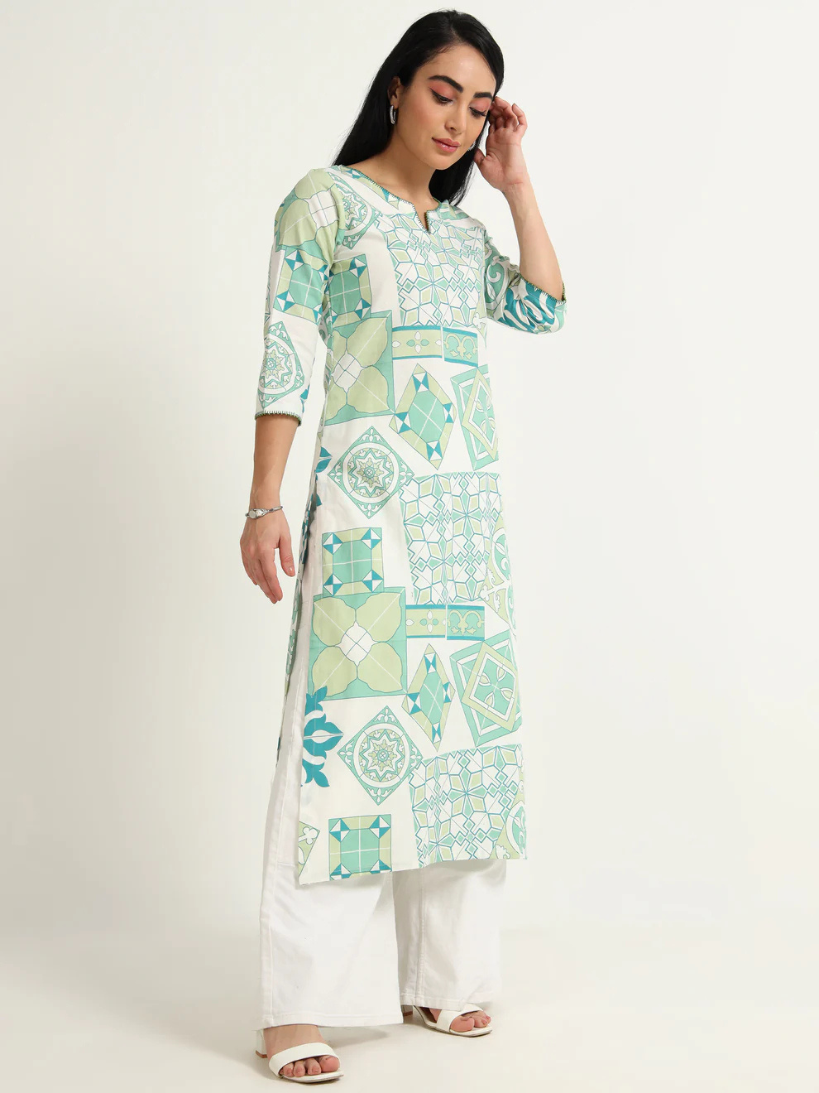

Reepeat: Sustainable Fashion for Women That Doesn't Cost the Earth (or Your Style)
Tagline: Dress well, live green with sustainable fashion for women that inspires.

Slide 2
The Problem With Fast Fashion (and Why Sustainable Fashion for Women is the Answer)
Fast fashion causes 10% of global carbon emissions. It harms people and planet.
Reepeat promotes sustainable fashion for women as a conscious alternative.
  Environmental damage from waste and pollution
  Exploitation of garment workers worldwide
  Ethical and eco-friendly choices instead

Slide 3
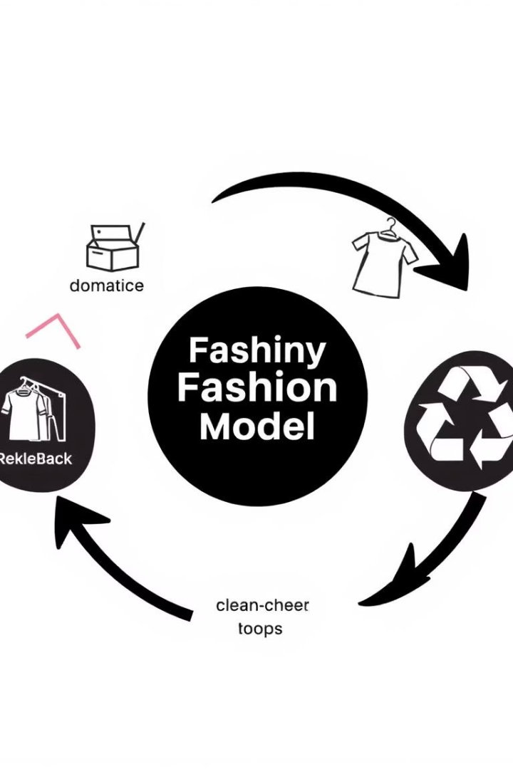
Reepeat's Circular Solution: Sustainable Fashion for Women, Redefined
Extending Clothing Lifecycle
Eco-Friendly Materials & Production
Reducing waste by enabling reuse, resale, and recycling.
Committed to sustainable fashion for women at every step.
Less Waste, Less Pollution
Innovative solutions for a cleaner, greener fashion industry.

Slide 4
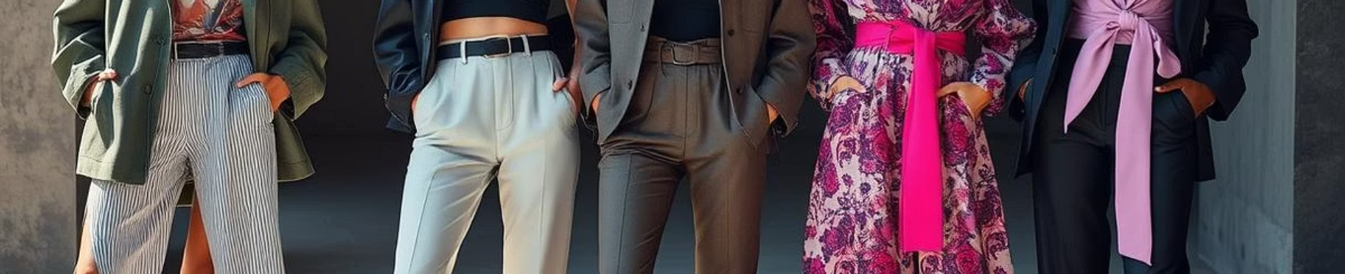
Style Without Sacrifice: Sustainable Fashion for Women for Every Occasion
Ethical & Stylish
Curated Collections
Durable Quality
Look fabulous while supporting sustainable fashion for women.
Wide range of styles to fit every taste and occasion.
High-quality garments designed to last and reduce waste.

Slide 5
Behind the Seams: Our Commitment to Sustainable Fashion for Women
1
Transparent Sourcing
Clear origins make each piece trustworthy and eco-friendly.
2
Empowering Workers
Fair wages and respectful conditions for garment workers.
Community Support
3
Supporting local artisans and sustainable fashion for women.

Slide 6
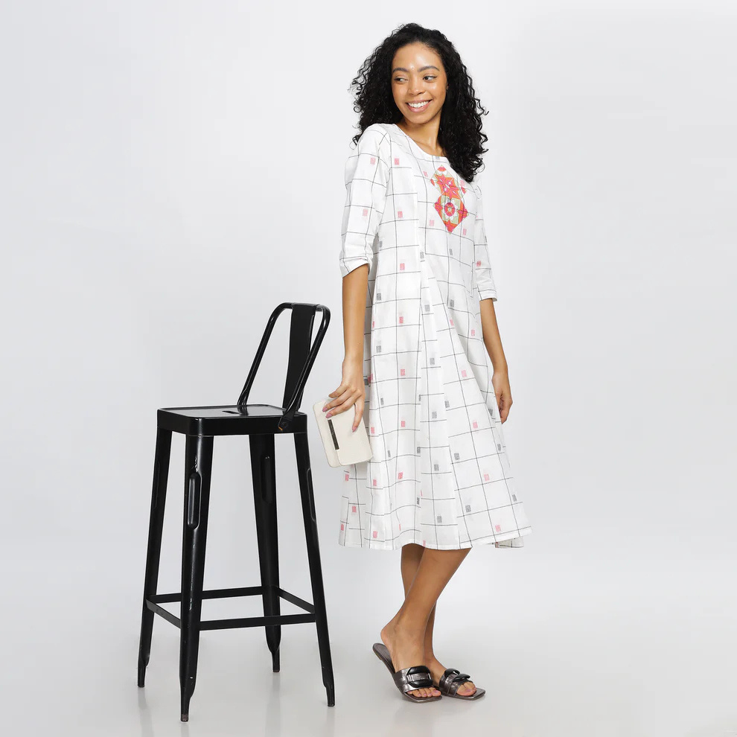



Join the Reepeat Revolution: Making Sustainable Fashion for Women Accessible to All
Consumer Demand
60% want more sustainable fashion for women options.
Circular Movement
Customers join to reduce fashion waste and shop consciously.
Discounts & Promos
Special offers welcome new sustainable fashion enthusiasts.

Slide 7



What's Next? Our Vision for Sustainable Fashion for Women
Collaborations
2
Partnering with brands and artists for green innovation.
Expanding Lines
1
Growing our sustainable fashion for women collections.
Material Innovation
3
Creating eco-friendly fabrics and designs with impact.

Slide 8

Get in Touch & Embrace Sustainable Fashion for Women!
Website
.https://reepeatshop.com/
Email
reepeatclothing@gmail.com
Store Location
Check website for physical store details
Connect with Reepeat and join the sustainable fashion for women movement today!

