Slide 1


Best MBA College in Lucknow
https://srmu.ac.in/program/mba-master-of-business-administration

Slide 2

Benefits of Pursuing MBA at Shri Ramswaroop Memorial University (SRMU), Lucknow
  Industry-Aligned Curriculum
  Specializations in Six Domains
  Hands-On Learning Approach
  Extensive Internship Opportunities
  Strong Placement Record​

Slide 3

ADDRESS
Shri Ramswaroop Memorial University
Village - Hadauri, Post - Tindola, Lucknow-Deva Road
Phone: 18001026004, +91-9120007948
Email: examination.cell@srmu.ac.in, admissions@srmu.ac.in

Slide 4
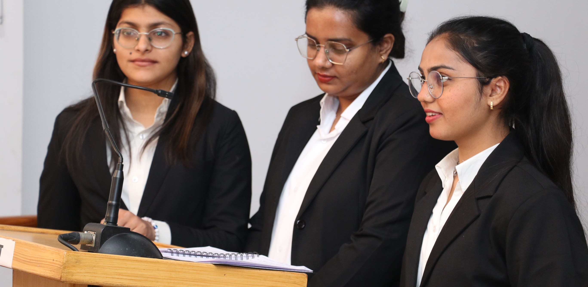
Thank You
Visit - https://srmu.ac.in/program/mba-master-of-business-administration

