Slide 1

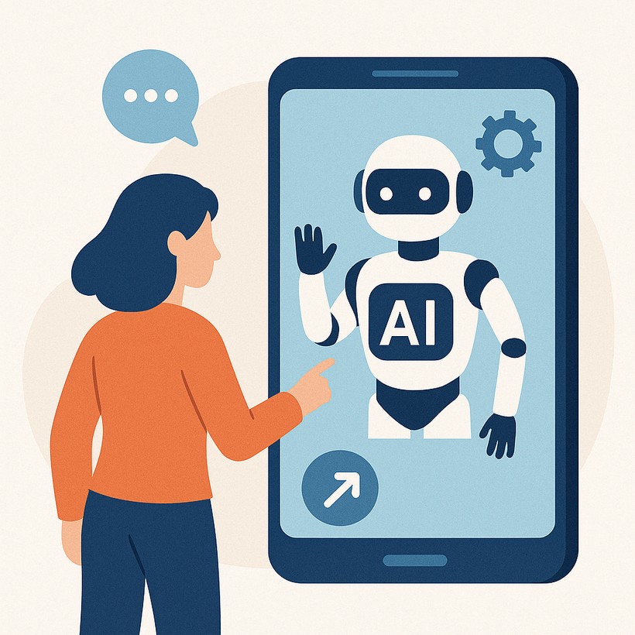

FORGET CHATBOTS: AI AGENTS ARE THE REAL GAME CHANGER
www.blockchainx.tech

Slide 2
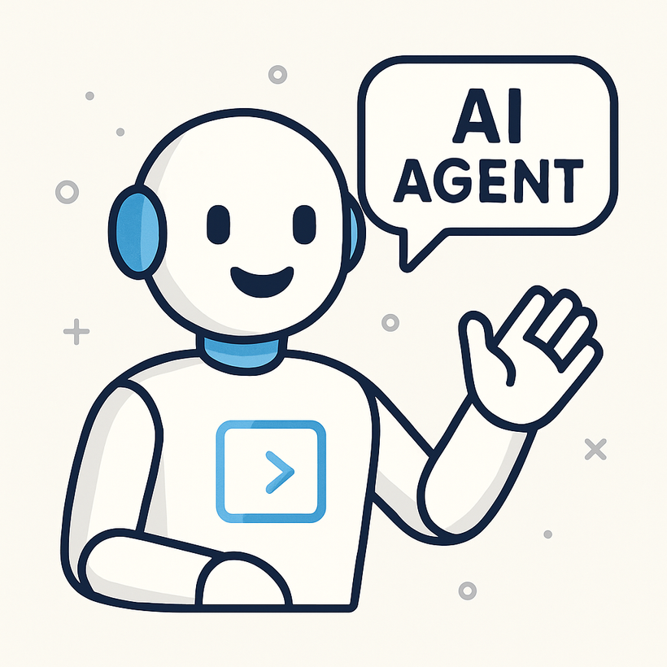
Chatbots have provided an automated customer service facility and streamlined business communication for over 10 years. In return, automated help organizations process squeezed time and money but allow users to have instant answers. Of course, the limitations have become more evident-they tend to be rigid, are prone to misunderstanding context, and cannot handle complex tasks like others. Enter the AI agent-the next generation of AI. Not merely a replying tool, but a proactive, intelligent individual system that thinks, decides, acts, and learns. These redefine how software is built and used. They aren't there to attend a single conversation; they are there to take on the ownership of the destination and achieve outcomes.
The requirement for AI agents development services is rising rapidly within organizations to create tailor-made intelligent systems to manage autonomous tasks and decision-making processes and improve over time as companies seek higher levels of sophistication in automation. The development of AI agents is the start of a more significant digitization workforce that will act smarter and more autonomously.

Slide 3
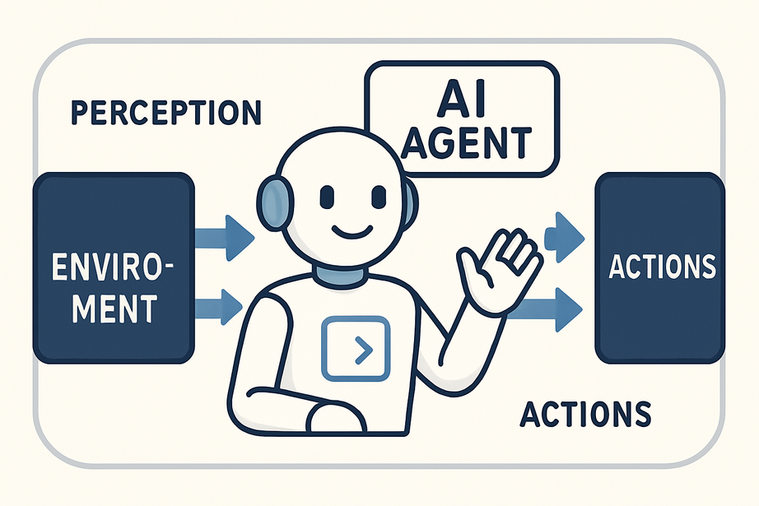
What is an AI Agent?
The AI agent is a highly sophisticated software entity that can operate by itself in a digital setting. Unlike traditional bots or programs that execute static instructions, these are quite dynamic and context aware. They learn from data, perceive language, reason, and act toward a goal defined by a human with little more than cursory supervision.
AI agents are modeled after human-like reasoning and behavior. These agents do not simply ask for information; they see the big picture by working across systems and can coordinate with each other or humans. Their sophistication and autonomy make them well-suited for handling multi-part tasks like project coordination, financial planning, or IT system auditing. In conclusion, an AI agent, therefore, can be regarded as a virtual co-worker capable of managing work streams, optimizing results, and continually improving its own effectiveness.

Slide 4
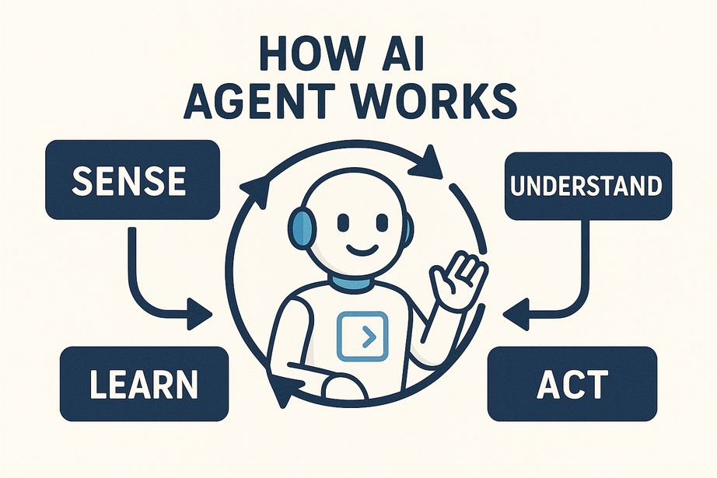
How Does an AI Agent Work?
They comprise a continuous cycle of sensing, reasoning, and acting action by the AI. They start with perception, which includes things like user input, system logs, sensor data, and digital interfaces. Then they interpret this data with machine learning algorithms, NLP (Natural Language Processing), and sometimes RL (reinforcement learning) to figure out the best possible action. Finally, they perform actions such as emailing, initiating tasks, triggering workflows, or updating systems.
Most special are their very high capacity for learning and adapting. A feedback loop could help an AI agent improve its future decisions. A situation in point is where an agent fails to meet its goal; it then analyzes what went wrong and changes its strategy accordingly. Many AI agents also have a goal-based architecture: rather than being programmed by the human being how to perform an action, they are simply told what to achieve through available tools and data, and let them figure out the most efficient way to get there.

Slide 5
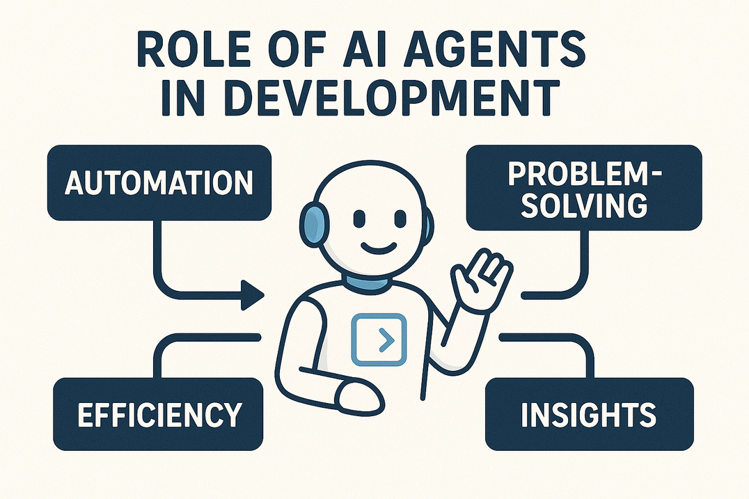
What is the Role of AI Agent Development?
An AI agent can be developed not just by programming and coding simple logic or conversation flows. Rather, there has to be a deep integration of different AI techniques like machine learning, deep learning, and decision-making frameworks with the aim of creating systems that work independently and intelligently. Developers must also take into consideration an agent's architecture, knowledge base, ability to learn through experience, and ability to interact with multiple digital environments.

Slide 6
What is the Role of AI Agent Development?
An AI agent can be developed not just by programming and coding simple logic or conversation flows. Rather, there has to be a deep integration of different AI techniques like machine learning, deep learning, and decision-making frameworks with the aim of creating systems that work independently and intelligently. Developers must also take into consideration an agent's architecture, knowledge base, ability to learn through experience, and ability to interact with multiple digital environments.

Slide 7
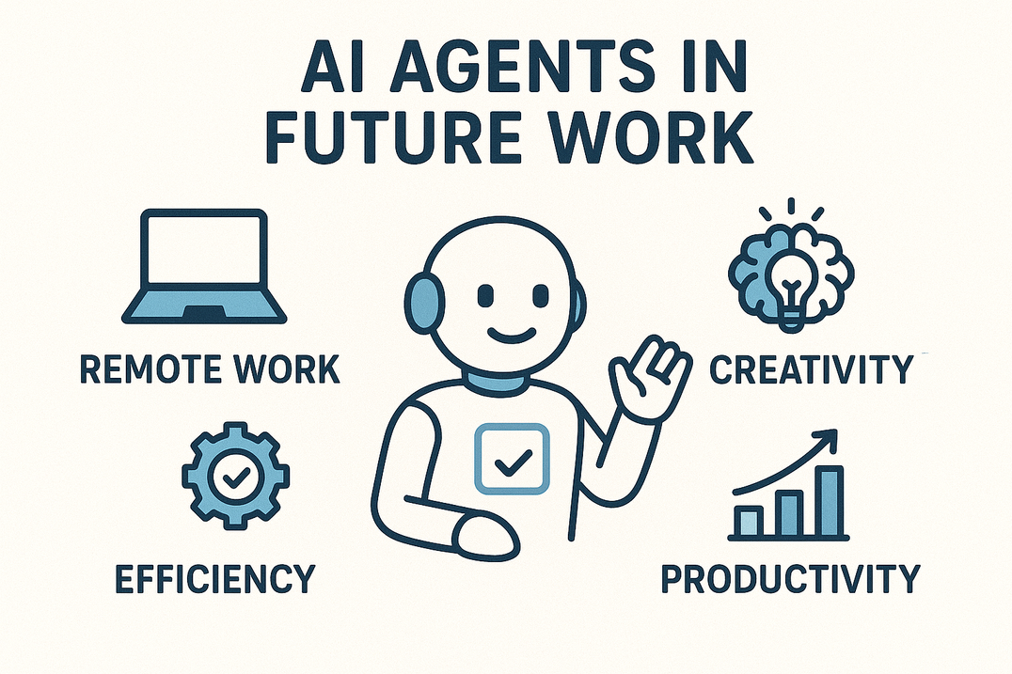
AI Agents in the Future of Work
An AI agent can be developed not just by programming and coding simple logic or conversation flows. Rather, there has to be a deep integration of different AI techniques like machine learning, deep learning, and decision-making frameworks with the aim of creating systems that work independently and intelligently. Developers must also take into consideration an agent's architecture, knowledge base, ability to learn through experience, and ability to interact with multiple digital environments.

Slide 8
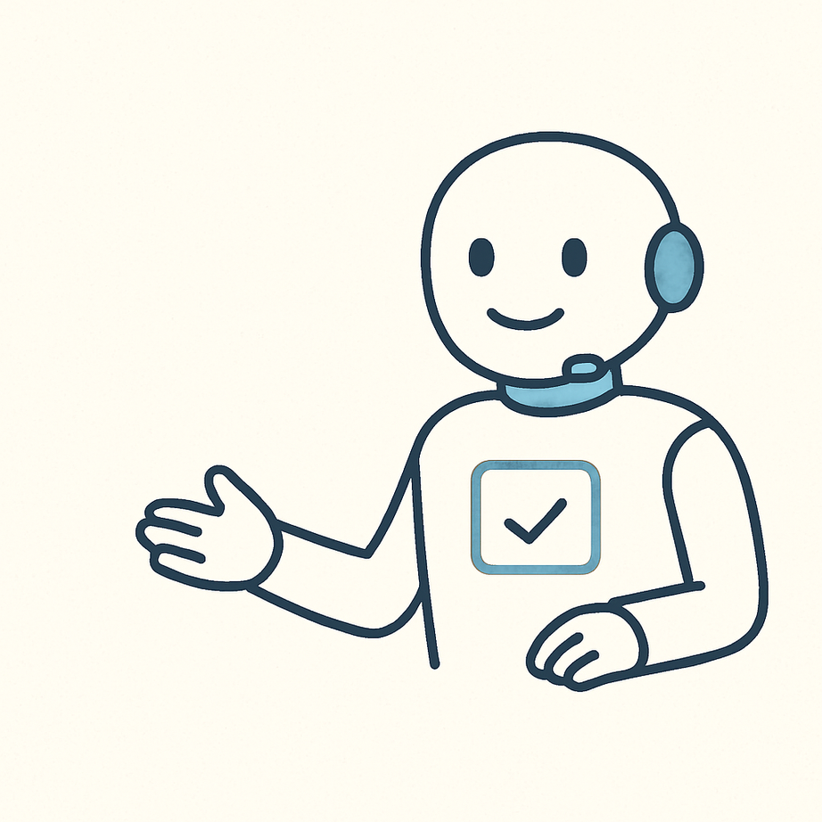
Conclusion
With AI agents, we have made an enormous jump beyond traditional and normal chatbots, as these are smart, independent systems that can perform a number of complex tasks in a range of areas. They are turning out to be important in scaling in the modern economy driven by AI for efficient and competitive business continuity, bringing in understanding of context, initiative, and learning by experience over time.
Investing in AI agent development solutions toward the future of long-term automation becomes a strategy rather than an investment for organizations. Business entities may now build intelligent systems that really not only answer but also take actions and generate tangible changes. If chatbots represent the beginning of automation, AI agents leap to true, digital intelligence. Moving beyond interacting with scripted conversations opens a door to intelligent, actions-oriented systems getting the job done.

Slide 9
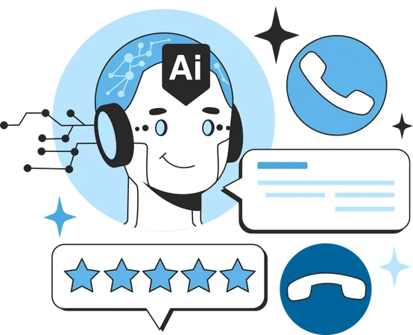




thank you!
  +91 7708889555
  www.blockchainx.tech
  contact@blockchainx.tech

