Slide 1
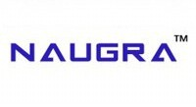
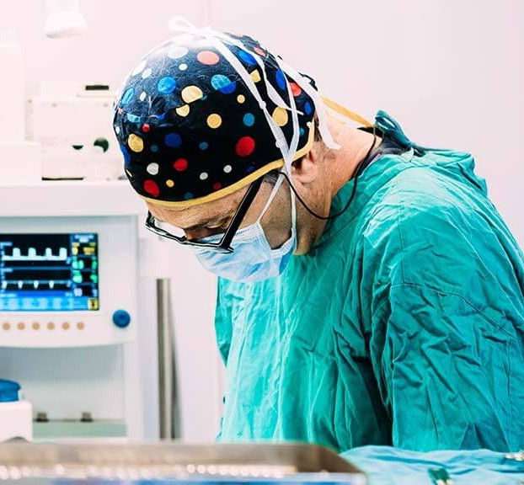
Naugra Medical
About us
Naugra Medical is a trusted manufacturer and exporter of high-quality medical, surgical, and hospital equipment. Based in Ambala, India, we supply a wide range of products to hospitals, clinics, and institutions across Asia, Africa, the Middle East, Europe, and South America. With a focus on innovation, quality, and affordability, we serve the healthcare and medical education sectors worldwide. Our commitment to excellence, timely delivery, and international standards makes us a preferred choice for reliable medical equipment solutions globally.
Patient Monitor Exporters
Patient monitors are vital tools used in medical facilities to continuously track a patient’s vital signs such as heart rate, oxygen saturation, blood pressure, and respiratory rate. As global healthcare
infrastructure expands, the demand for high-quality, reliable monitoring systems continues to rise. Naugra Medical has emerged as a trusted name among leading Patient Monitor Exporters, offering precision-engineered devices designed to meet the needs of modern healthcare institutions. Known for delivering consistent performance, advanced features, and durability, Naugra Medical supports hospitals, clinics, and healthcare professionals worldwide with cutting-edge monitoring technology.
Why Choose Naugra Medical?
Naugra Medical has over 20 years of experience in manufacturing and exporting high-quality medical equipment. The company exports to more than 80 countries, supported by a robust global logistics network and dedicated customer service. All patient monitors from Naugra Medical are certified to international standards, including CE and ISO, ensuring compliance and safety. The brand also provides customized solutions tailored to specific client requirements, making them an ideal partner for healthcare projects of all sizes. With a proven track record of delivering excellence, Naugra Medical stands out as a reliable exporter in the global medical industry.

Slide 2
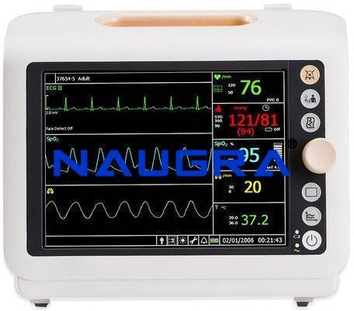
Contact us:
Patient Monitor Device
Product Code: NMCBS37001
Email : sales@naugramedical.com
Telephone: +91-0171-2643080 , 2601773,
Fax: +91-0171-2607146
Website: Patient Monitor Device

