Slide 1


Uniswap Clone Script is the Future of Digital Finance?
In this Article about Uniswap Clone Script is the Future of Digital Finance?, Read it out.
Explore Now

Slide 2

What is Uniswap Clone Script
The Uniswap clone script functions as a pre-developed software which duplicates the essential capabilities from the decentralized exchange (DEX) platform Uniswap. The script enables users to develop their own decentralized exchange (DEX) through liquidity pools connected to automated market making and token swapping functions.
The script enables high customization which leads to cost-effectiveness along with rapid launching capabilities of decentralized platforms that retain Uniswap's core DeFi system features.

Slide 3

Overview of Digital Finance
Financial services along with their products become accessible through technological systems which constitute digital finance. Digital finance includes numerous financial operations which now operate through digital network systems and technological infrastructure.
The new age of digital finance brought revolutionary changes to financial operations which now control transactions and expenditures while determining the nature of investments and lending practice and currency utilization. Digital finance includes online banking alongside several financial services industry innovations that speed up efficient financial products accessibility.

Slide 4




Key Components of Digital Finance
Cryptocurrency development and Blockchain Technology
Decentralized Finance
Digital Payments and Banking
Robo-Advisors and AI in Finance

Slide 5




Role of Uniswap Clone Script in Digital Finance
Enabling Decentralized Finance (DeFi)
Financial Inclusion
Lower Costs and Fees
Liquidity and Market Efficiency
Security and Trust
Supporting Tokenization and Asset Diversity

Slide 6



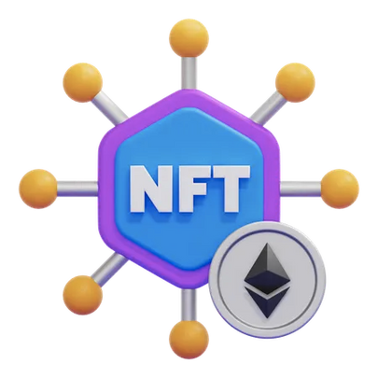
Top Key Features of Digital Finance with Uniswap Clone Scripts
Layer 2 Solutions for Scalability
Advanced Governance Models
Cross-Chain Interoperability
NFT and Tokenized Asset Support

Slide 7

Conclusion
The Uniswap Clone Scripts function as fundamental tools for developing the digital financial landscape through decentralized operations and reduced costs together with advanced security features and user-friendly platforms.
Through empowerment they enable users to create new possibilities for DeFi development while establishing conditions for financial access for all.

Slide 8




My Contact
7708889555
https://www.blockchainx.tech/
contact@blockchainx.tech
CM Nagar, Sathy Rd,Ramakrishnapuram.Coimbatore

