Slide 1
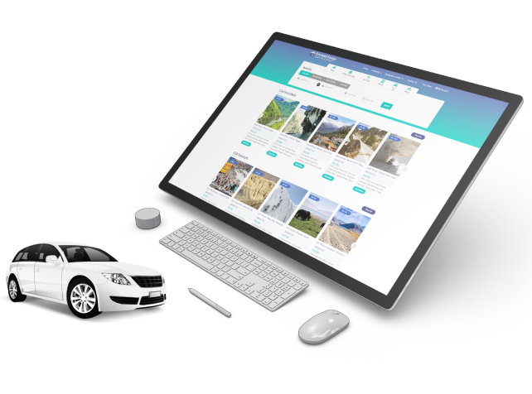

Online Bus Ticket Booking Software
By Travipro

Slide 2
Key Featurers of Travipro’s Online Bus Ticket Booking Software
  Customizable bus route scheduling
  ​Interactive seat selection for passengers
  ​Multi-currency and multilingual support
  ​Real-time booking and payment processing
  ​Automated booking confirmations and notifications
  ​Comprehensive booking and sales reporting
  ​Integrated customer relationship management (CRM)
  ​White-label integration with existing websites
  ​Admin panel for route and seat management
  ​Mobile-responsive and user-friendly interface

Slide 3
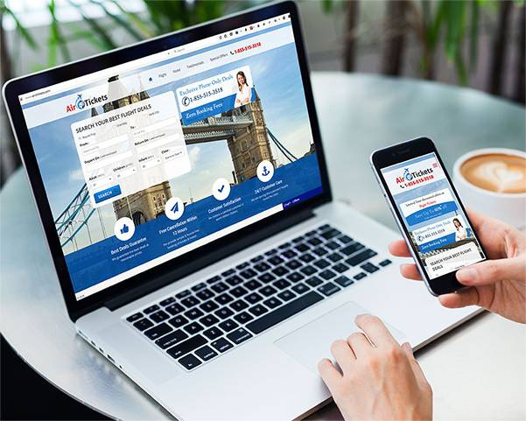
Address
B-112, Sector-64 Noida - 201301, Uttar Pradesh
Phone - +91 9560 433 318
Email - info@travipro.com
Website - https://www.travipro.com/bus-reservation-system.html

Slide 4
Thank
You
Visit - https://www.travipro.com/bus-reservation-system.htmll

