Slide 1

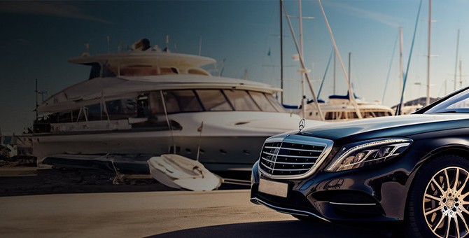
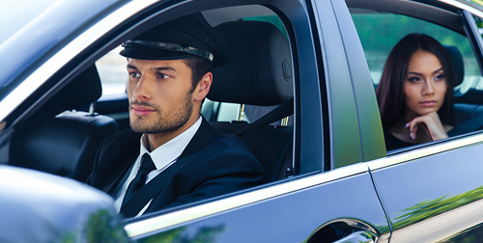
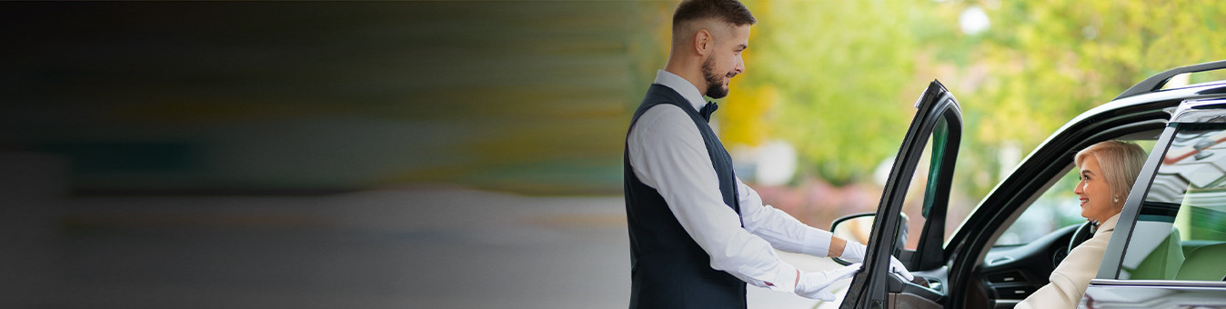
Luxury Chauffeured Cars Sydney

Slide 2
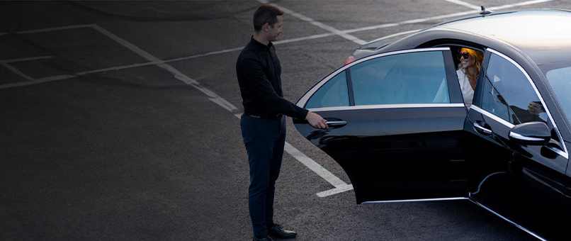
  Professional chauffeur services across Sydney and suburbs.
  Luxury vehicles available for every travel need.
  Punctual, courteous, and experienced private drivers.
  Ideal for corporate, airport, or event transport.
  Easy online booking with flexible service options.

Slide 3

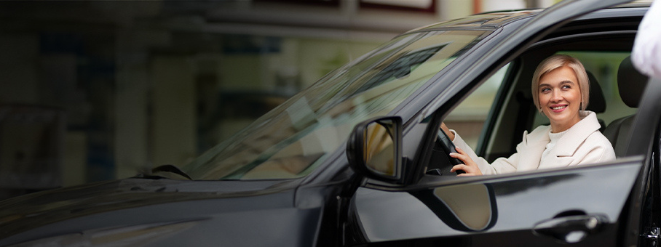

THANK YOU
Address - 12 Brahman Rd, Box Hill NSW 2765
Call - +61 451139131
Visit - https://www.chauffeurhire.com.au/our-services/chauffeurs-driver-car-in-sydney

