Slide 1

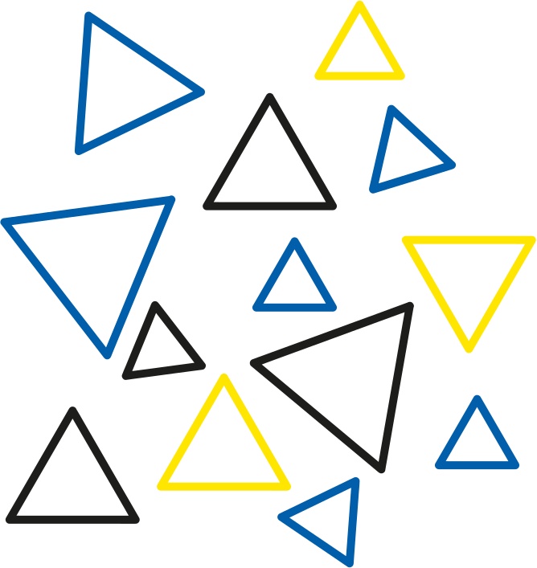

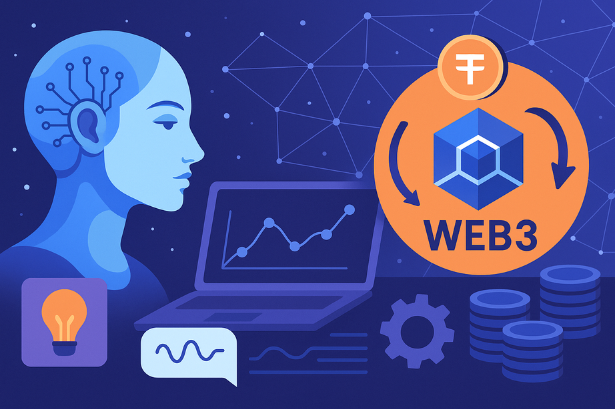

How AI and Web3 Are Merging in 2025: Use Cases and Tools
www.blockchainx.tech

Slide 2
In 2025, very rapidly, everything has been merging between the two terminologies, namely Artificial Intelligence (AI) and Web3. In fact, these two were viewed, at some point, as entirely separate areas separated by a line; one was the brain behind smart automation, while the other was otherwise termed decentralized-the infrastructure behind web3. This is evolving towards redefining the experience with technology. Now, prospective users are trying out decentralized systems that give them a glimpse of a day when they'd have their data completely under control. This would involve major upheaval in the identity of how we use, govern, and benefit from data, and it is a start towards making a smart, fairer, and more transparent internet ecosystem. This is going to change the whole face of Web3 development because, with artificial intelligence-driven capabilities, it becomes very easy to develop next-gen decentralized platforms and applications.

Slide 3
Why AI and Web3 Make Sense Together
AI and the technology of the future, Web3, go hand in hand so well together. After all, AI works best on data, and it should never stop learning, considering that Web3 can offer an open, secure, verifiable, and user-owned data-fuel - just the right conditions for applying AI. This is also the other side of the coin where there is a lack of user-friendly interfaces and personalization in the applications of Web3, which is itself an area that well fits AI's strengths. Therefore, by bringing intelligence and adaptability to Web3 systems, AI breathes the life of intelligence into them while Web3 guarantees transparency, integrity, and ownership. Such synergies make it possible to create intelligent decentralized applications (dApps) and autonomous agents with smarter user interfaces, all operating within a trustless environment.

Slide 4
Top Use Cases of AI + Web3 in 2025
One of the most anticipated applications for 2025 is the entire establishment of AI-controlled DAOs (Decentralized Autonomous Organizations). These will utilize AI techniques to filter out proposals, automate decisions, and increase overall operational effectiveness within the governance. In the artistic world, AI-generated NFT's are totally growing-An artist uses machine learning models to create unique digital art whose ownership and royalties are controlled by smart contracts on Web3 platforms. In DeFi, AI-based trading bots optimize yield farming and portfolio management by analyzing blockchain data in real-time for some yield farming and portfolio management tasks. AI also makes it personalized in Web3-in dApp dashboard customization and AI-chat assistants. There emerges data marketplaces where users will sell their data to train the best AI models while protecting their privacy and ensuring fair compensation. There are also emerging decentralized identity systems incorporating AI to make the facial recognition process for secure verification and behavior-based onboarding smooth and more secure.

Slide 5
Leading Tools and Platforms
On this convergence of AI and Web3, several advanced platforms are standing out. Ocean Protocol allows training AI models over decentralized data, without compromising data privacy. Fetch.ai is building a network of autonomous agents, which will negotiate, transact and analyze on behalf of users in a decentralized manner. SingularityNET is a blockchain-powered marketplace where developers can share and monetize their AI services. Numerai combines a crowdsourced machine learning approach with the decentralized hedge fund model. Altered State Machine creates AI-driven agents as NFTs meant for games and virtual worlds. Alethea AI focuses on interactive NFTs (iNFTs), endowing digital assets with the ability to learn and converse with users. These tools demonstrate how AI and Web3 are being merged in realistic and scalable ways.

Slide 6
Benefits of the Merge
AI and Web3 when merged have many advantages for the global populace through making AI accessible to every individual by minimizing the influence of centralized platforms. Therefore it makes the development of AI more inclusive. It augments data privacy whereby the user gets to have control over what he/she considers personal information and how it shall be shared or monetized. Transparency is enhanced where the AI models and their decisions can be traced and verified on-chain. This reduces algorithmic bias and enhances fairness. Also, decentralized incentivization motivates participation, innovation, and open collaboration from the community, pushing AI development beyond the confines of traditional tech ecosystems.

Slide 7
The Future Outlook
Looking into the future, as always, there would be an infusion of AI and Web3. One could imagine autonomous dApps that think, learn, and evolve independent of human interactions into the very near future. Intelligent agents will probably fuel metaverse experiences and personal assistants and be decentralized services. New regulations and ethical standards ensuring responsible use of AI and decentralized data practices will undoubtedly guide the way. Improved interoperability and computing power will eventually make it easier, quicker, and more feasible for developers around the world to construct intelligent decentralized systems.

Slide 8
Conclusion
The fusion of AI with Web3 in 2025 marks a striking transition in the way we build and use digital technologies. The new gold mine for digital innovation is born from the union of AI intelligence and Web3 transparency and security-a land where autonomy, privacy, and fairness hold great importance. This convergence presents numerous opportunities for developers and companies ready to push the horizon of what decentralized applications can achieve. AI will be at the center of the revolution that creates even smarter, faster, and more user-friendly decentralized systems as developers move toward the future of Web3 app development. Now is the time for visionary entrepreneurs, developers, and businesses to create win-win synergies between AI and Web3 to develop the next generation of decentralized apps to contribute value and change how we interact with digital technologies.

Slide 9





Thank You
CONTACT US
www.blockchainx.tech
contact@blockchainx.tech
+91 7708889555

