Slide 1

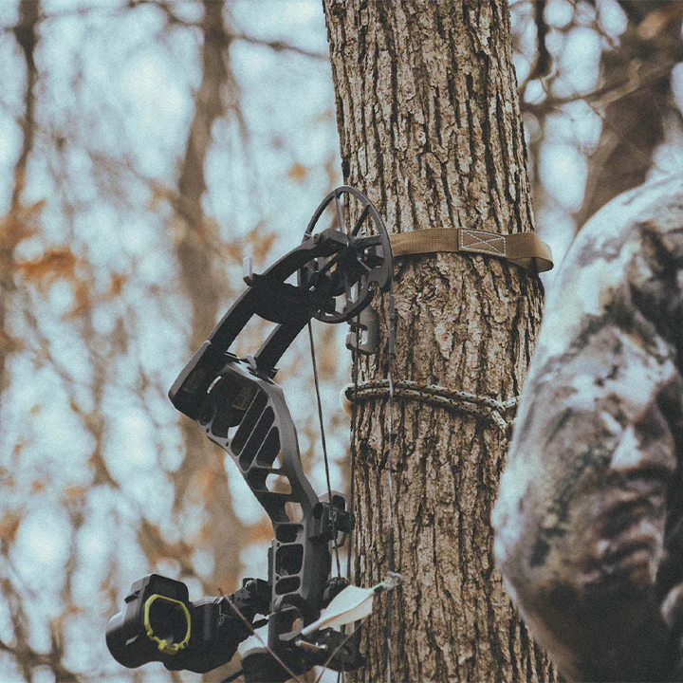
Muzzy Bowfishing Gear for Sale | Bowfishing Kits, Arrows & Reels
Find Your Perfect Equipment Here
www.jamesriverarchery.com

Slide 2
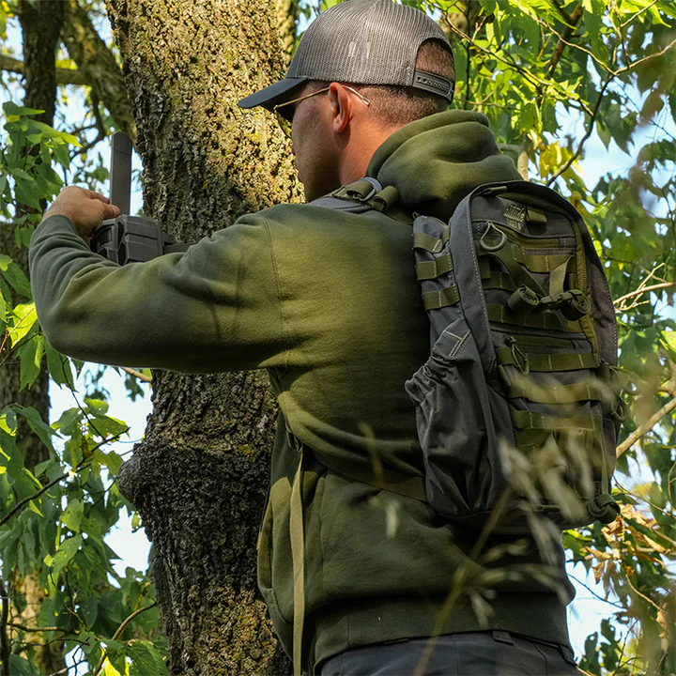

Muzzy Bowfishing Arrows & Gear
Shop top-rated Muzzy bowfishing gear including bows, arrows, reels, and kits. Perfect for beginners and pros. Fast shipping from James River Archery.
www.jamesriverarchery.com

Slide 3
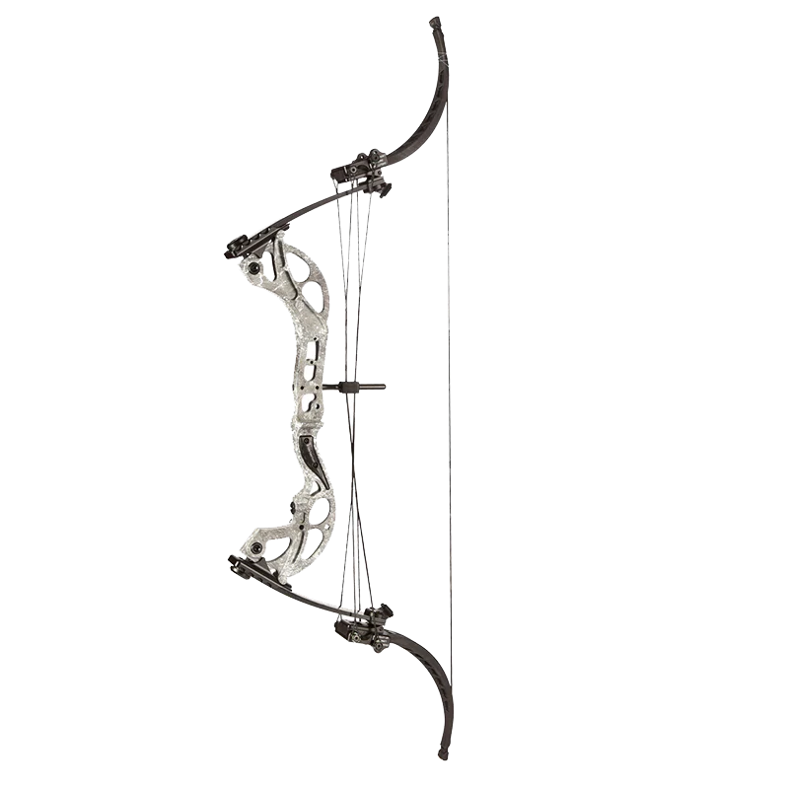
VXM Bowfishing Bow
Muzzy VXM Bowfishing Bow, the perfect companion for both freshwater and saltwater enthusiasts. Powered by Oneida's renowned lever action technology, this bow is smooth drawing and deep penetrating, ensuring an unrivaled bowfishing experience.
www.jamesriverarchery.com

Slide 4
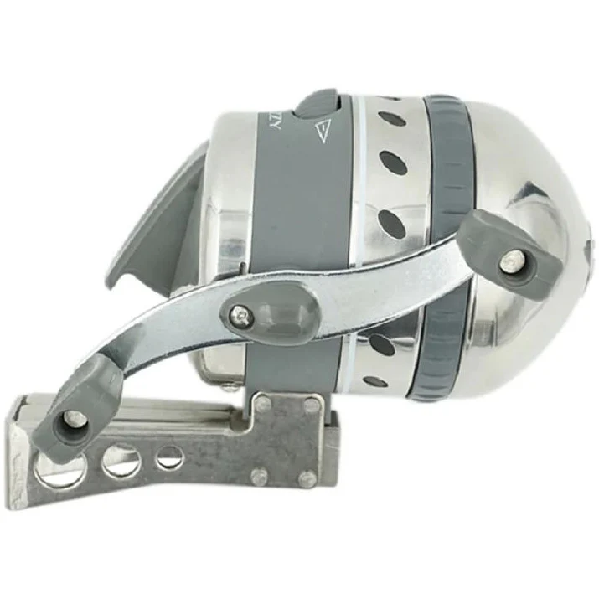
XD Pro B Reel With Button
Combining a bomb-proof stainless steel spin-style reel with an integrated reel seat the new Muzzy XD Pro B is poised to make your next bowfishing excursion a success. The stainless steel and brass internal drive-system components and new elongated hood design join to deliver ultra-smooth line feed for increased accuracy and better retrieval.
www.jamesriverarchery.com

Slide 5
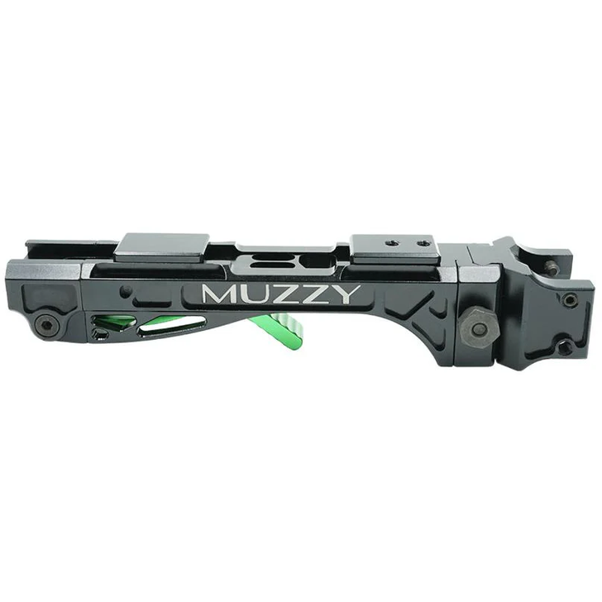
LV-R Quick Detach Reel Seat
Easily mount or remove your bowfishing reel with the LV-R Quick Detach Reel Seat. Durable, lightweight, and built for fast action on the water.
www.jamesriverarchery.com

Slide 6
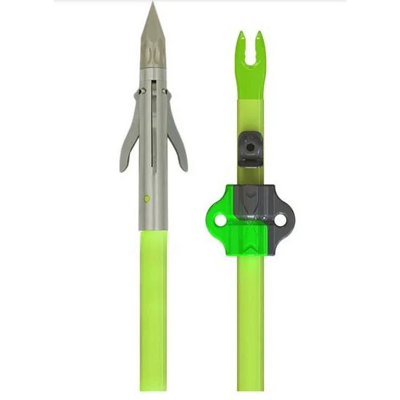
Iron 3 Barb Chartreuse Fish Arrow and Bottle Slide
New for 2018 is Muzzy's Iron 3-Barb bowfishing arrow. Chartreuse fiberglass arrow with the nock and bottle slide installed. Point will release at the turn of the point.
www.jamesriverarchery.com

Slide 7
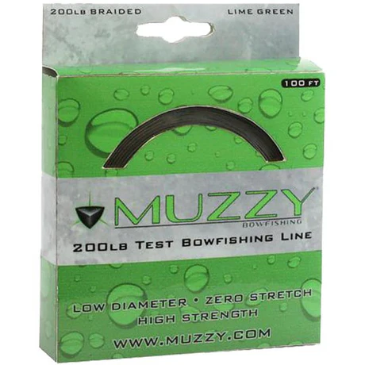
Lime Green Braided Bowfishing Line
Muzzy 200# Lime Green Bowfishing Line is a high-visibility, thicker line than our 150# Tournament Test Line. The line is braided for strength, durability, and less stretch. It's a great choice if you are looking to re-spool your reel with a thicker line that is easier on your hands and easy to distinguish from other lines in the water
www.jamesriverarchery.com

Slide 8
Conclusion: Gear Up and Join the Adventure
Whether you're just getting started in bowfishing or you're a seasoned veteran on the water, the Muzzy Bowfishing collection at James River Archery has everything you need to gear up for success. From high-performance MuzzyBowfishingArrows to all-in-one MuzzyBowfishingKits, our selection is designed for power, precision, and durability. Explore our full range today and experience why Muzzy is a trusted name in the sport. Your next big catch starts here.
www.jamesriverarchery.com

Slide 9
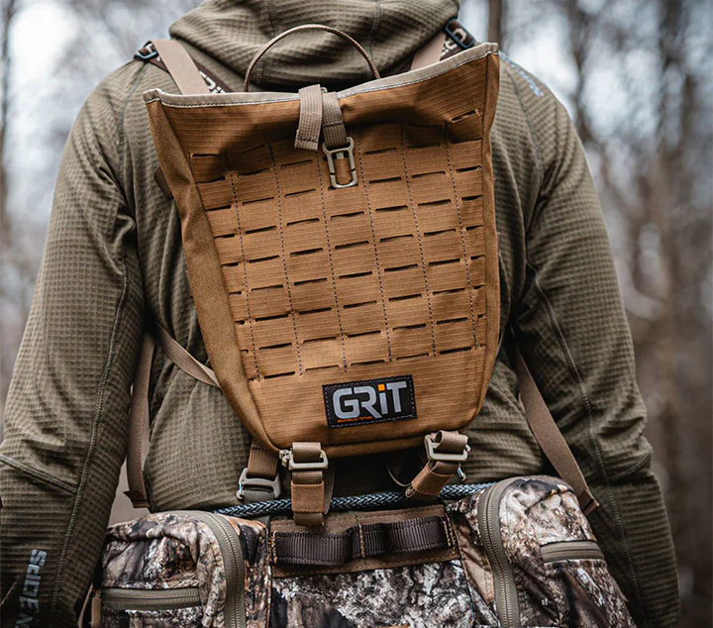


CONTACT US
James River Archery
2734 South Campbell Ave Springfield, Mo. 65807
Tues - Sat,
10:00am - 7:00pm
WWW.JAMESRIVERARCHERY.COM

