Slide 1
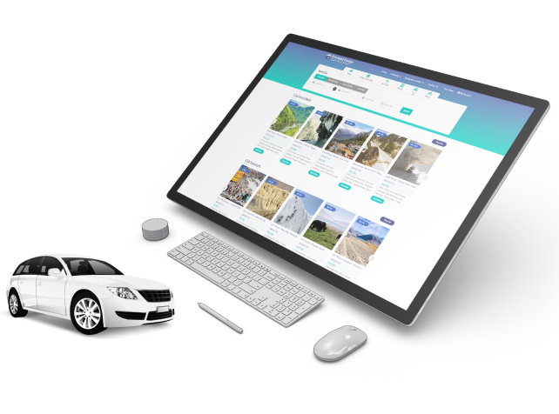

Social Media Marketing For Travel Agents
By Travipro

Slide 2
Key Featurers of Travipro’s Social Media Marketing
  Develops strong brand social identity
  Tailors content to audience preferences
  Crafts engaging, shareable content
  Allocates budget for optimal ROI
  Monitors and updates accounts regularly
  Enhances brand visibility and reach
  Builds national and international reputation
  Provides personalized client attention
  Aligns strategies with business goals
  Offers bespoke pricing based on needs​

Slide 3
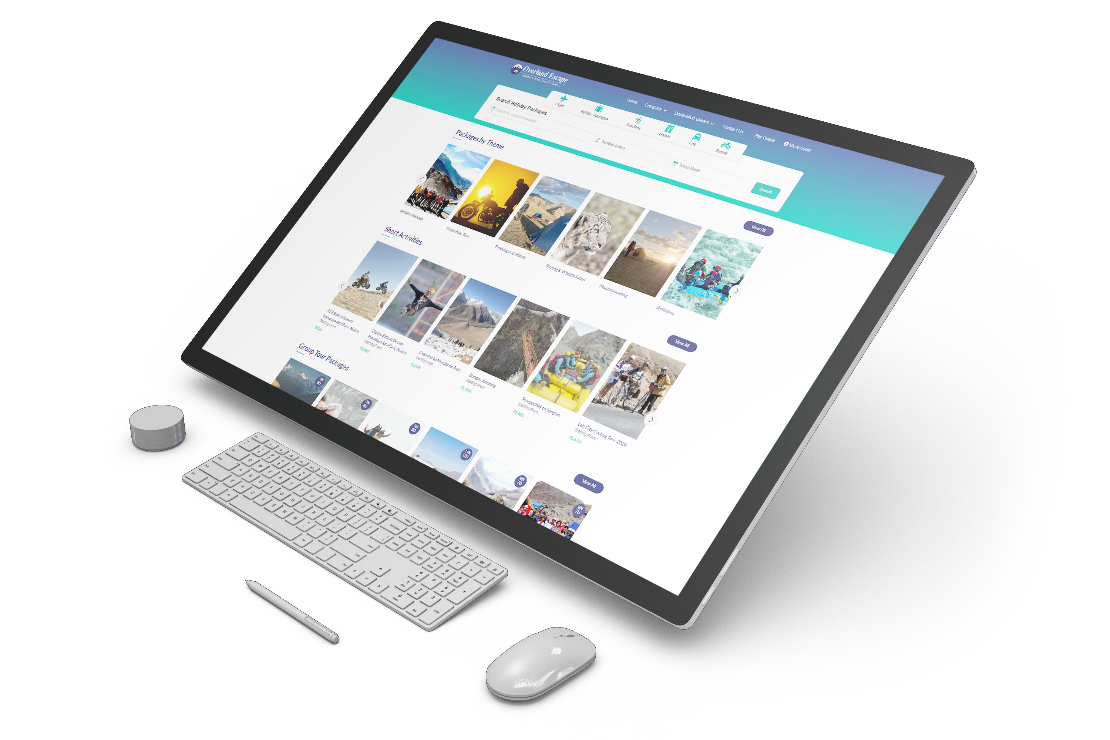
Address
B-112, Sector-64 Noida - 201301, Uttar Pradesh
Phone - +91 9560 433 318
Email - info@travipro.com
Website - https://www.travipro.com/social-media-marketing.html

Slide 4
Thank
You
Visit - https://www.travipro.com/social-media-marketing.htmll

