Slide 1
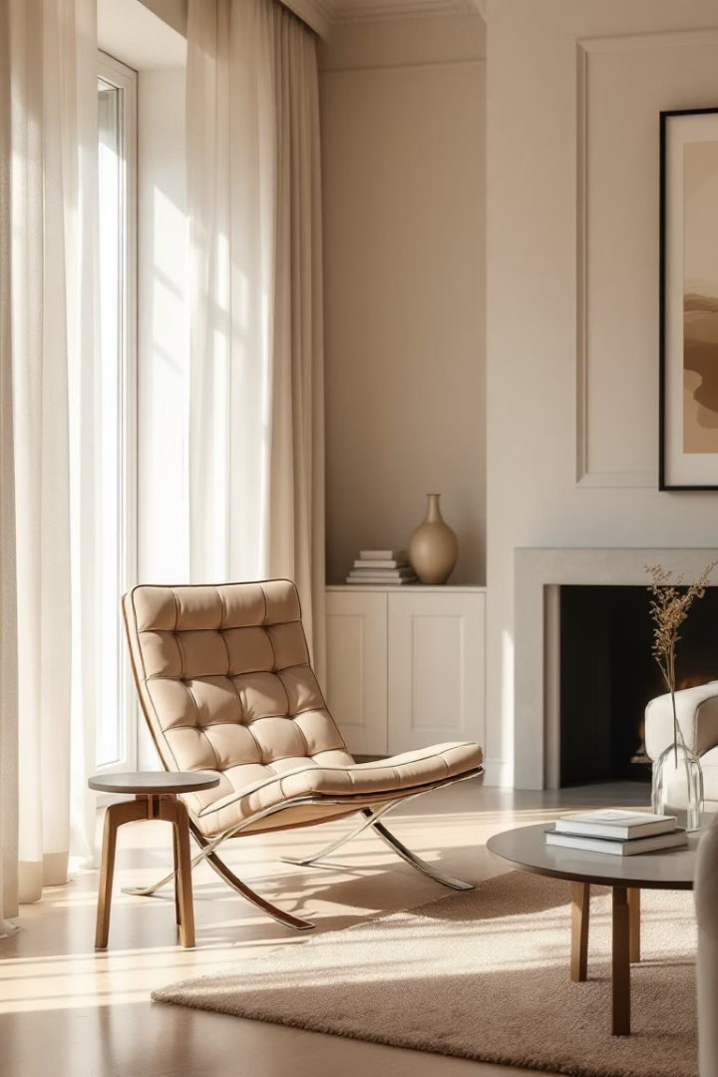


Discover the Barcelona Style Chair
The Barcelona style chair blends modern design with comfort. Iconic style for any space.
https://www.luxefurnishes.com/
Notes:
1

Slide 2
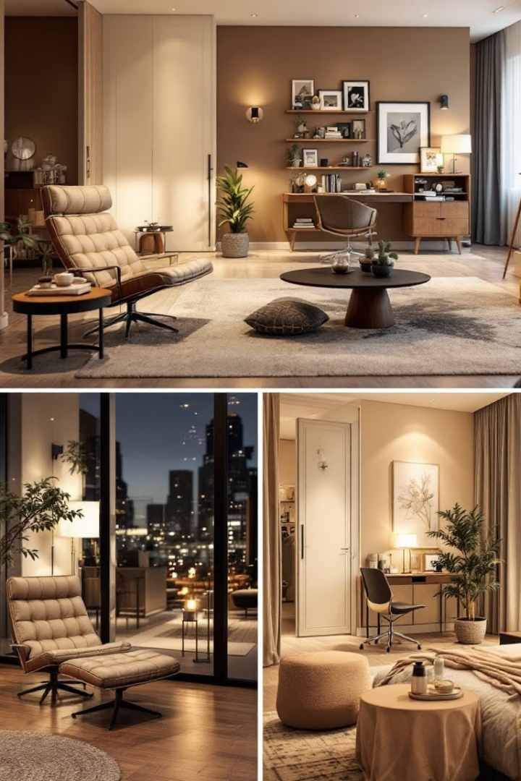
Perfect for Any Space
Living Rooms
Home Offices
Reception Areas
Bedroom Corners
Notes:
2

Slide 3


Experience superior relaxation with the Barcelona style chair
Deep Cushioning
Ergonomic Backrest
Wide Seat
https://www.luxefurnishes.com/
Notes:
3

Slide 4
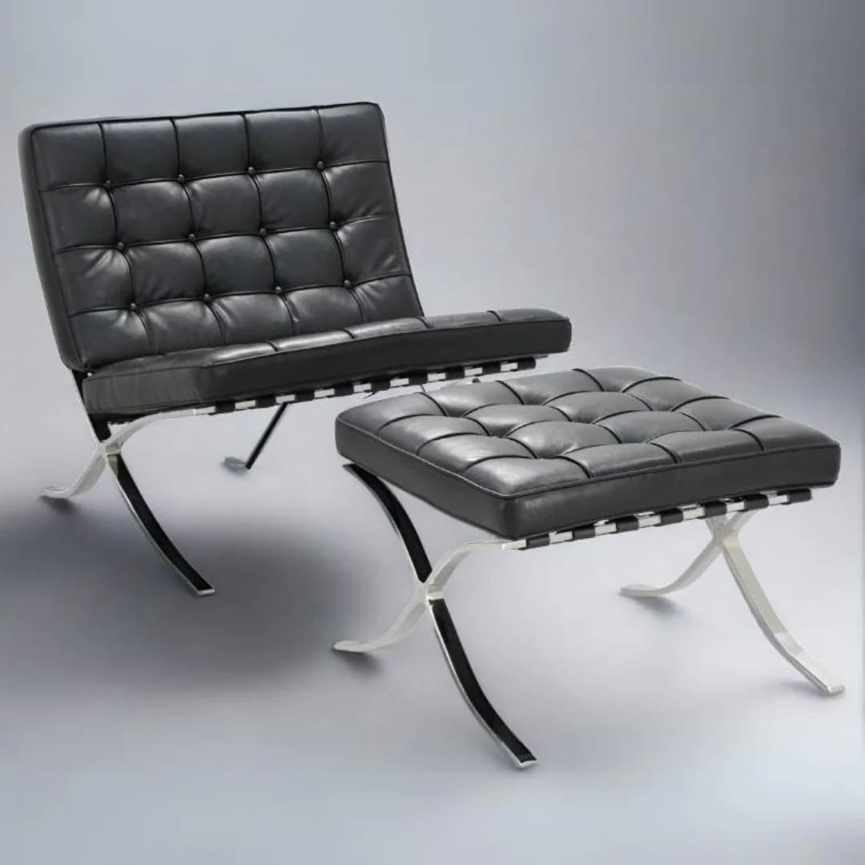
Standout Features
Tufted Leather
Every Barcelona style chair is Hand-stitched for refined quality
Stainless Steel Frame
At Luxe we use sleek and polished stainless steel for modern appeal
Elegant Geometry
Clean lines define its timeless design
Notes:
4

Slide 5
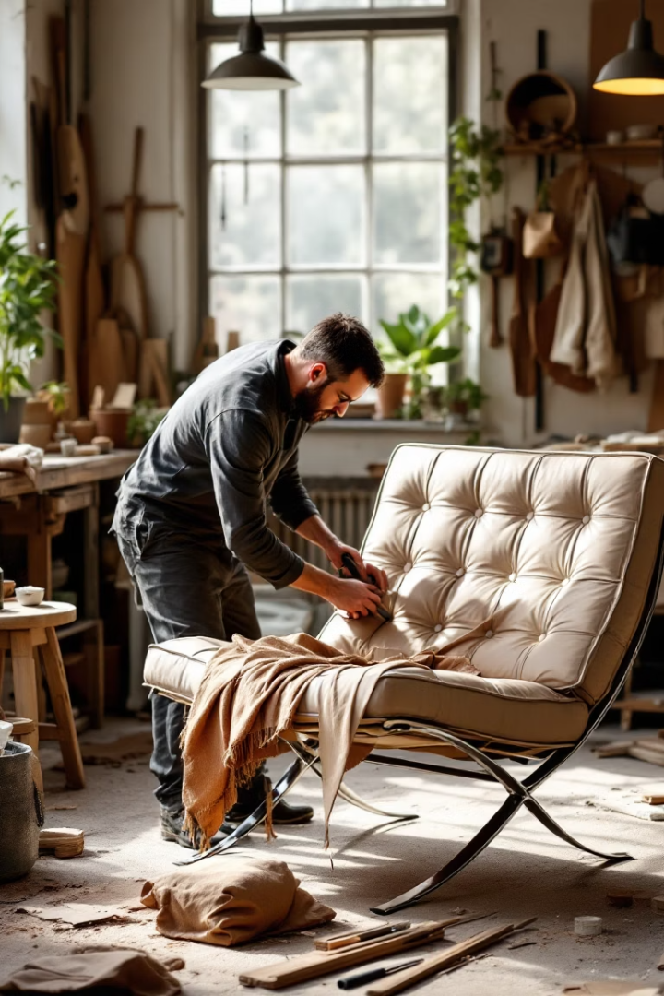



Quality You Can Trust
Premium Materials
Durable
Reliable Service
https://www.luxefurnishes.com/
Notes:
5

Slide 6






Bring Home the Barcelona Style Chair today !!!
https://www.luxefurnishes.com/
12 Constance Street, London, England
contact@luxefurnishes.com
Notes:
6

