Slide 1


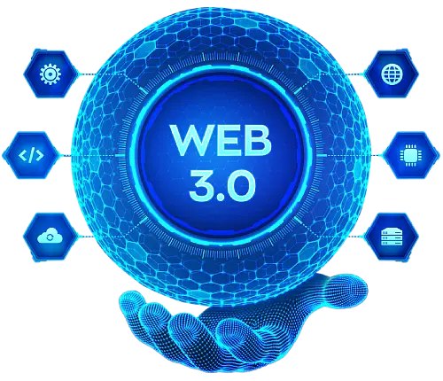
The Role of Blockchain in Preventing Fraud and Ensuring Transparency in Web3
www.blockchainx.tech

Slide 2
With increasing decentralized applications and digital interactions, transparency and security have become crucial challenges. Thus, Web3 development services employ blockchain technology for combating fraud and instilling trust in digital transactions. The capacity of blockchain technology to eliminate intermediaries and provide transactions with cryptographic security reinforces the integrity of Web3 ecosystems against fraud. The relatively fair and transparent way of maintaining immutable records of transactions by blockchain also assists organizations in complying with regulatory requirements, thereby boosting credibility for decentralized applications. Increased adoption of blockchain in various industries such as finance, supply chain, and healthcare is proof of its ability to revolutionize security and data integrity. As organizations head toward digital transformation, Web3 development services are vital for managing online transaction security, identity verification, and fraud risk reduction across various industries.

Slide 3
How Blockchain Prevents Fraud in Web3
Enterprise-grade security is built into the framework of blockchain technology to ensure fraud prevention. Blockchain is essentially a decentralized and immutable ledger system. The uniqueness about the blockchain is that the records on the system are tamper-proof, that means wherever a transaction is recorded, no one can alter the data since it is validated and stored. This scenario validates extreme security, leaving no room for data manipulation and unauthorized changes. Smart contracts, on the other hand, provide additional security by automating contracts and helping to chicken manual intervention and human error risks. Smart contracts hold transactions in high-security fashion by executing contract terms only when certain requirements have been met, thus ruling out the chance of successful claims and disputes. Auditable records on the blockchain minimize fraudulent activities by providing a paper trail that can easily be verified, thereby reducing the possibility of identity theft and double-spending issues. Businesses and individuals are thus provided with more secure environments with less exposure to fraud, which makes the blockchain essentially useful within the Web3 ecosystem.

Slide 4
Transparency Through Decentralization
Blockchain's most notable feature is its decentralized structure. Unlike other systems where data is stored centrally in servers, vulnerable to manipulation, this information is spread across multiple nodes. Thus, it ensures that there is transparency owing to the fact that all participants in the network have an identical copy of the ledger. This level of openness increases the trust towards users and stakeholders' interests in Web3 applications. Decentralized finance (DeFi) platforms, indeed, use blockchain technology to create real-time and transparent financial transactions between economic agents, minimizing the chances for fraud and mismanagement from the financial sector. Atreal time-dispersed verification of transactions prevents illicit activities such as money laundering and market manipulation while promoting a fair and open digital economy. Blockchain codifies transparency beyond the financial transactions to supply chains, digital rights management, and other spaces, where accountability and visibility are critical to the prevention of fraud and unethical practices.

Slide 5
Smart Contracts and Fraud Prevention
A smart contract is a contract that is self-executing where the terms are written directly into lines of code placed on a blockchain. A smart contract automatically executes a transaction when its conditions are met, thereby removing the need for intermediaries. This reduces the likelihood of fraud by assuring the enforcement of a contract without any interference or possible tampering from outside parties. Apart from this, smart contracts also allow execution to be in an automated compliance mode, which means that compliance with laws can also be configured into the smart contract, such that the smart contract executes only when all conditions laid down by law are fully met. Now, this feature presents a low risk of cyber fraud or breach of contract where businesses and individuals can engage in trustless transactions. The amalgamation of smart contracts with AI and machine learning would arguably be the next evolution of fraud detection, helping identify suspicious activities in real-time, hence preventing fraudulent transactions from occurring. As the technology for smart contracts advances, however, its enforcement of fair transactions in sectors like insurance, real estate, and digital identity management will render fraud almost impossible.

Slide 6
Identity Verification and Security
Blockchain is a technology that enhances security by providing decentralized modes of identity verification. Centralized identity management systems are easily attacked, which rarely end in victory for the parties involved. It is viable although painfully slow. In contrast, blockchain identity solutions give users control over their personal data, and cryptographic means ensure verification. Therefore, unauthorized access and fraud in the Web3 setting are reduced. In addition, self-sovereign identity systems based on blockchain give users full control of digital identities, cutting reliance from centralized authorities, thereby addressing some concerns due to threatening links such as data breaches and phishing. Employing biometric authentication and multi-factor authentication mechanisms makes it much harder for any cybercriminals to hijack personal data, further providing the building blocks to security for any Web3 application. As these decentralized identity solutions enhance the security and validation of digital identities to reduce fraud and increase data privacy, the spirit across healthcare, finance, and e-commerce industries has gathered some steam.

Slide 7
Conclusion
The blockchain provides a crucial mechanism against fraud and brings transparency to the Web3 ecosystem: risks are lowered, and digital interactions rely on trust. Allowing businesses to comply with regulations further supports their use in decentralized environments. Businesses adopting Web3 have to focus more on investing in a good Web3 development platform for safeguarding and ensuring transparency in the decentralized application. With blockchain technology constantly being improved, an even more secure, efficient, and fraud-resistant Web3 landscape will emerge in the coming years. When the blockchain joins hands with other emerging technologies such as artificial intelligence and the Internet of Things (IoT), the mechanisms against fraud will receive a further boost, ensuring a viable digital future-a future with transparency as its hallmark. On the way towards that future, due to increased adoption, industries worldwide would benefit from reduced fraud and thus achieve higher operational efficiency and trust in digital transactions, essentially creating a new secure and transparent Web3 world.

Slide 8




Connect with us.
contact@blockchainx.tech
www.blockchainx.com
+91 7708889555

