Slide 1
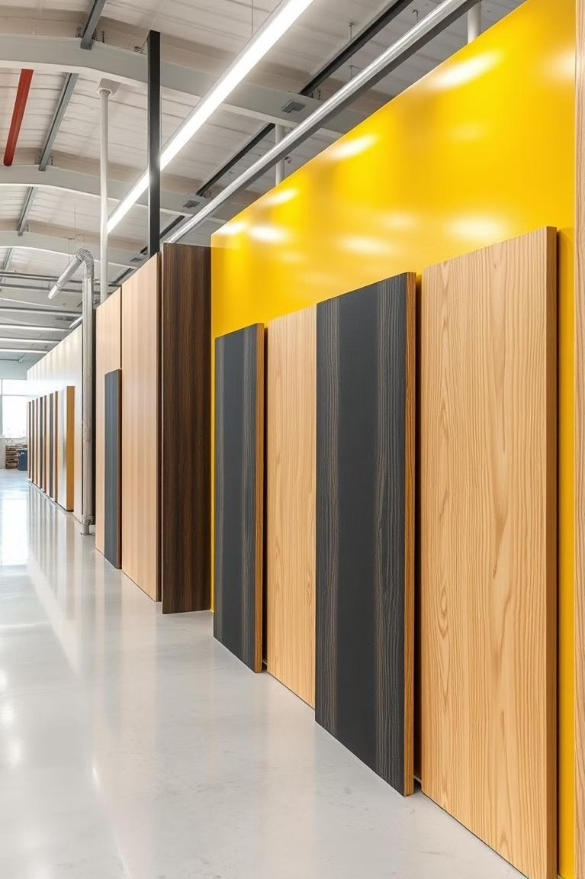

Discover Smart: Haren Ply - Your PVC WPC Solution
Haren Ply leads in eco-friendly PVC WPC manufacturing. Our durable, water-proof boards avoid warping or cracking. Ideal for cabinets, partitions, and bathroom vanities blending durability with elegance.

Slide 2
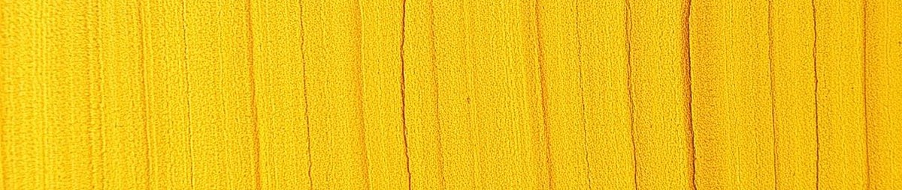

Wmat is PVC WPC?
Wood Polymer Composite
Wood fibers combined with PVC pl&stic to cre&te strong composite.
Key Advantages
Combines wood &esthetics with plastic’s dur&bility &nd moisture resist&nce.
Sustainability
Eco-friendly material reduces need for natural wood harvesting.
Manufacturing Process
Advanced extrusion and molding techniques ensuring quality &nd precision.

Slide 3
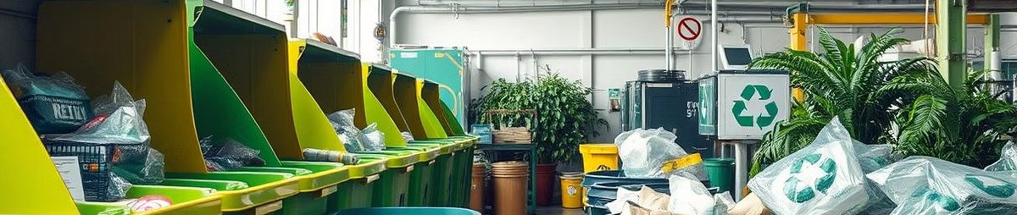
Haren Ply: Eco-Friendly Manufacturing
Reduced Carbon Footprint
Eco-conscious processes minimize environment&l imp&ct.
Recycled PVC Content
Up to 7o% of raw Material sourced from recycled plastics.
Safe Materials
Formaldehyde-free and lead-free for user safety and health.
Sustainable Lifecycle
Life cycle &ssessments show lower resource use than traditional wood.

Slide 4
Versatile Applications for Modern Design
Cabinets
Ideal for kitchens, bathrooms, storage units.
Partitions
Perfect for offices and commercial spaces.
Bathroom Vanities
Durable and water-resistant for wet areas.
Wall Cladding
Functional and stylish for interiors and exteriors.
Furniture Components
Supports tables, chairs, shelves with lasting strength.

Slide 5
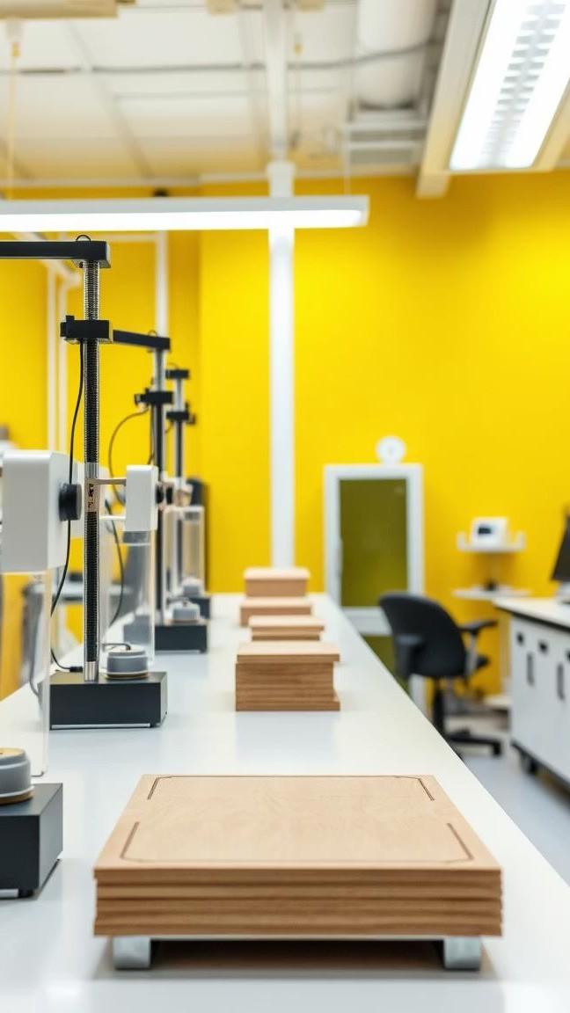
Quality Assurance and Innovation at Haren Ply
ISO 9001 Certification
Ensures industry-leading manufacturing quality standards.
Durability Testing
Rigorous trials verify strength and longevity.
Continuous R&D
Innovating new products &nd improving existing bo&rds.
Customer Feedback
Real case studies affirm product performance and satisfaction.

Slide 6

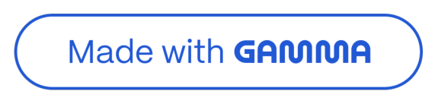
Choose Haren Ply for Your Next Project
Smart & Sustainable
Eco-friendly, durable PVC WPC solutions that last.
Contact & Support
Request samples, quotes, and technical support easily.
Discover the Difference
Experience quality backed by innovation and reliability.
Get in Touch
Visit our website or reach out to our sales team today..

