Slide 1

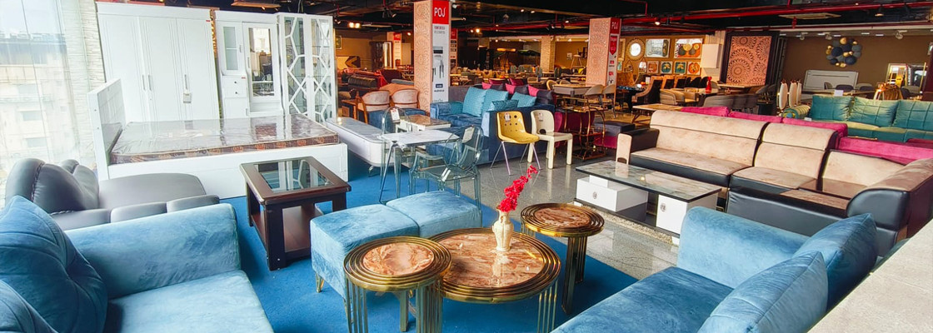
Buy Home Furniture Online in Bhubaneswar

Slide 2
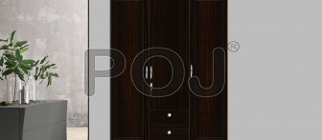
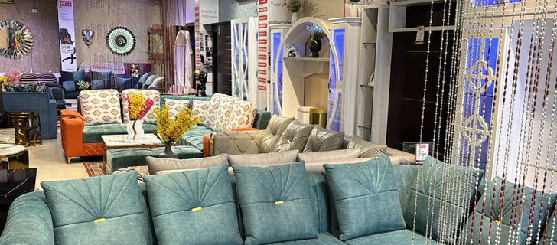
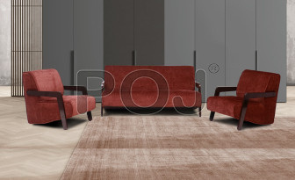

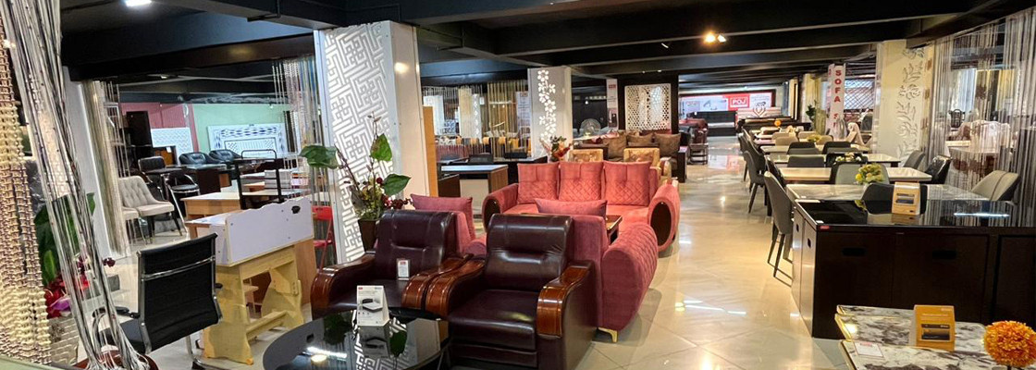
​POJ Furniture's Bhubaneswar showroom offers elegant, durable furniture for home and office spaces. It showcases a wide range of high-quality wooden pieces, including beds, wardrobes, sofas, and office tables, blending style with functionality. The showroom provides both online and offline services, ensuring customer satisfaction with its exceptional craftsmanship and design.

Slide 3
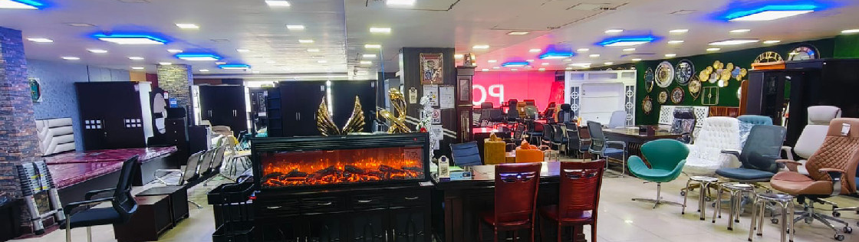

Contact Us
Address : Opp. Sapta Sati Mandir, Above Reliance Fresh, NH-5, Satya Vihar, Palasuni, Bhubaneswar, Orissa , - 751010
Phone : 9905900136
Email : bhubaneswar.pojfurniture@gmail.com
Visit - https://www.pojfurniture.com/our-showrooms/bhubaneswar

