Slide 1




Discover Exquisite Cotton Kurta Sets for Women at Reepeatshop
Welcome to Reepeatshop, your destination for sustainable fashion. Our cotton kurta sets for women combine comfort, style, and eco-friendly materials perfect for any occasion.

Slide 2

The Allure of Cotton Kurta Sets for Women
Breathable Comfort
Everyday Versatility
Our cotton kurta sets for women suit all climates and daily wear.
Cotton fabric keeps you cool and comfortable all day long.
Stylish Design
Experience the perfect blend of style and comfort with cotton kurtas.

Slide 3
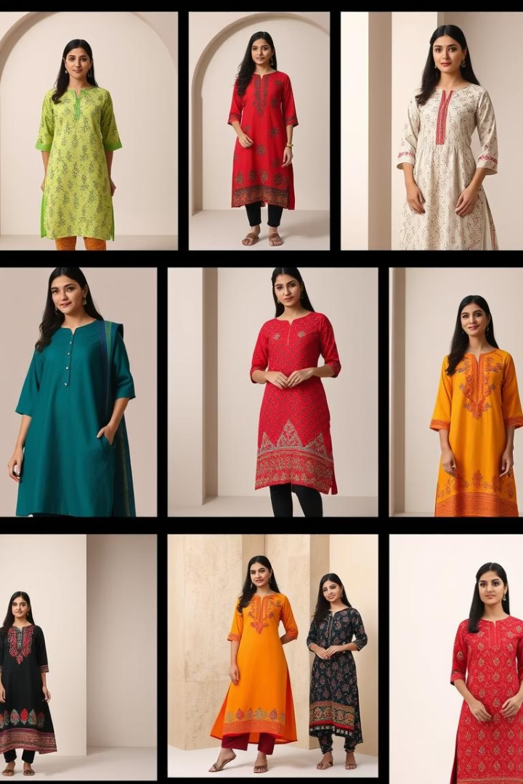
Reepeatshop's Unique Cotton Kurta Set Collection
Variety of Designs
Vibrant Colors
Choose from Anarkali, straight cut, and A-line styles.
Explore rich hues and artistic patterns for every taste.
Intricate Details
Each cotton kurta set for women features fine craftsmanship.

Slide 4






Sustainable Fashion: Cotton Kurta Sets for Women with a Conscience
Ethical Sourcing
Supporting fair labor practices and communities.
Eco-friendly Materials
Using pure cotton sourced responsibly.
Low Environmental Impact
Minimizing waste and pollution in production.

Slide 5
Styling Tips: Accessorizing Your Cotton Kurta Set for Women
Jewelry Pairings
Footwear Choices
Layering Ideas
Silver or oxidized jewelry enhances cotton kurtas beautifully.
Pair with juttis or sandals for casual to formal looks.
Add dupattas or stoles to elevate your outfit.

Slide 6




Customer Testimonials: Love for Our Cotton Kurta Sets for Women
Comfort
"The soft cotton fabric keeps me comfortable all day."
Quality
"Stitching and detail work are impeccable and durable."
Style
"I receive compliments every time I wear my kurta set."

Slide 7
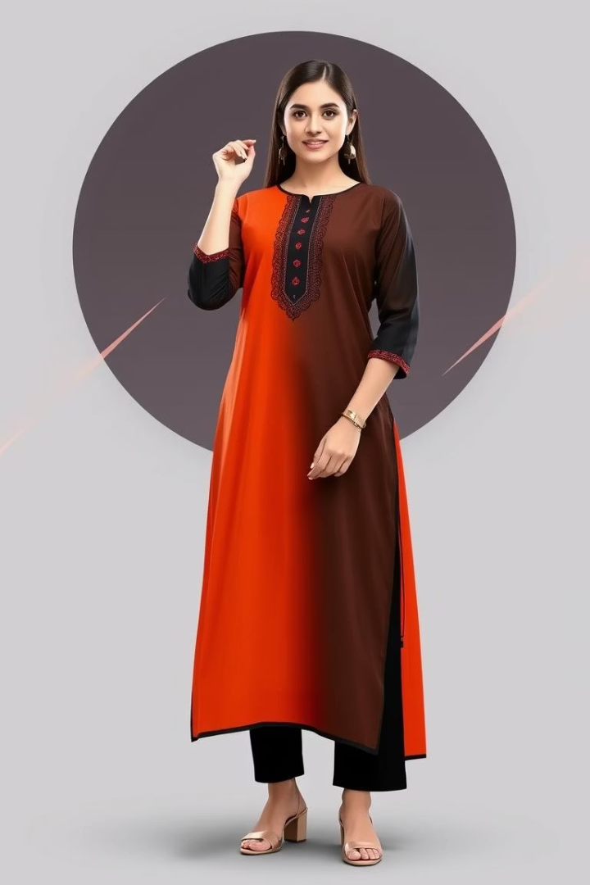
Shop the Latest Cotton Kurta Sets for Women at Reepeatshop
Explore the Collection
Browse a wide variety of cotton kurta sets for women.
Take Advantage of Deals
Enjoy exclusive promotions and seasonal discounts.
Easy Checkout
Secure your favorite cotton kurta sets with fast shipping.

Slide 8
Get in Touch: Reepeatshop Contact Information
Email
Phone
Social Media
Customer Service
support@reepeatshop.com
+1 (800) 123-4567
  Facebook: @Reepeatshop
Available Mon-Fri, 9am to 6pm for inquiries about cotton kurta sets for women.
  Instagram: @reepeatshop
  Twitter: @reepeatshop

