Slide 1



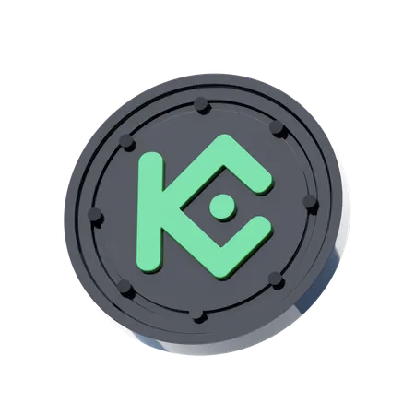


How to Launch a High-ROI Crypto Exchange with KuCoin Clone script?
In this Article about How to Launch a High-ROI Crypto Exchange with KuCoin Clone script.

Slide 2
Introduction
Cryptocurrency exchanges are expanding rapidly because digitalization continues to advance throughout the world. The crypto market attracts numerous businesses and entrepreneurs but creating an exchange platform from absolute basics proves to be challenging for both cost and development duration.
An enterprise needs a KuCoin clone script at this point. An exchange script based on KuCoin allows you to establish a cryptocurrency marketplace that matches the popular features of KuCoin while bypassing traditional software development times.
This article will provide you with essential guidance to launch a high-ROI crypto exchange through a KuCoin clone script along with explanations for its advantages and critical features which boost profitability.

Slide 3
What is a KuCoin Clone Script?
The KuCoin cryptocurrency exchange functionality can be accomplished through its ready-to-use KuCoin clone script software solution.
The KuCoin clone script includes essential features such as trading pair integration and wallet connection along with an interface design that mimics original KuCoin platform features.
Entrepreneurs can achieve faster market entry and reduce expenses through customized clone scripts since these scripts serve as complete versions of KuCoin cryptocurrency exchanges.

Slide 4
Why Choose KuCoin Clone Script for Your Crypto Exchange?
Proven Success
Customizability
Faster Time to Market
Cost-Effective
Security

Slide 5
Steps to Launch a High-ROI Crypto Exchange
Define Your Business Model and Goals
Select the Right KuCoin Clone Script Provider
Customize the Script to Meet Your Needs
Test Your Platform
Implement Robust Security Features
Set Up Payment Gateways and Liquidity

Slide 6
Key Features for Maximizing ROI in Your Exchange
USER-FRIENDLY INTERFACE
MULTI-LAYER SECURITY
LIQUIDITY MANAGEMENT
DIVERSE TRADING OPTIONS
ROBUST CUSTOMER SUPPORT

Slide 7

CONCLUSION
Initiating a cryptocurrency exchange script project with high financial returns does not need to span multiple lengthy and expensive stages. With a KuCoin clone script implementation you acquire both time and resource savings together with a secure platform that provides multiple trading features. Implementing the provided steps alongside customized platform development and liquid market enablement and strong security protocols will allow you to establish a profitable exchange serving numerous users.
Implementing a well-planned KuCoin clone exchange will create opportunities for both a high return on investment and future growth in the competitive cryptocurrency market.

