Slide 1

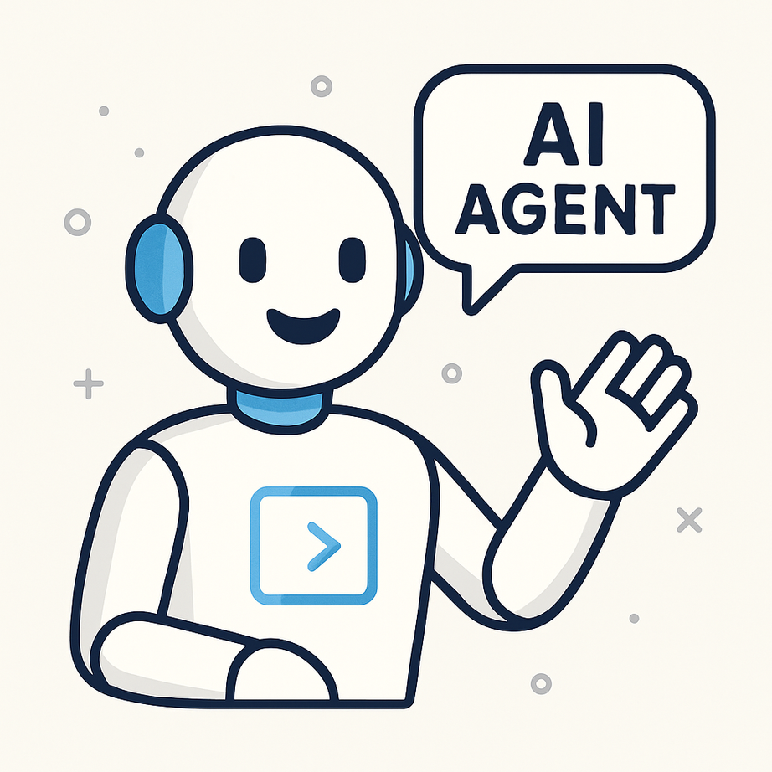
The Rise of Autonomous AI Agents in Blockchain Ecosystems
www.blockchainx.tech

Slide 2
Autonomous AI agents are intelligent systems that can act on their judgment, make decisions, and dispatch tasks without continued human supervision. Agents analyze data, operate in an environment, and accomplish a defined goal using machine learning, natural language processing, and decision-making algorithms. Within digital ecosystems, they act as self-operating software entities that conduct complex tasks—from data analysis to trading and governance. With blockchain technology extending its tentacles, the synthesis of autonomous AI with decentralized networks has unlocked unprecedented levels of automation, efficiency, and scalability. Major companies are now collaborating with an AI Agent Development company to create intelligent blockchain-integrated solutions that are transforming different idustries.

Slide 3
How Blockchain Empowers AI Agents
Blockchain is the perfect empowering infrastructure for autonomous agents due to its decentralized, transparent, and secure nature. Smart contracts on the blockchain serve to automatically execute agreements for these agents, with no intermediary needed. Decentralization guarantees that an agent cannot fail in its operations at a single point of failure, with immutability providing traceable and verifiable interactions. Furthermore, identity and access systems based on blockchain allow agents to authenticate, authorize, and act autonomously across multiple platforms. Tokenomics might also be used to influence agent behavior or allow direct transactions, making these agents economic actors in decentralized ecosystems.

Slide 4
Key Roles of AI Agents in Blockchain Ecosystems
  DeFi Protocol Management: Agents are capable of actively monitoring liquidity pools and dynamically adjusting strategies based on market changes to perform arbitrage across decentralized exchanges.
  Data Oracles: The ideal use case for AI agents is collecting and verifying real-world data and feeding it into smart contracts with minimal human effort.
  Governance Participation: In decentralized autonomous organizations (DAOs), agents can represent stakeholders by analyzing proposals and voting according to their predefined strategies.
  Supply Chain Automation: They can capture access and verify the movement of assets within the supply chain, assuring full transparency and authenticity.
  NFT and Digital Asset Management: AI agents help manage, analyze and trade NFTs/real time evaluation of market conditions and user preferences.

Slide 5
Real-World Use Cases and Protocols
  Fetch.ai: A platform for the deployment of autonomous economic agents (AEAs) for activities such as booking hotel rooms, ridesharing, and energy trading.
  Ocean Protocol: Encourages decentralized data marketplaces in which these AI agents can without human intermediary buy, sell, and analyze datasets.
  Autonolas: A protocol enabling off-chain computation and coordination of agents to accommodate DeFi, governance, and logistics operations.
  Numerai: It melds AI and blockchain technology by rewarding data scientists for contributing predictive models to a decentralized hedge fund.

Slide 6
Benefits of Integrating AI Agents with Blockchain
  Efficiency: Automation minimizes latency and eliminates the need for continuous human monitoring.
  Trust and Transparency: Thanks to the immutability of a blockchain, every action by an agent is entirely auditable and verifiable.
  Security: Distributed ledgers protect the agents from tampering and interference by unauthorized entities.
  Scalability: Agents can work across multiple blockchain networks and protocols at once.
  Incentivization: Token-based reward systems align agents to act in economically rational and productive ways.

Slide 7
Future Outlook: Towards Fully Autonomous Decentralized Systems
The future of AI and blockchain is likely evolving into autonomous decentralized systems. The environment will have thousands, if not millions, of AI agents who are competing and collaborating for resources across various networks. Think of thousands of DAOs totally run by agents; DeFi markets stabilized by intelligent trading bots; and global logistics networks run by supply chain AI agents. It is a rather bright picture for the emerging self-regulating and self-improving digital economy as AI models reach their peak performance and the blockchain scalability layer, including layer 2s and cross-chain protocols, matures. With such an enticing future outlook come serious problems that need to be tackled, such as ethical AI governance, legal accountability, and fail-safe measures in case of unwanted behavior.

Slide 8
Conclusion
The autonomous AI agents are quickly acting as the cornerstones for the evolution of blockchain ecosystems. Their capacity to perform tasks and take decisions through secure interactions via the blockchain infrastructure represents a paradigm shift on how decentralized systems operate at large. With the maturity of the technology, an upcoming era of intelligent, self-organizing networks that require minimal human input can be foreseen in terms of efficiency, transparency, and innovation. To tap into this opportunity to the fullest, businesses are turning towards AI Agent Development Solutions that marry the latest AI capabilities with the robust building blocks of blockchain. Thus creating an era that will be smarter, but also decentralized by design.

Slide 9





thank you!
  +91 7708889555
  www.blockchainx.tech
  contact@blockchainx.tech

